Slide 1

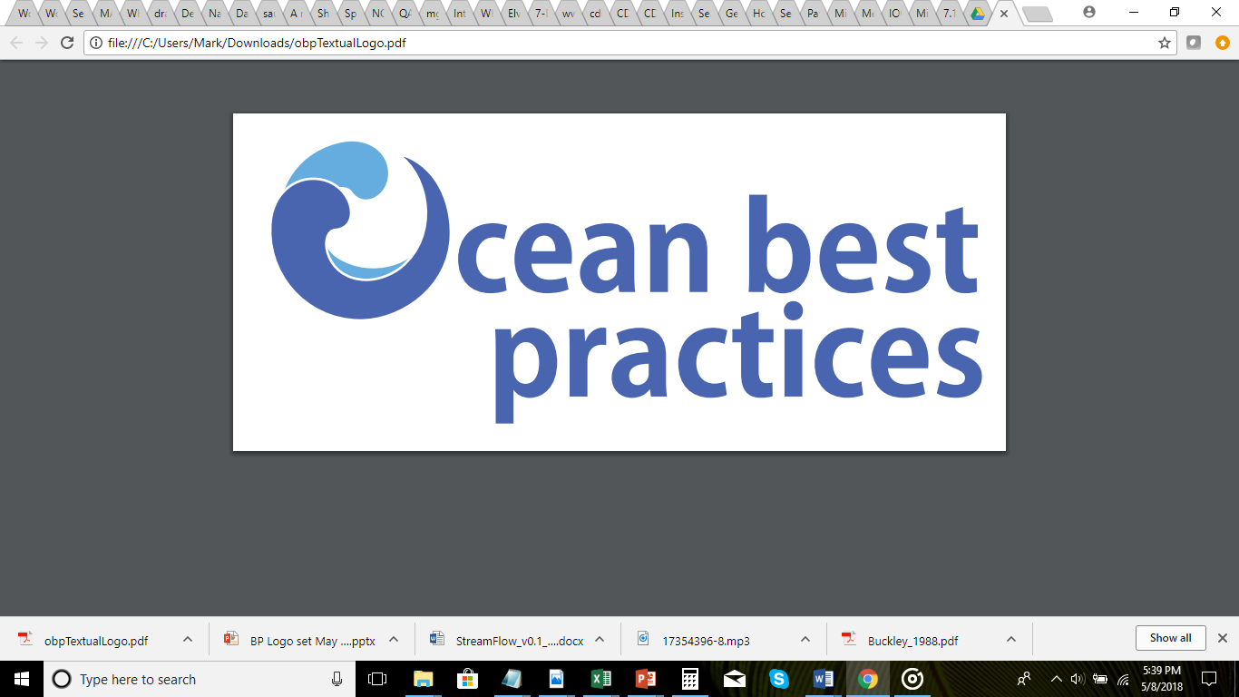

QARTOD Status, Best Practices
Mark Bushnell, U.S. IOOS
2018 IOOS DMAC Annual Meeting
May 21, 2018
Notes:
Three quick topics:
1) QARTOD – who’s using it, and might they help with implementation questions,
2) Intro to Ocean Best Practices,
3) Question for the group about real-time QC over the next decade, for input to community white paper for OceanObs’19

Slide 2
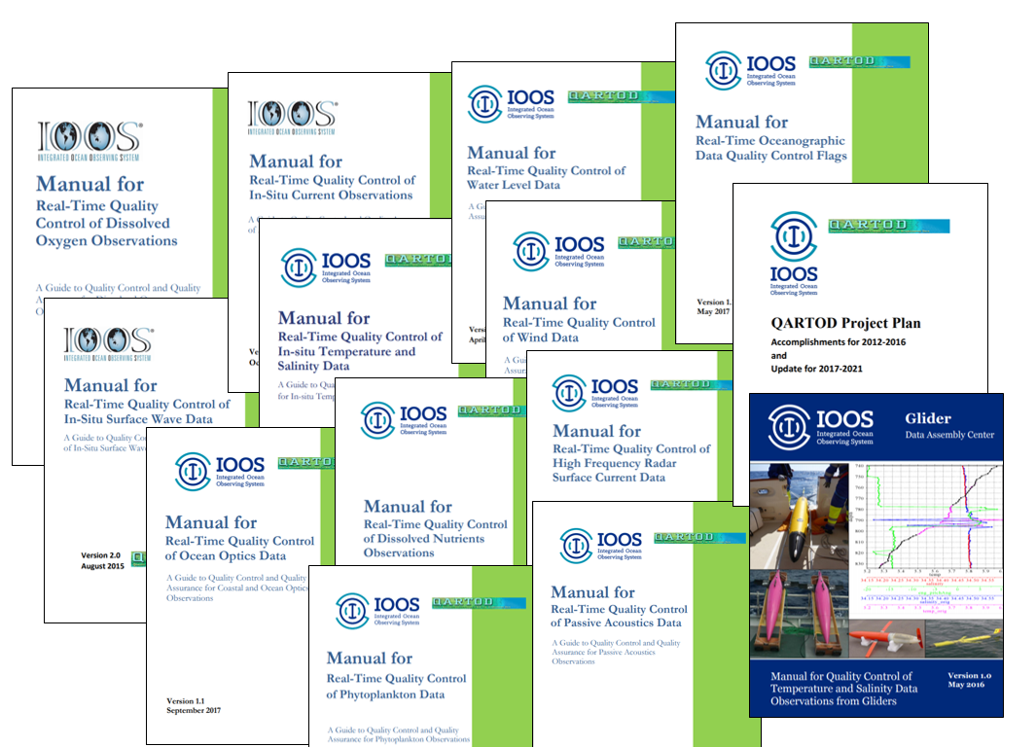
QARTOD Manuals, Manual Maintenance

Slide 3
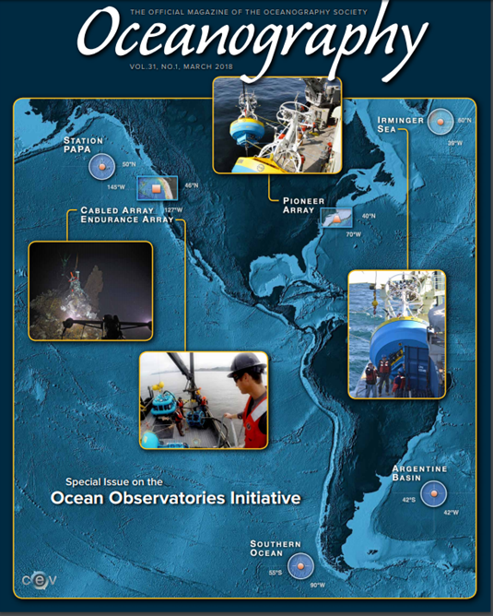
Who else is using QARTOD? 1
NSF Ocean Observatories Initiative
“Data Quality Control Processes - Oceanographic and engineering data throughout the OOI system are reviewed through manual (human in the loop) and automated quality control procedures. The overall goal is to ensure that the data and metadata delivered by the OOI meet community data quality standards. These standards were designed with the goal of meeting the Integrated Ocean Observing System (IOOS) Quality Assurance of Real Time Ocean Data (QARTOD) standards.”
Smith, L.M., J.A. Barth, D.S. Kelley, A. Plueddemann, I. Rodero, G.A. Ulses, M.F. Vardaro, and R. Weller. 2018. The Ocean Observatories Initiative. Oceanography 31(1):16–35, https://doi.org/10.5670/oceanog.2018.105.
After nearly 10 years and expenses of US$386 million, in June 2016, NSF announced that most OOI data were flowing in real time from more than 900 sensors at the 7 sites. The annual budget is approximately $55 million.
Witze, Alexandra (2016-06-09). "US ocean-observing project launches at last". Nature. 534 (7606): 159–160. Bibcode:2016Natur.534..159W. doi:10.1038/534159a
Notes:
Used by NSF for QC of OOI, large program ($386M) with ~900 sensors

Slide 4
Who else is using QARTOD? 2
U.S. Private Sector & University Classroom
Jay Titlow / Weatherflow – Using wind tests for QC for their Caribbean installations
Jeff Hansen / WaveForce Technologies - “We’ve applied QARTOD rules when rebuilding the USACE/FRF database.”
Bruce Magnell / Woods Hole Group – “The QA/QC procedure implemented by WHG, in part follows QARTOD recommendations.”
Rutgers University - Masters of Integrated Ocean Observing, a software/QA/QC boot camp informed by QARTOD.
Notes:
Used by within the U.S. private sector, and starting to be used by academic institutions.

Slide 5
Who else is using QARTOD? 3
International Use, Government & Private Sector
British Oceanographic Data Centre - Global Sea Level Observing System (GLOSS) Quality Control Manual
The Southern Ocean Time Series (SOTS) - Quality Assessment and Control Report
OMC International, Australia - QC optimised for operational under keel clearance management purposes
Mark Calverley / Fugro UK – “We've been advocating QARTOD in the oil and gas sector for quite a few years…”
Carlos Garcia /SIMCosta – Implementing QARTOD in SiMCosta, the Brazilian Coastal Monitoring System.
Christian Senet / Bundesamt fuer Seeschiffahrt und Hydrographie - “Have started to implement QARTOD wave QC testing.”
Notes:
Used by many international entities. Just some of the users we’ve heard of anecdotally, and we presume there are more (we’ll explore that when we discuss OBP).
The point is that there are many others who may wish to participate in the development of implementation standards.

Slide 6
What’s next for QARTOD? Your thoughts appreciated!
FY 2019 Tentative QARTOD Plans
One new manual, perhaps pH
Update two manuals
Shift a bit toward QA, measurement uncertainty examples
Continued international interaction
Support for implementation, i.e. OMAO use aboard NOAA vessels, data flagging standards, others?

Slide 7

QC Data Flagging Implementation
Known
Every real-time observation distributed to the ocean community must be accompanied by a quality descriptor.
QARTOD (and IOC) suggest a Tier 2 flag for more detailed QC test results.
Unknown
How standardized should RAs strive to be?
How to meet NCEI data input constraints?
How to meet User desires for various levels of QC?

Slide 8
QC Data Flagging Implementation (cont.)
Known issues:
Data , data flag
or
Data
Data flag
Challenges (from Axiom, January webinar):
  Transmitting quality flags around
  Interface for displaying and communicating quality checks
  Duplication of effort surrounding check implementations
  Are flags served alongside the data? SOS/ERDDAP? NCEI?
  Setting thresholds for third party stations
  Documenting check configuration
Notes:
Some at NCEI have concerns about separating data and data flags into two different files.
Questions remain, community interaction required!

Slide 9
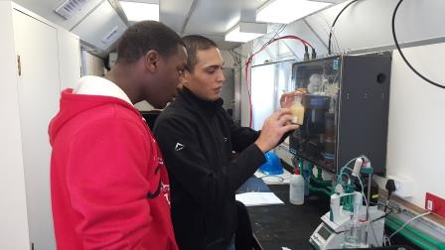

What is a Best Practice?
Global Best Practice System
“A community best practice is a methodology that has repeatedly produced superior results relative to other methodologies with the same objective.
To be fully elevated to a best practice, a promising method needs to be adopted and employed by multiple organizations.”
Notes:
For years, there has been a continuing debate over what is a best practice. At our Workshop of community experts last November, we developed a definition that … read above. This definition includes different types of documents such as standard operating procedures, manuals and others

Slide 10
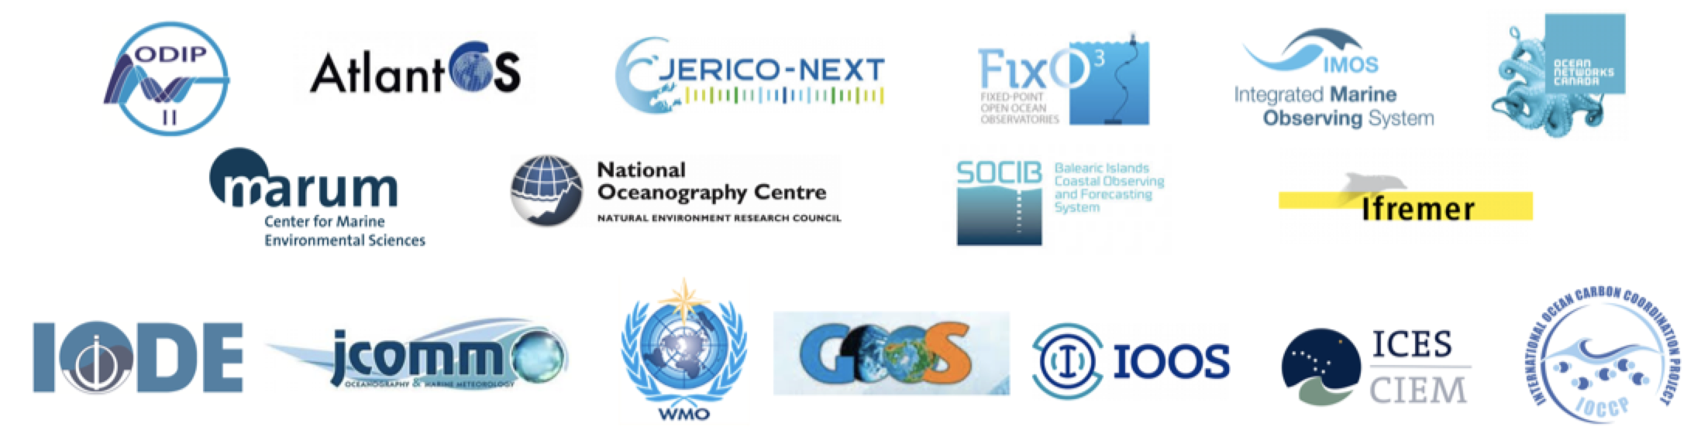

Global Best Practice System
Participating Organizations and Programs
Peer
Review
Journal
Repository
Internet
Crawling
Advanced Discovery and
Access Technology
Notes:
The key to usable best practices is a sustained repository with advanced discovery and access technologies based on machine readability. Current participants working with IODE and the Best Practice Working Group are familiar organizations and programs. Expansion to additional communities is encouraged and welcome. The BPWG has created a Research Topic in the Frontiers in Marine Science Journal to stimulate peer review as well as community engagement and discussion

Slide 11

Best Practice System
Expand IODE repository capabilities
  Expand Permanent IDs through DOI, ORCHID
  Implement Natural Language search drawing on marine vocabularies; compatibility with machine readability
  Internet Crawling as inputs of additional practices
Alignment with FAIR principles and open operations
Introduction of community peer review including Research Topic in Frontiers in Marine Science
Notes:
The BP System works through open principles so that a BP may reside at its program home and also in the Ocean BP repository. The repository adds value through assignment of DOIs, semantic tagging, conversion to machine readable formats, usage tracking and encouraging optional peer review. A pilot system will be available in a few months and the full operational capability will be available next year. Stay tuned.

Slide 12

Future Data Management Services RT QC – Thoughts?
Technology is making it cheaper & easier for more observers to obtain new types of data
Existing DMS can’t absorb it – more specialized DMS entities emerge
Decentralization is a challenge, but QC closer to data source is a good thing
Big DMS must guide emerging DMS standards & requirements
Data variety
DMS capability
Emerging observations
Olden days
Now
Pretty soon

Slide 13
Summary
QARTOD is broadly accepted, and implementation partnerships might be more widely explored.
Ocean Best Practices is worthy of your consideration.
How can we prepare ourselves for the next decade of RT QC?
Thanks!

