Slide 1
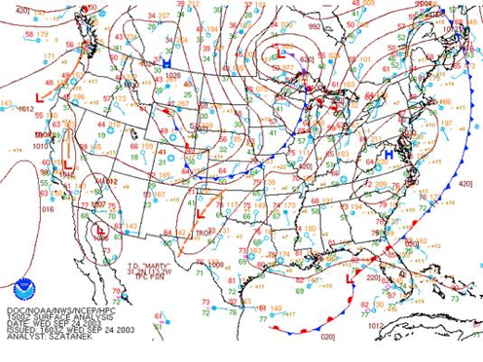
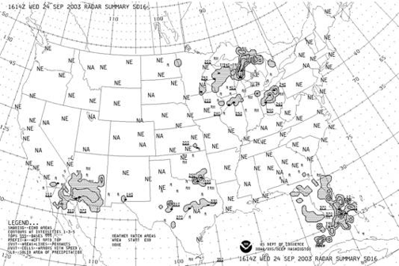
THREDDS 5.0 Update
(and a bit about Unidata)
Ethan Davis
UCAR Unidata
IOOS DMAC Mtg
21-23 May 2018

Slide 2
Unidata
Helping the University Community Access and Use Real-time Weather Data
Facilitate access to (real-time) data by the University research and education community
Support the community in their use of the data
Help build, represent, and advocate on behalf of the community
Develop, provide, and support open source tools and infrastructure for data access, analysis, visualization, and data management
Advance metadata standards for the earth science community

Slide 3
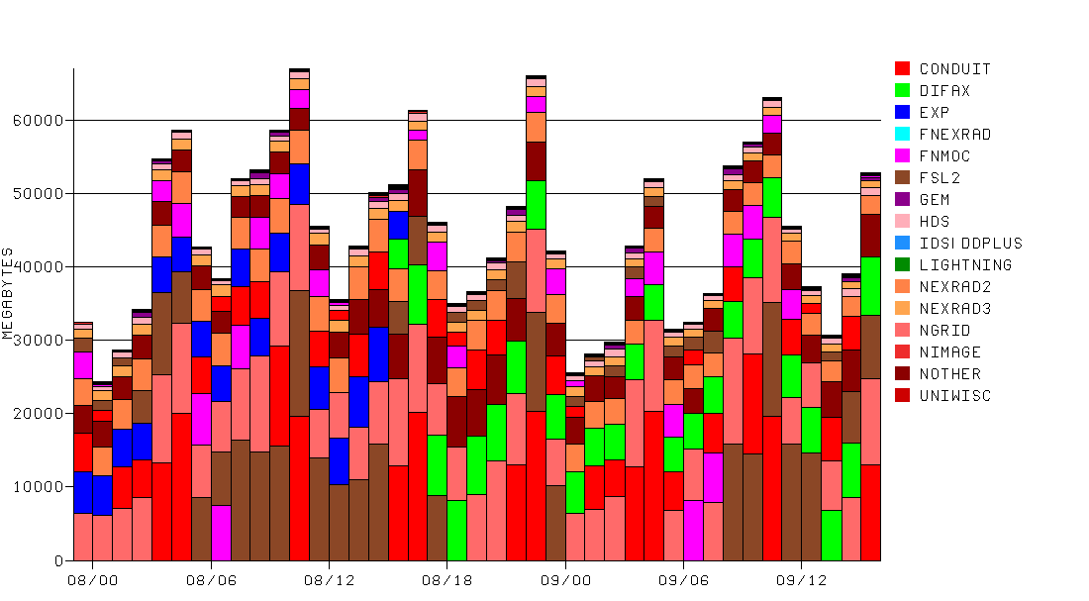
Unidata: Facilitate access to real time data
IDD: Real-Time Data Distribution
Network of over 200 sites
Approimately 60 GB/hour
Each node runs Unidata’s LDM
Protocol and client/server software
Event-driven data distribution
Supports subscription to subsets of data feeds

Slide 4
Unidata: Provide tools to work with the data
Tools to Manage Data
Local Data Manager (LDM)
THREDDS Data Server (TDS)
McIDAS ADDE
netCDF
Tools for Visualization and Analysis of Data
Integrated Data Viewer (IDV)
AWIPS / GEMPAK
McIDAS-X
MetPy
python-awips

Slide 5
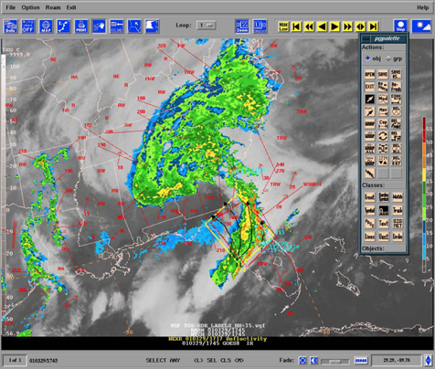
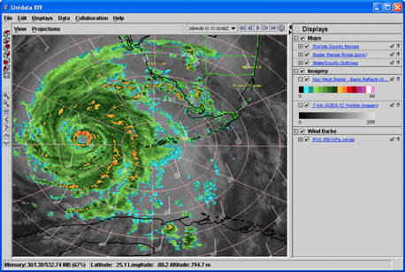
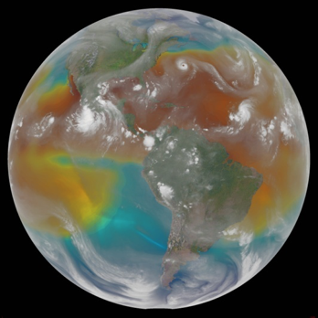
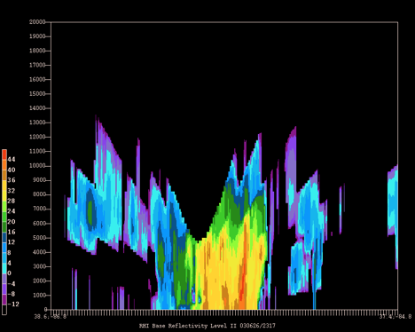
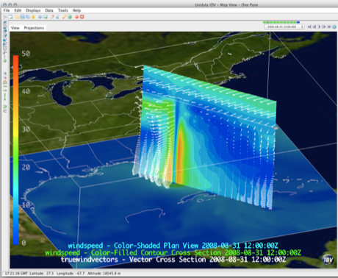
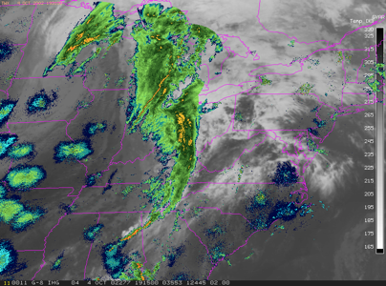
Unidata: Visualization and Analysis Tools
AWIPS / GEMPAK
IDV
McIDAS

Slide 6
Unidata: Support, Training, Engagement
User support
Technical Training
User Workshops
Community Governance

Slide 7
Unidata: Support, Training, Engagement
2018 Unidata Users Workshop
Reducing Time to Science: Evolving Workflows for Geoscience Research and Education
25-28 June 2018 - Boulder, CO
https://www.unidata.ucar.edu/events/2018UsersWorkshop/
2018 Unidata Software Training Workshops
LDM, netCDF, AWIPS, MetPy and Siphon, TDS, IDV
15-30 October - Boulder, CO
https://www.unidata.ucar.edu/events/2018TrainingWorkshop/

Slide 8
Unidata in the Cloud
Amazon, Azure, Google (a bit), and NSF XSEDE Jetstream
NOAA Big Data project (with Amazon)
UnidataScience Gateway
IDD/LDM real-time data streams
TDS, AWIPS EDEX, and other data servers
Jupyter Notebooks
http://science-gateway.unidata.ucar.edu

Slide 9
THREDDS 5.0 Update

Slide 10
THREDDS
Two existing software products
THREDDS Data Server (TDS)
netCDF-Java client library
Two new software products
Rosetta (Data Translation service/interface)
Siphon client library (Python)

Slide 11
THREDDS 5.0: Services
OPeNDAP DAP2 & DAP4
ncWMS
ncSOS
ncISO
NCSS (NetCDF Subset Service)
HTTP Server
OGC WCS 1.x

Slide 12
THREDDS 5.0: Services
OPeNDAP DAP2 & DAP4 (full netCDF-4 data model)
ncWMS (2.0 - grids and UGRID)
ncSOS (newly bundled with TDS)
ncISO
NCSS (improved interface)
HTTP Server
OGC WCS 1.x

Slide 13
THREDDS 5.0: Improvements
Rewrite of TDS catalog and state handling
Scales to very large numbers of catalogs
Automatic update using CatalogScan

Slide 14
THREDDS 5.0: Improvements
New API for gridded data in netCDF-Java
Used in TDS (by NCSS, WCS, and GRIB)
Improved coordinate system queries
Handle queries across -180/180 and 0/360 seam
(Available in NCSS)

Slide 15
THREDDS 5.0: Improvements
Improved handling of unsigned integers and other primitive types in netCDF-Java
Using Guava Primitives
Cleaner in-memory storage

Slide 16
THREDDS 5.0: Improvements
THREDDS Development and Engineering Process
Newly modernized Build / Test system
Continuous Integration
GitHub workflow

Slide 17
THREDDS 5.0: Release Schedule
TDS 5.0
First beta release - March 2018
Stable release - planned Fall 2018

Slide 18
THREDDS: Discussion Topics
Dataset aggregations
Grid Feature Type
Aggregations with variable start times
Comparison: THREDDS and ERDDAP
DSG data and tabledap
Future of THREDDS
Support and development

Slide 19
TDS Dataset Aggregation
1) NcML Aggregation
Based on variable dimensions
Very brittle given slight data inhomogeneities
2) FMRC Aggregation
Based on coordinate systems
Improved tolerance of inhomogeneities
Very large collections not performant

Slide 20
TDS Dataset Aggregation
3) Feature Types: Station (and other DSG types)
Based on coord system and feature type
Does not scale to large collections
4) Feature Types: GRIB - gridded data
Based on coord system and grid feature type
Highly scalable

Slide 21
THREDDS
ERDDAP
Simple Gridded Datasets
---
Small In Situ Data
Complex Gridded Datasets
In Situ Datasets
Serves any data format read by netCDF-Java
Scales to very large GRIB collections
Supports FMRC
Supports ncISO metadata services
Data and metadata services: DAP2*, DAP4, ncWMS, WCS, NCSS, ncISO
Connects to wide variety of data formats (including databases)
Provides catalog search
Easy to add new datasets (no restarts needed)
Has a data “status” page for real time data sets
Data, metadata, products access services: DAP2*, RESTful services, tabledap, griddap

Slide 22
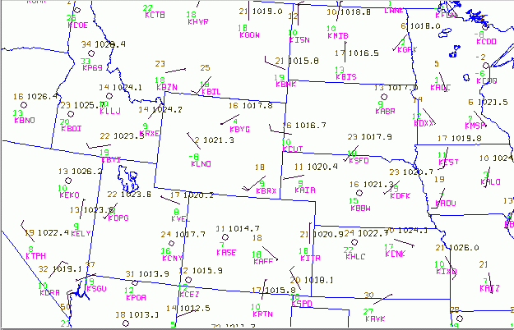
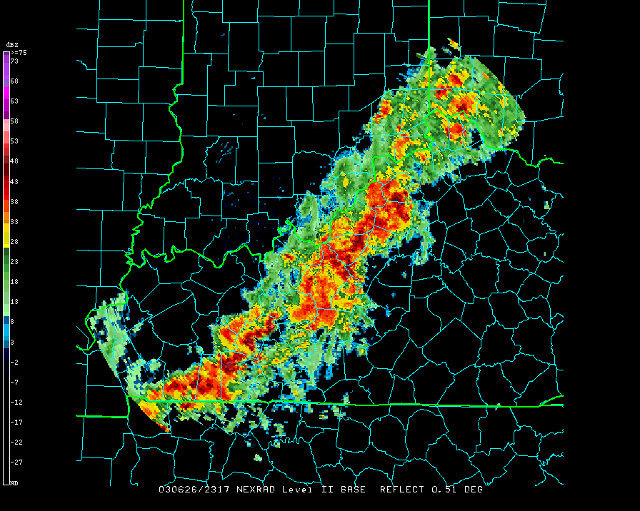
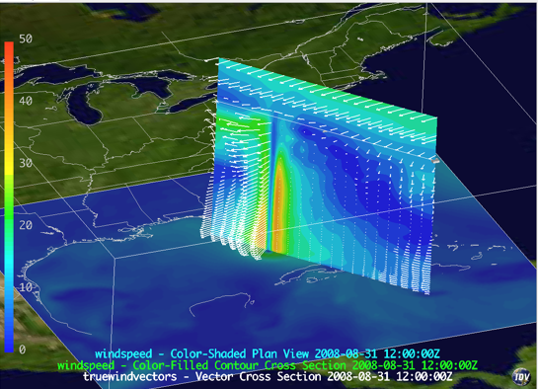
Thank You!
Ethan Davis
edavis@ucar.edu
Unidata is one of the University Corporation for Atmospheric Research (UCAR)'s Community Programs (UCP), and is funded primarily by the National Science Foundation (Grant NSF-1344155).

