Slide 1
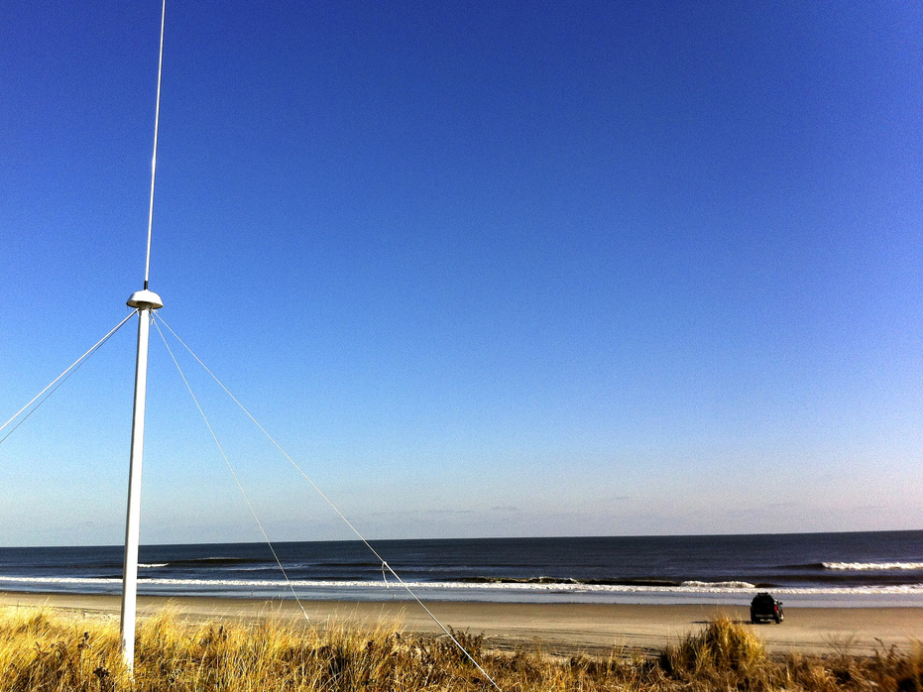
National High Frequency Radar Network: Applications to Search and Rescue, Spill Response, Vessel Tracking, ….
Scott Glenn
Rutgers University MARACOOS

Slide 2
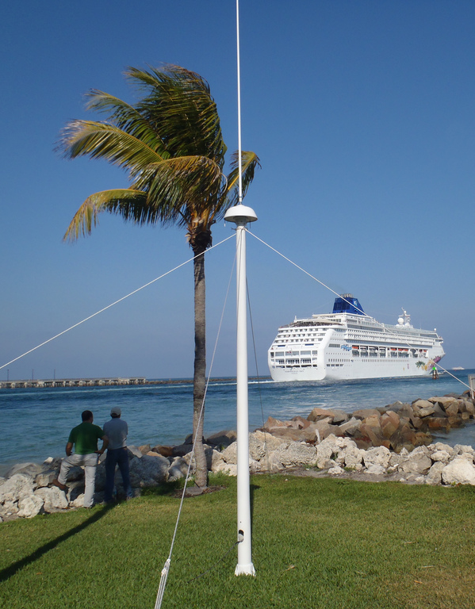
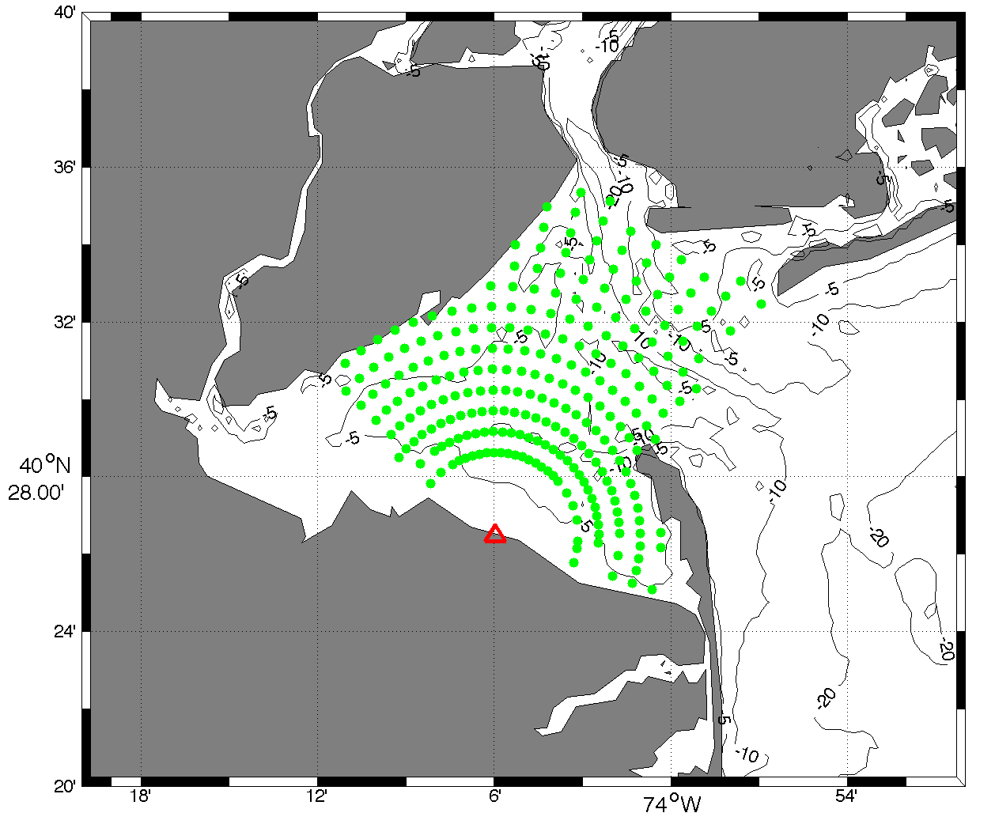
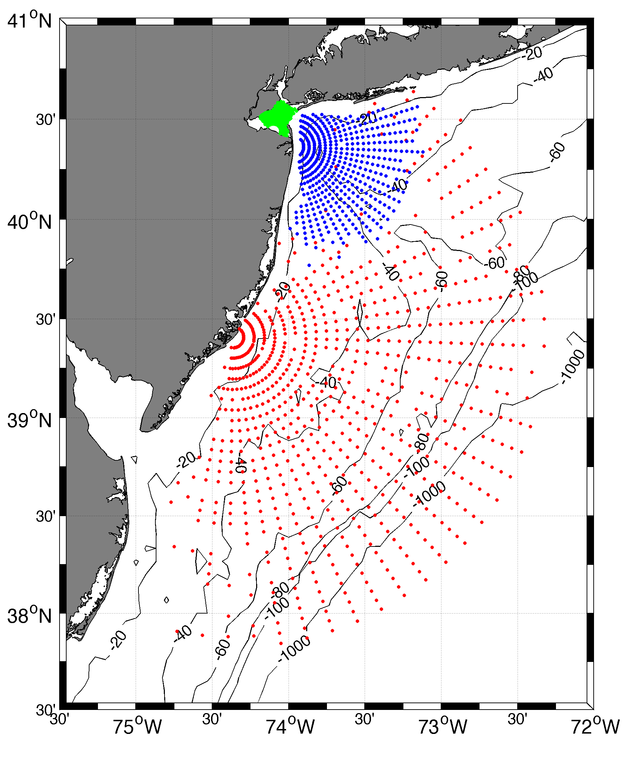
Over-the-Horizon HF Radar
Transmitter
Receiver
Mac Mini
Low Power,
Small Footprint
Transmits High Frequency (HF) radio waves that follow the salty ocean surface Over the Horizon.
Receives and interprets the backscattered signals.
Operates at 4 frequencies with different ranges and resolutions.
Maps currents, monitors waves, detects tsunamis & detects ships.

Slide 3
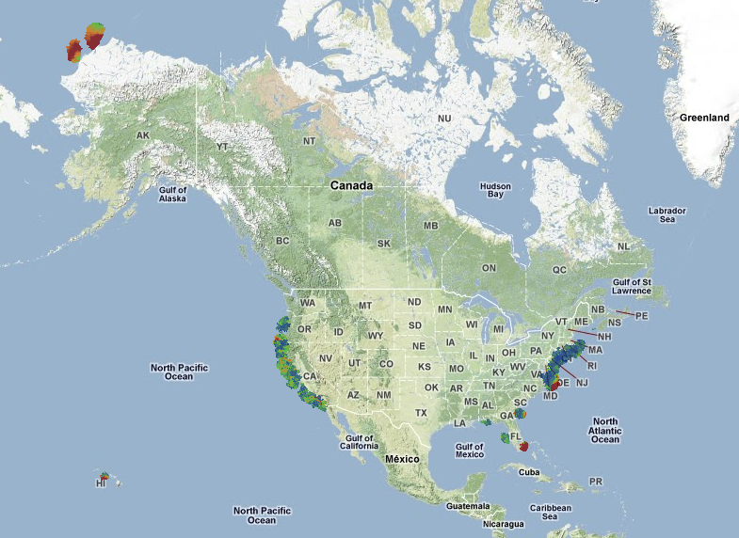
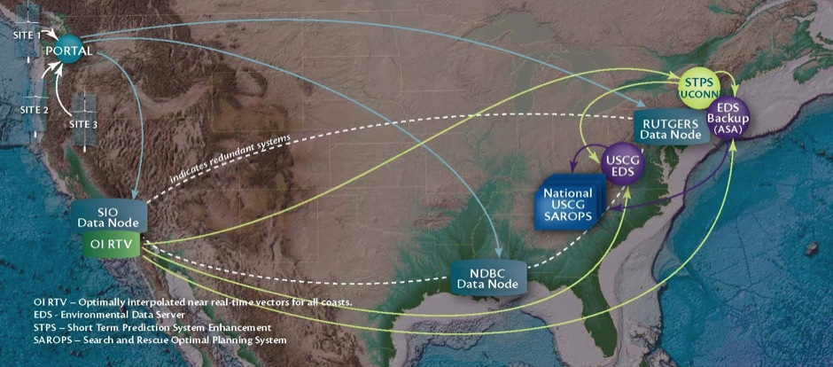
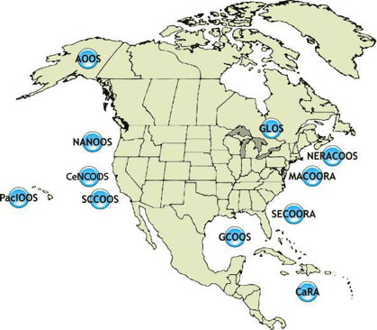
U.S. National HF Radar Network – 3 Components
3) Linked by
the U.S. IOOS
national data backbone
2) Operated by
the U.S. IOOS
Regional Associations
Data Flow since 2007
1) 150 HF Radars owned mostly by Universities

Slide 4
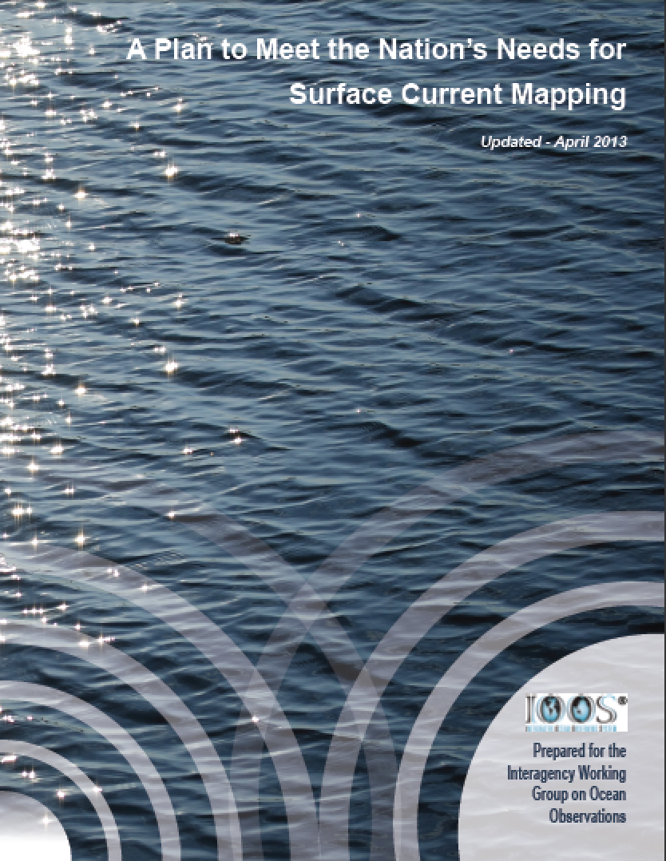
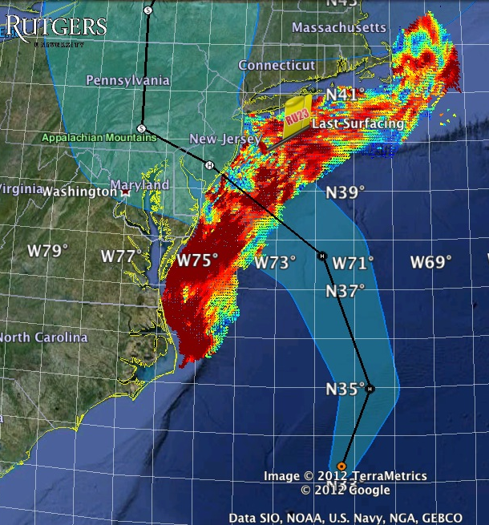
HF Radar Maps Surface Currents
Superstorm Sandy:
1 Day Before Landfall
National Surface Current Mapping Plan – Multi-use

Slide 5
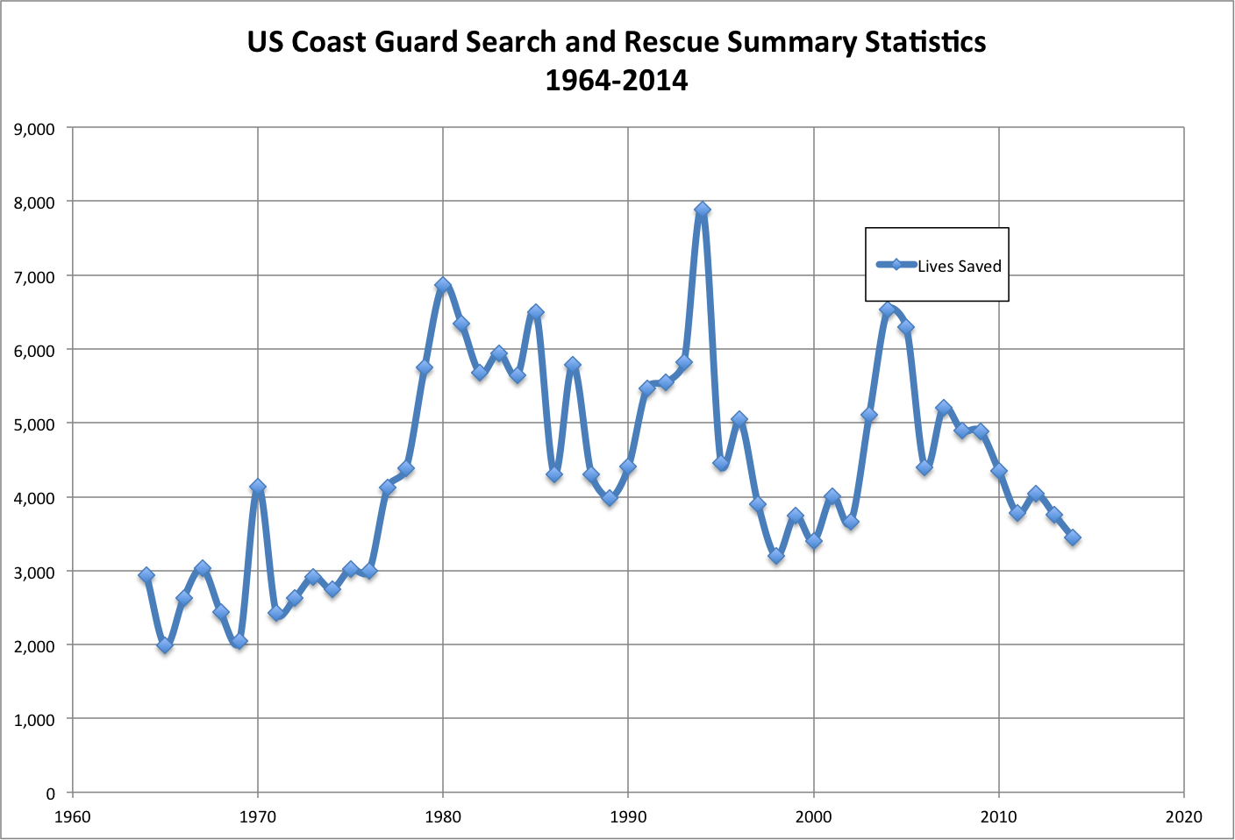
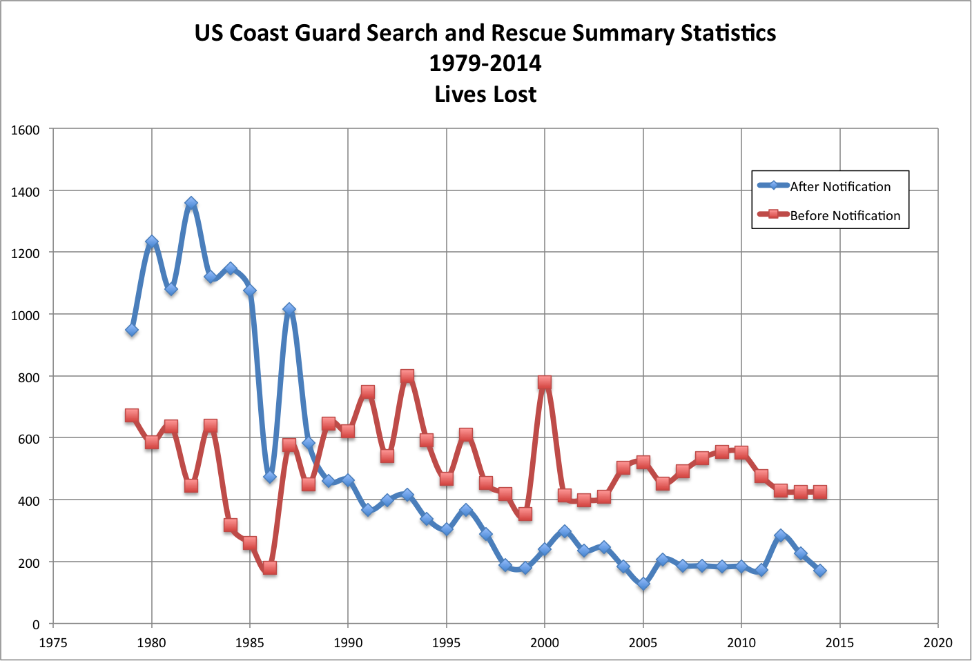
USCG Search And Rescue Statistics
Despite this heroic effort,
lives are still lost:
~400/year before notification
~200/year after notification
50 years
35 years
US Coast Guard saves lives:
~3,500/year
(~10/day)

Slide 6
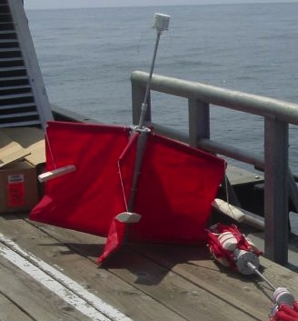
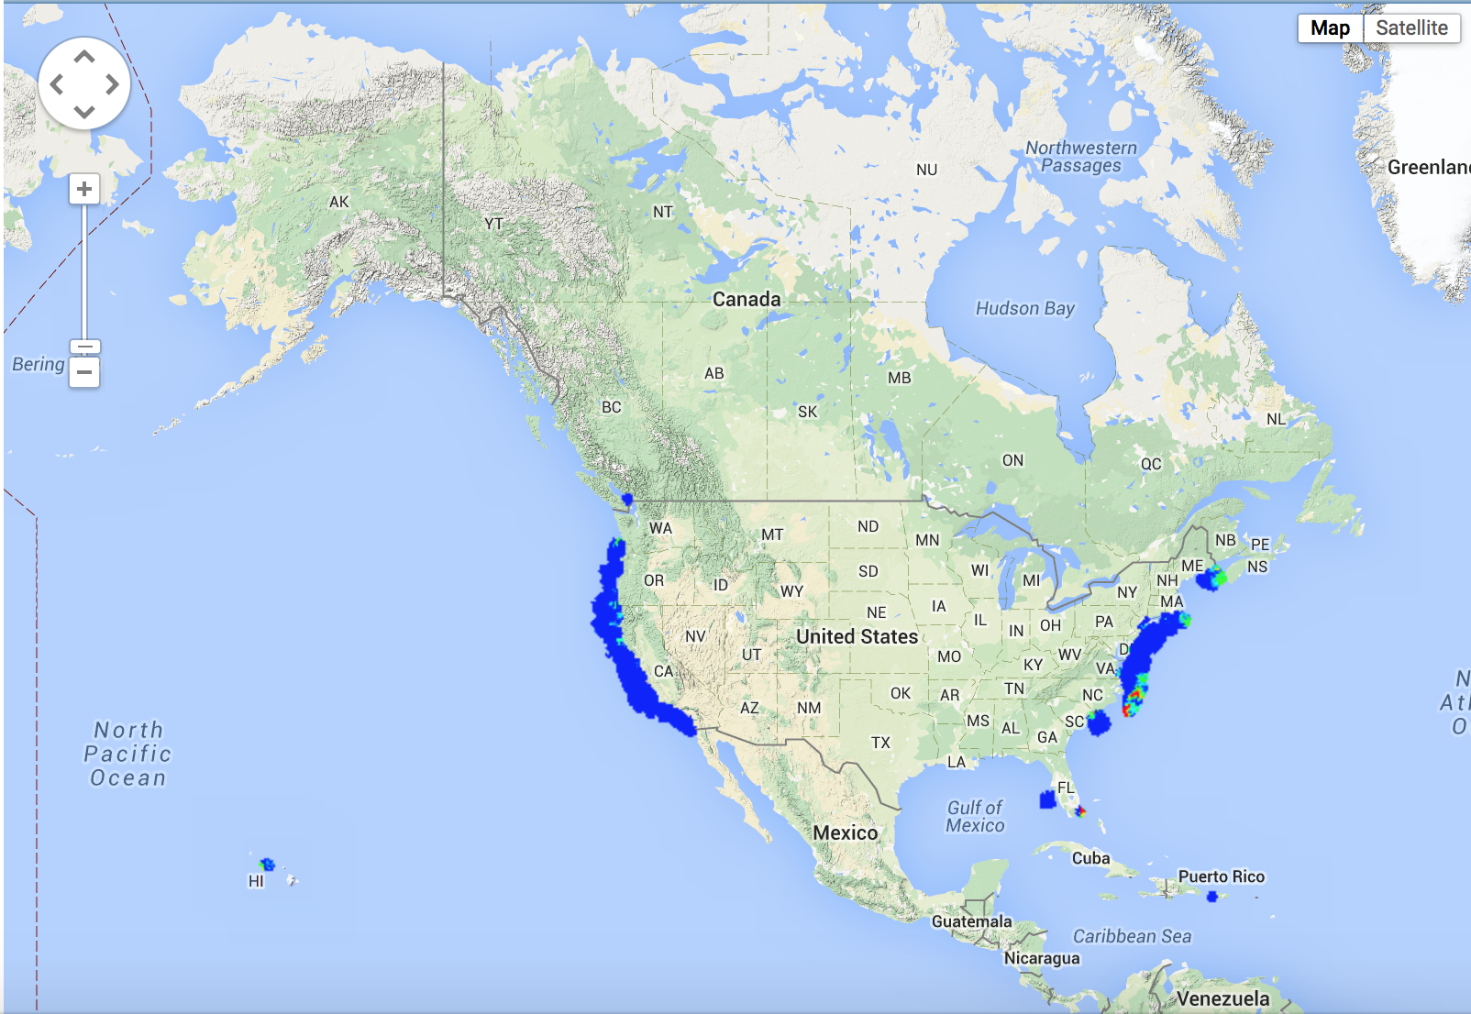
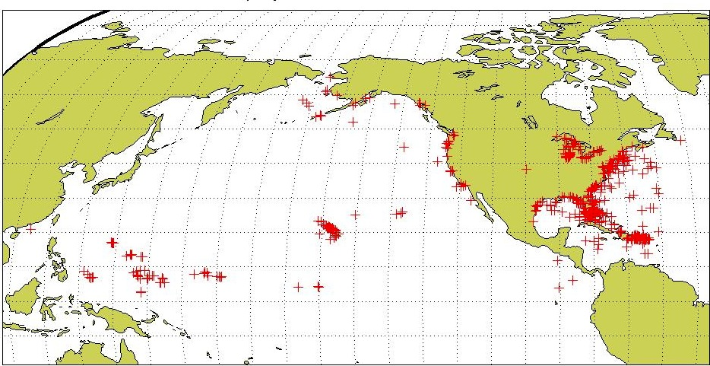
USCG Drifter Deployments
Self Locating Data Marker Buoys (SLDMB)
for Search And Rescue (SAR)
National HF Radar Network
Most SAR cases occur in the envisioned HF Radar Network footprint
Notes:
Here are the initial deployment positions for our SLDMBs. From these records we selected only those that exceeded 4 days in length

Slide 7
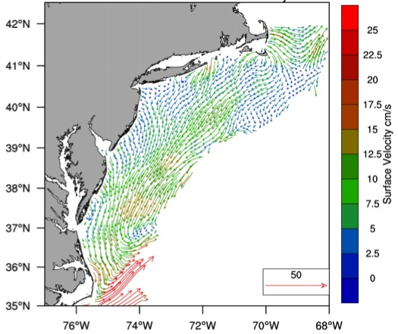
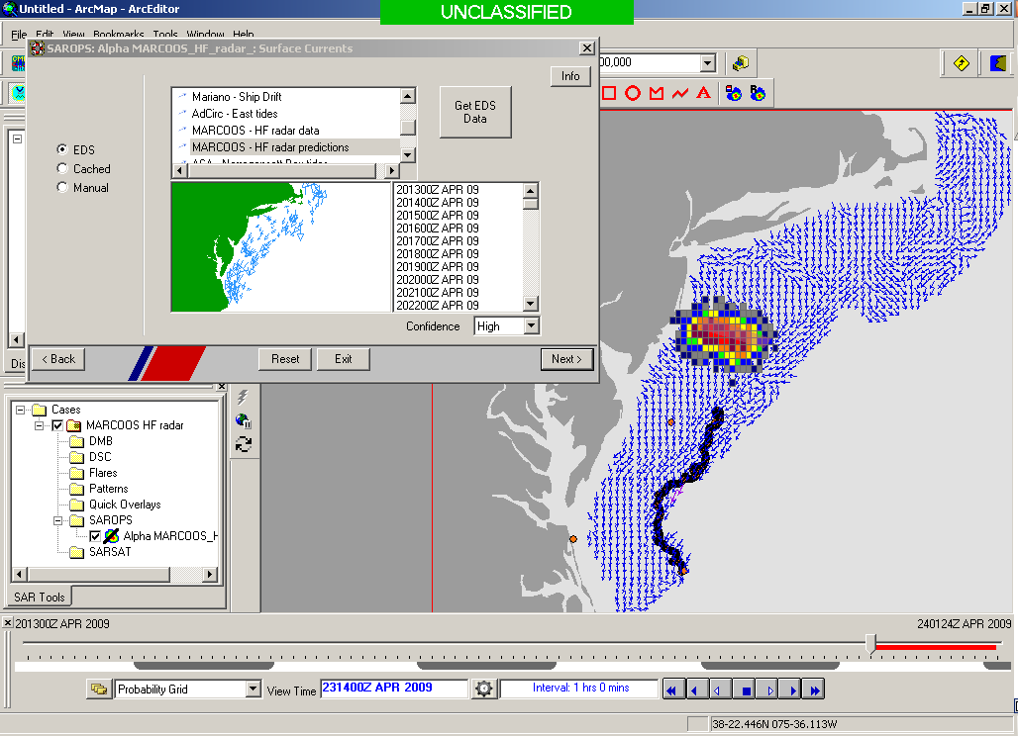
Surface Currents guide Search And Rescue
Surface Currents
Data Acquisition
Data Product Generation & Management
Search And Rescue Optimal Planning System (SAROPS)

Slide 8
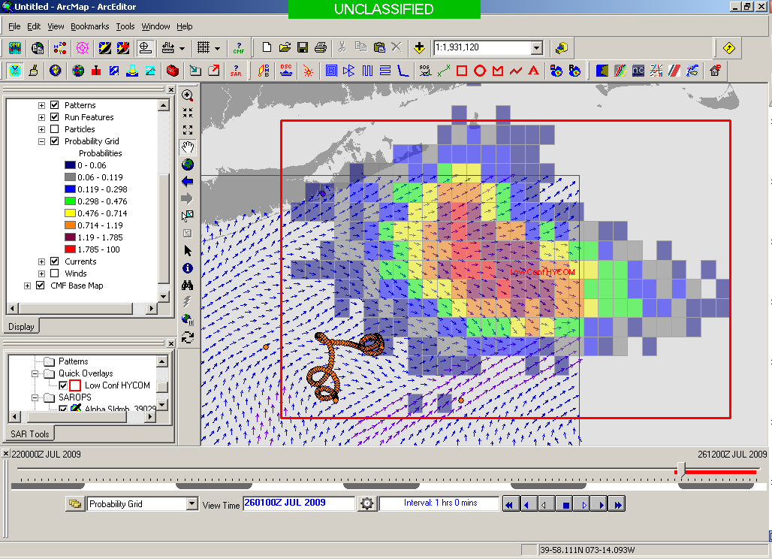
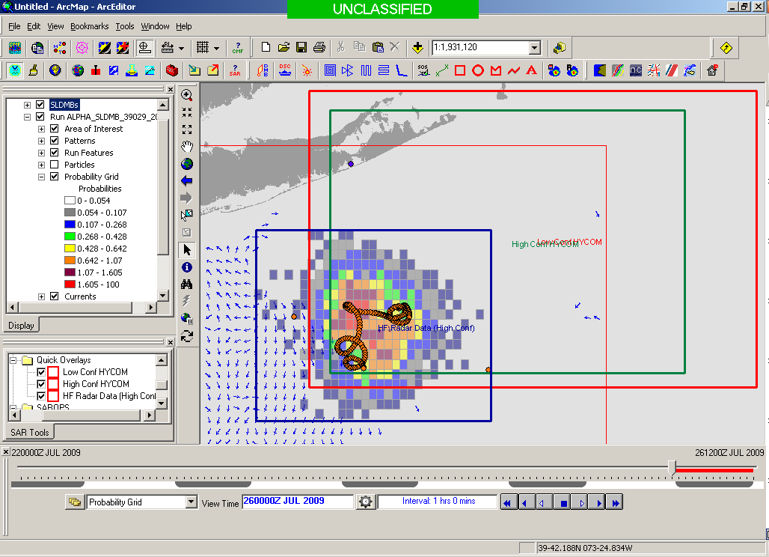
USCG Current Validation
Results of a 1-year blind validation study -
For every real drifter deployed at sea:
5000 Virtual Drifters Deployed in SAROPS
Search Areas compared to real drifters every 12 hours
154 km
100 km
232 km
123 km
HYCOM 96 hour Search Area
36,000 km²
HF Radar 96 hour Search Area
12,000 km²
Search area reduced by factor of 3
Notes:
Here are the initial deployment positions for our SLDMBs. From these records we selected only those that exceeded 4 days in length

Slide 9
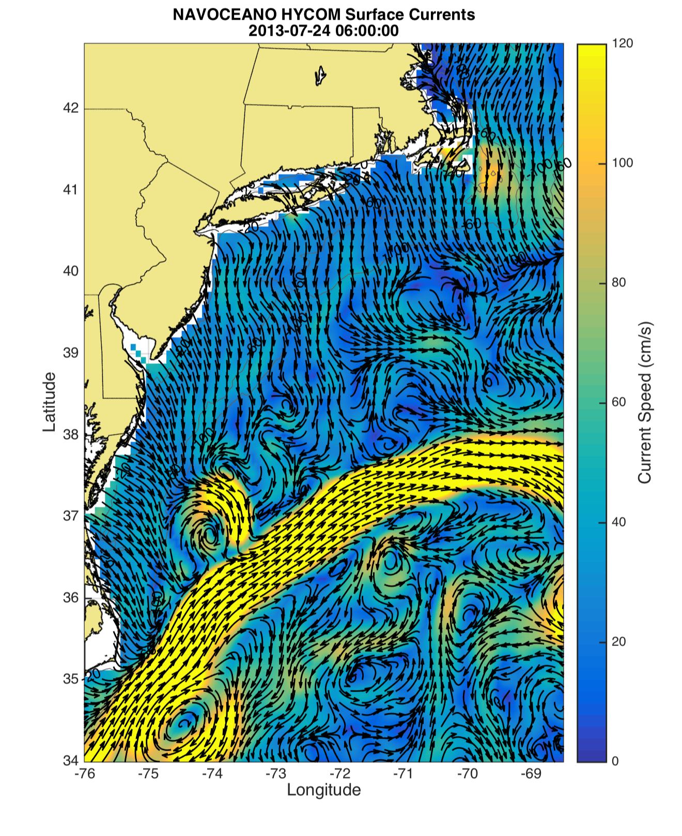
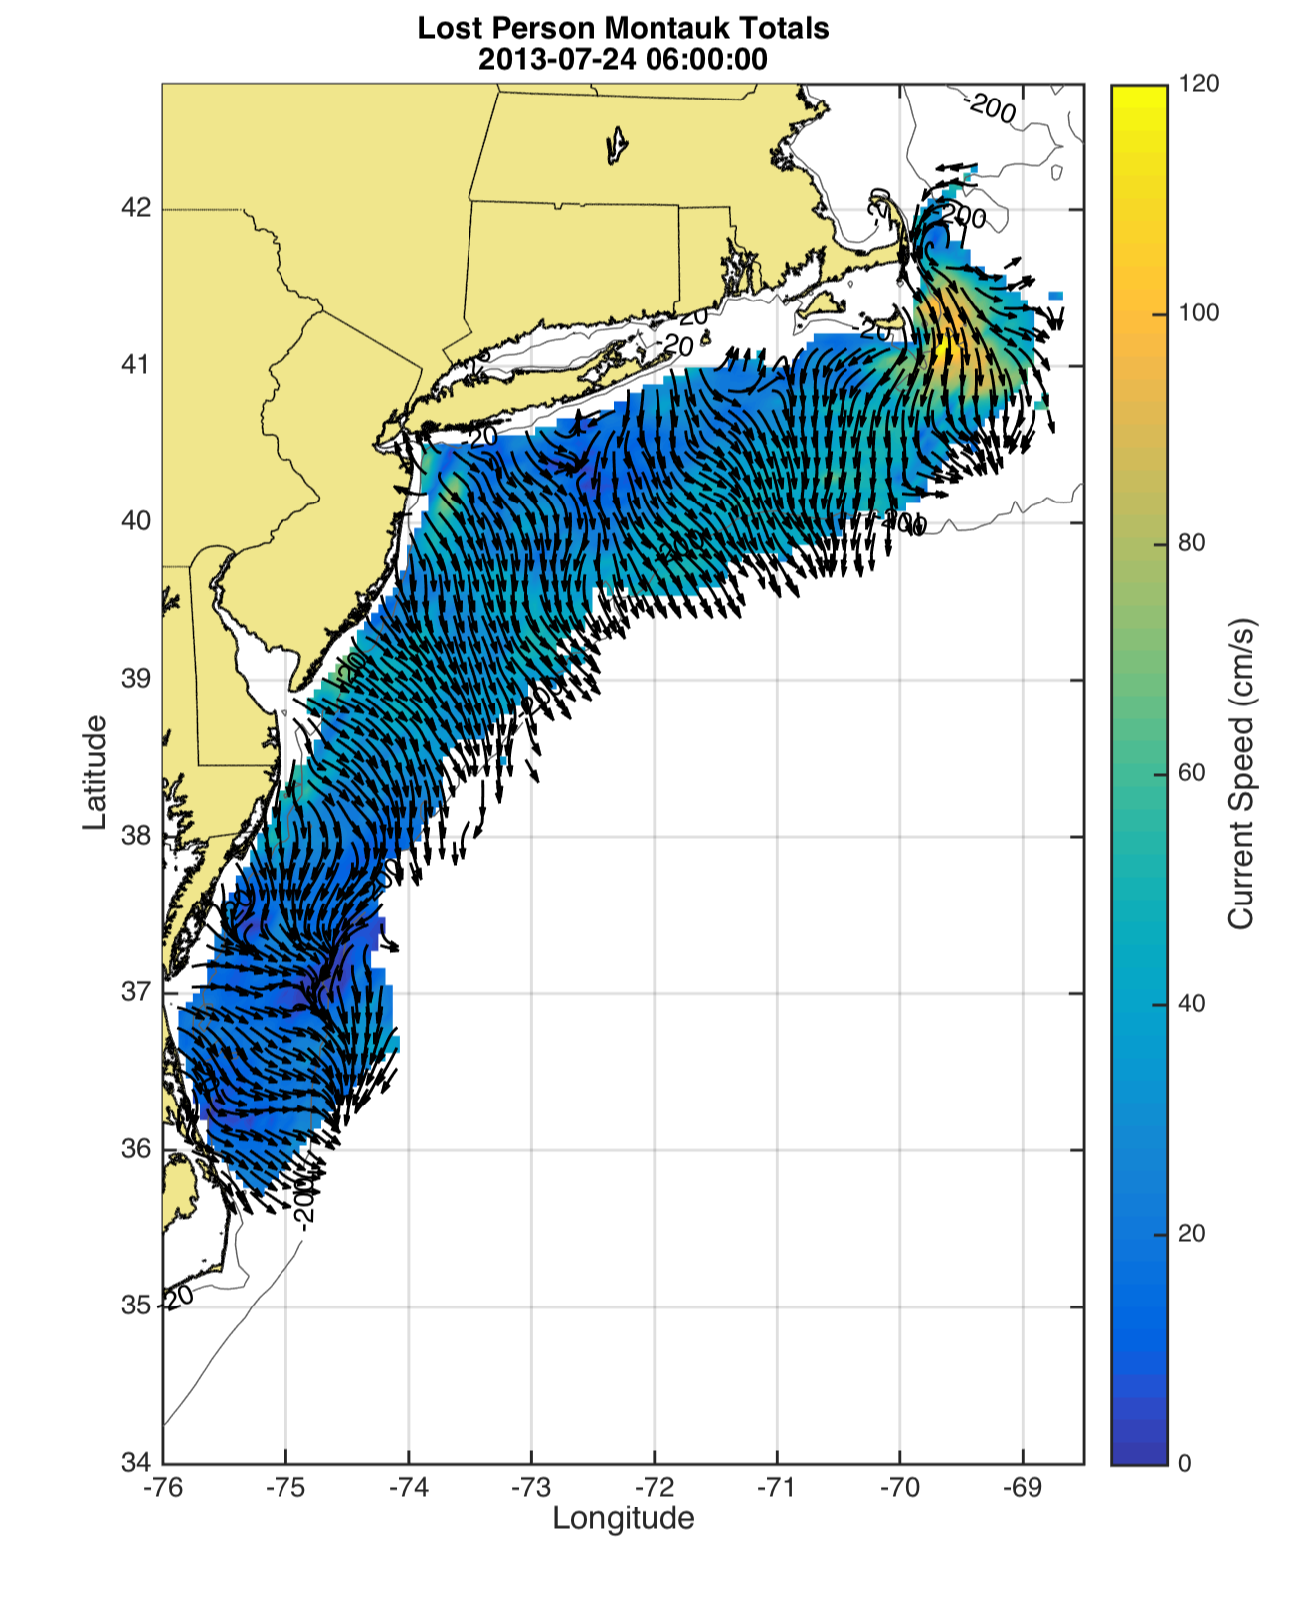
Forecast vs. Observed Surface Current Maps
HyCOM Forecast
06:00
HF Radar Observed
06:00
Forecast & Observations Agree at 06:00 GMT

Slide 10
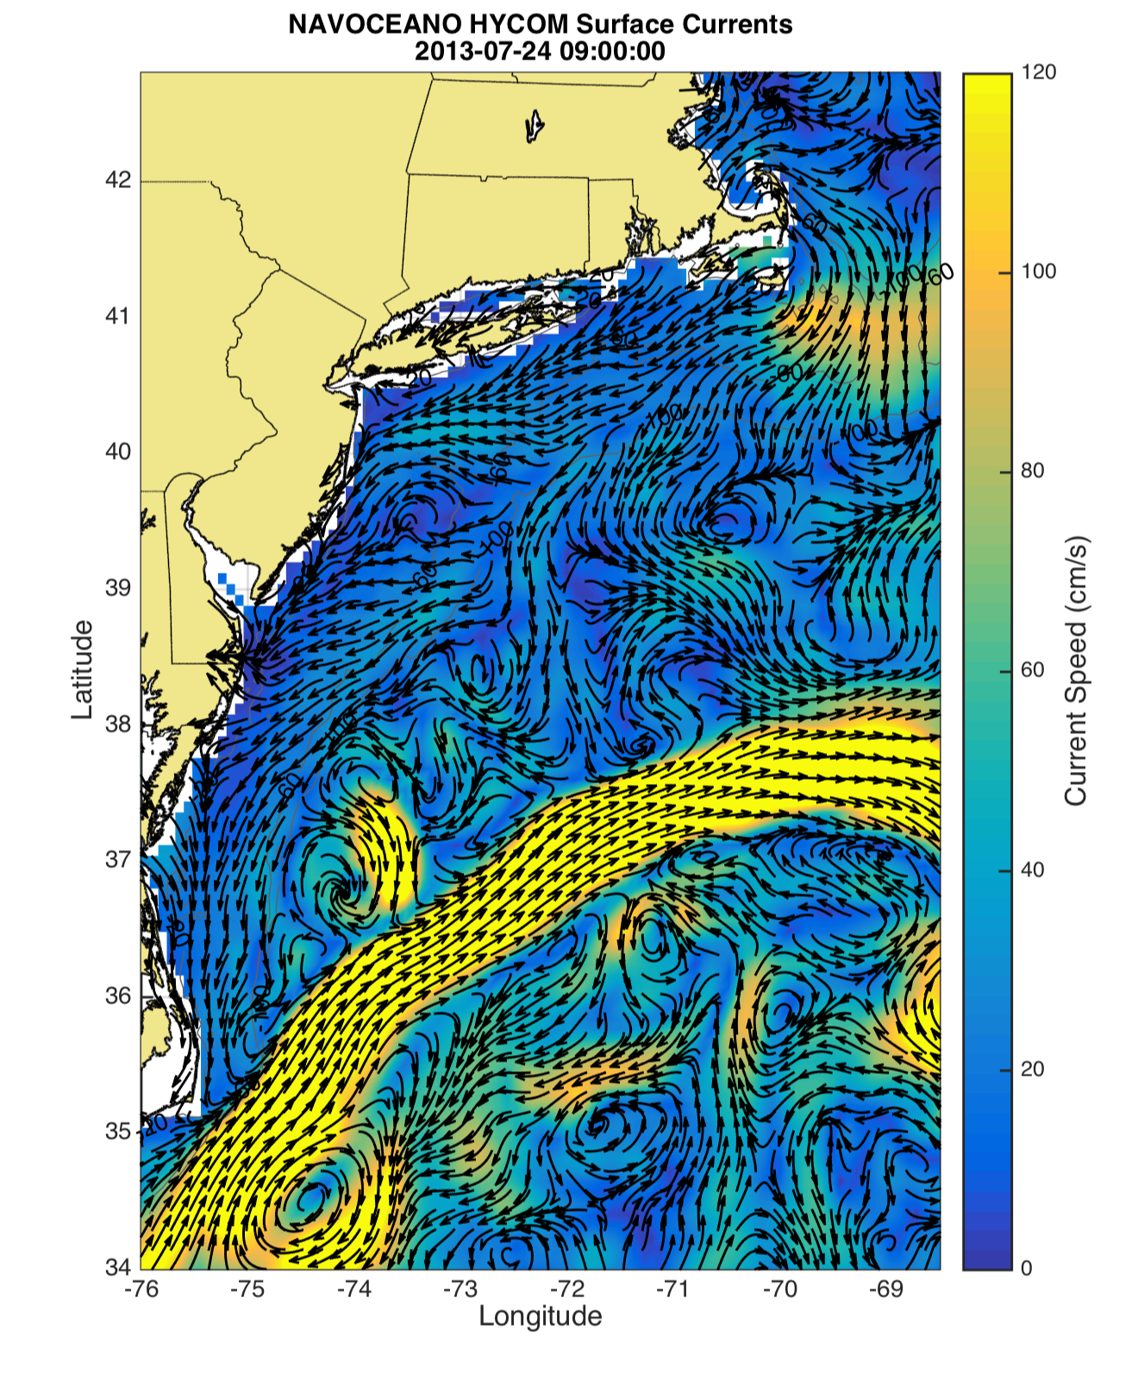
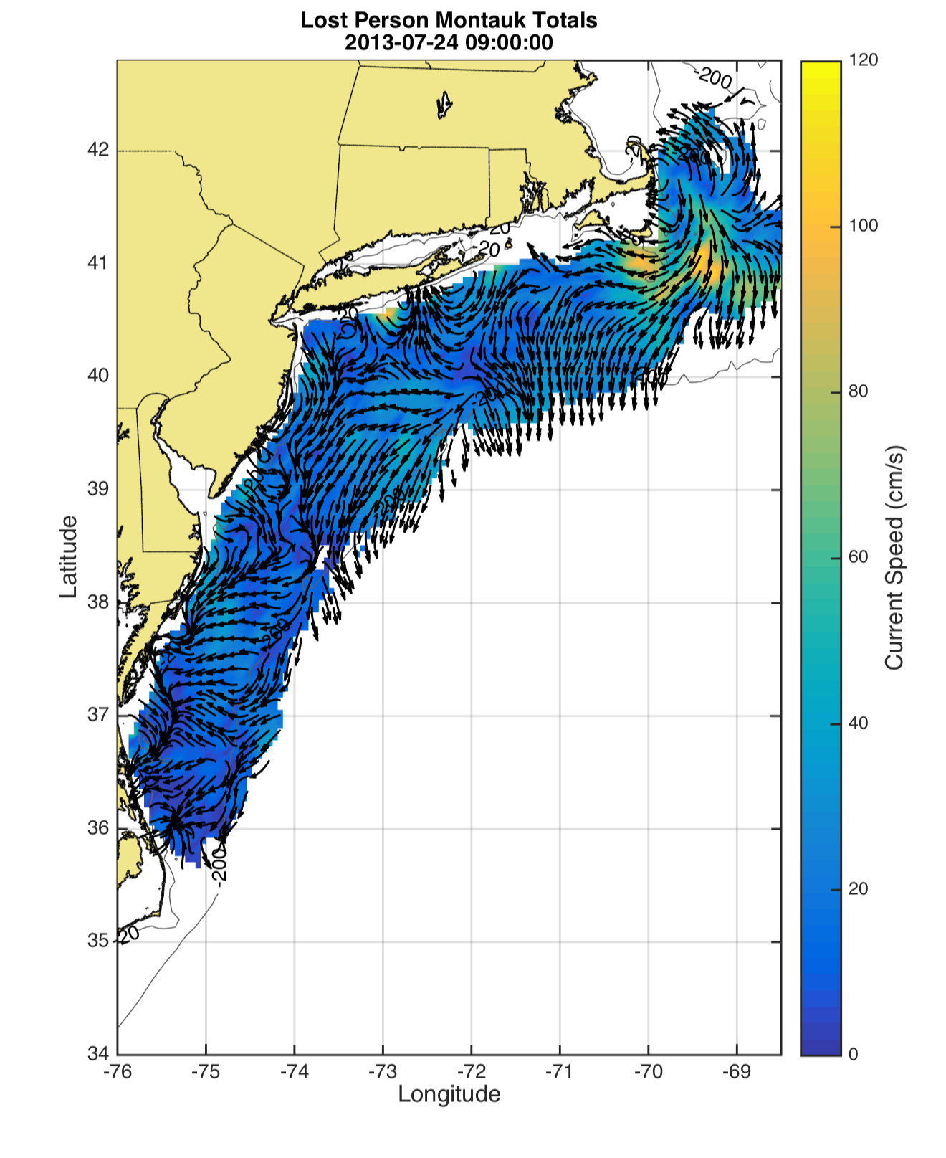
Forecast vs. Observed Surface Current Maps
HyCOM Forecast
09:00
HF Radar Observed
09:00
Forecast & Observations Disagree at 09:00 GMT

Slide 11
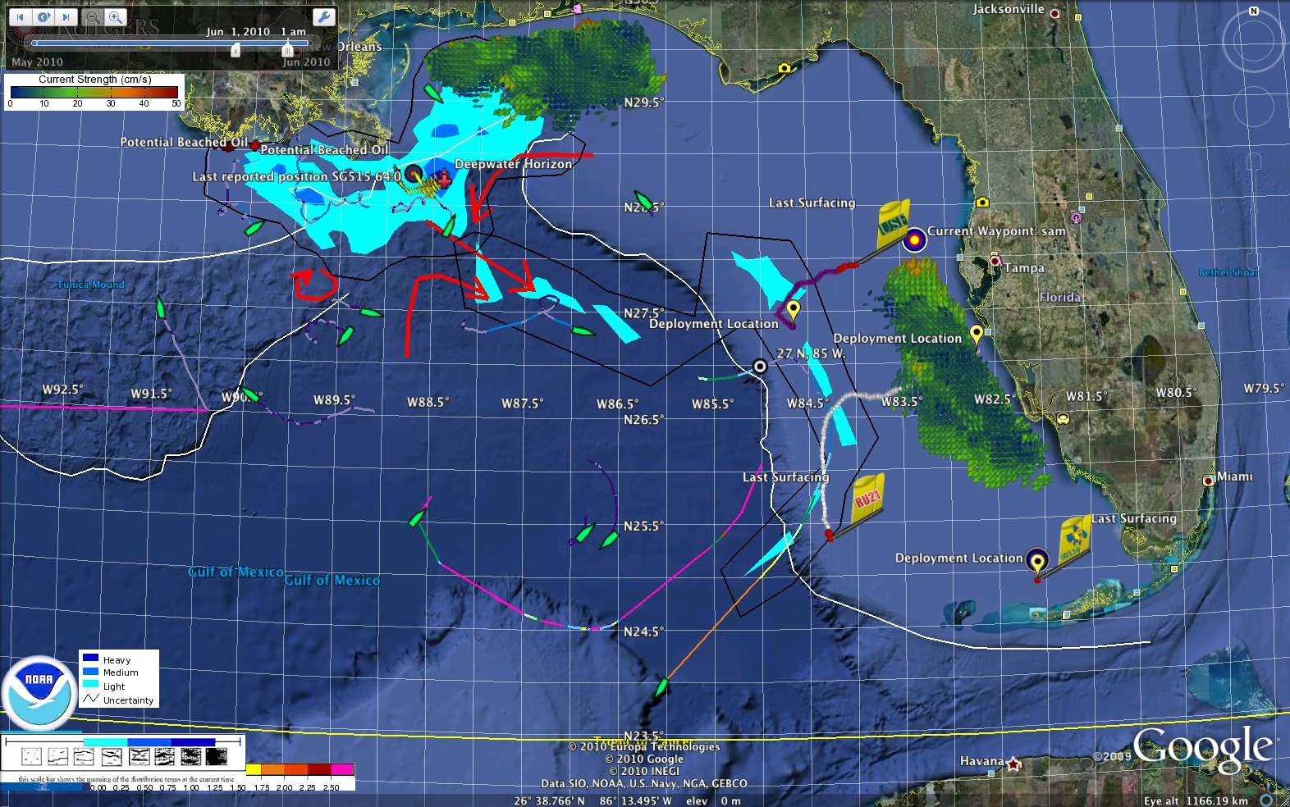
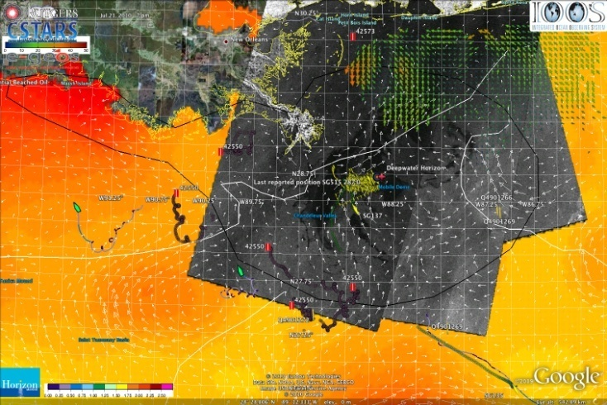
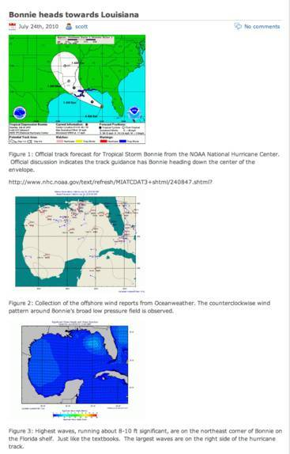
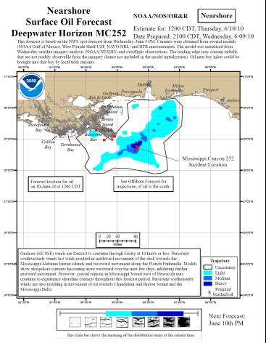
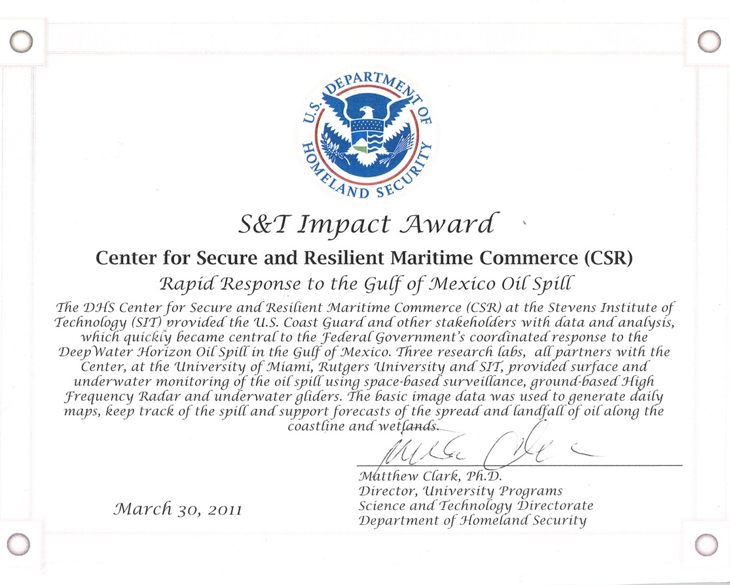
U.S. IOOS Responds to Deepwater Horizon
USM HFR
USF HFR
June 2
HFR validation of SABGOM Forecast combined with satellite detected slicks
Many datasets combined for situational awareness
Briefing Blog
127 Briefs
Distributed
DHS Impact Award for Rapid Response
HFR data informed NOAA
trajectory forecasts

Slide 12
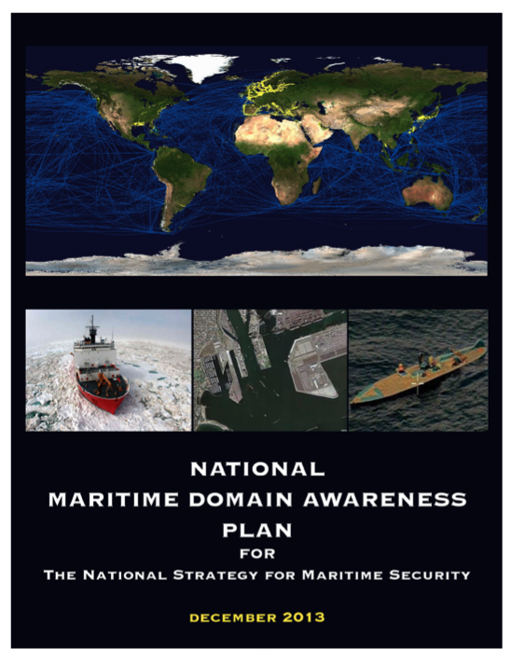
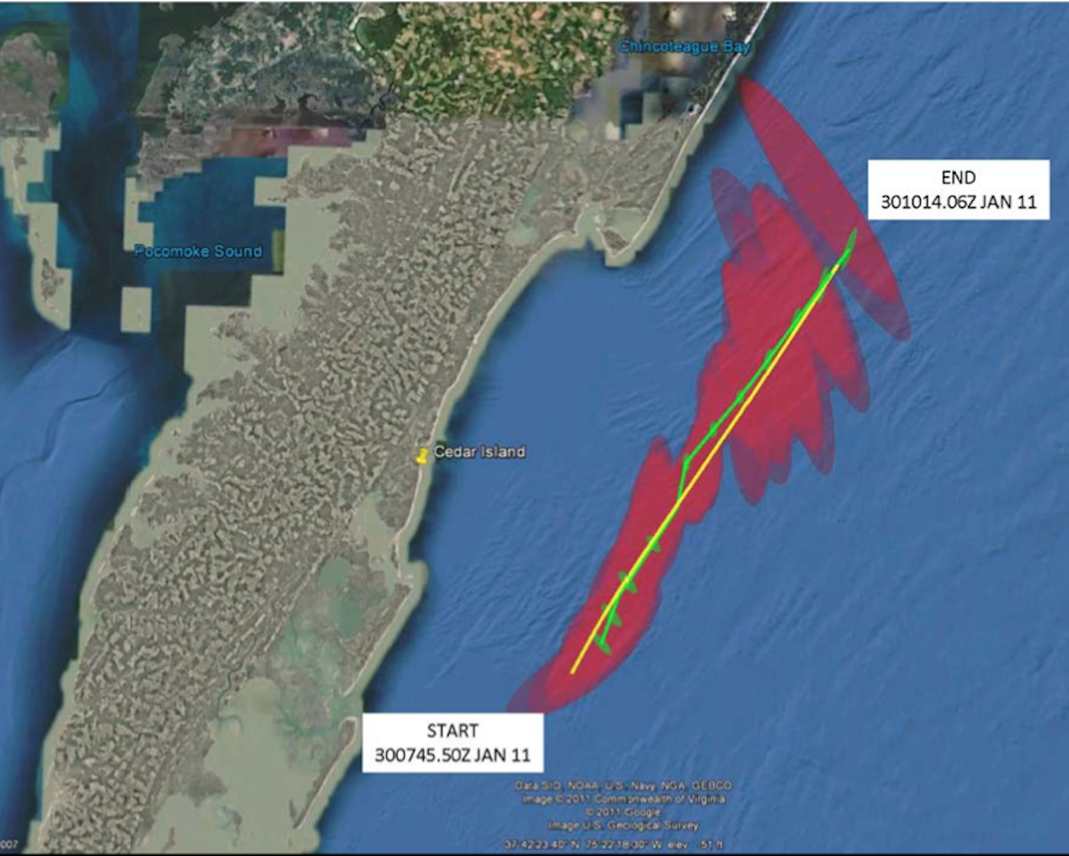
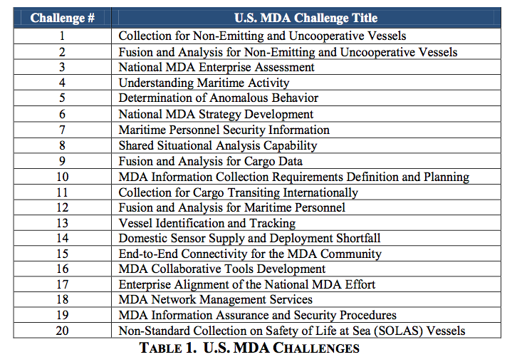
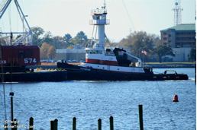
HF Radar Detects Ships Over-the-Horizon
Verification with Emitting Vessels
In Approaches to Chesapeake Bay

Slide 13
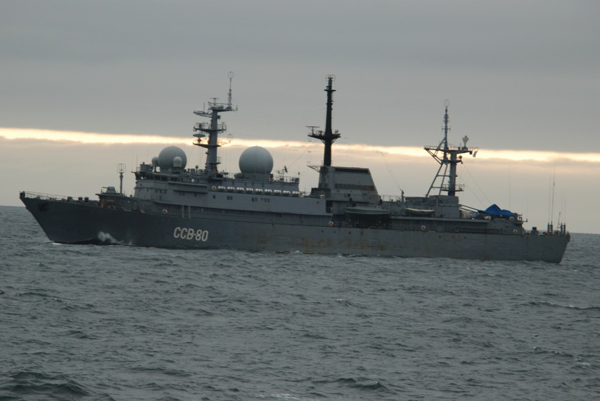
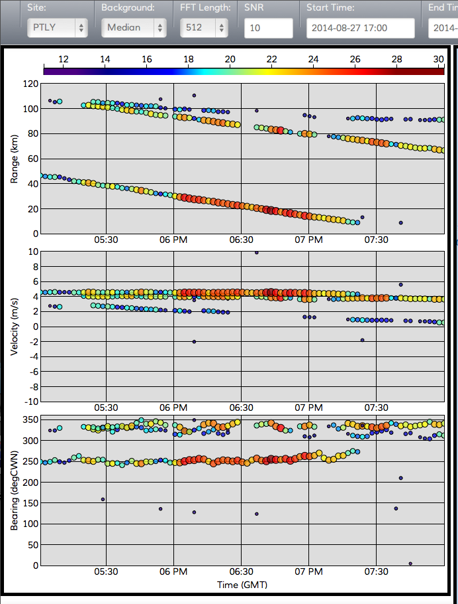
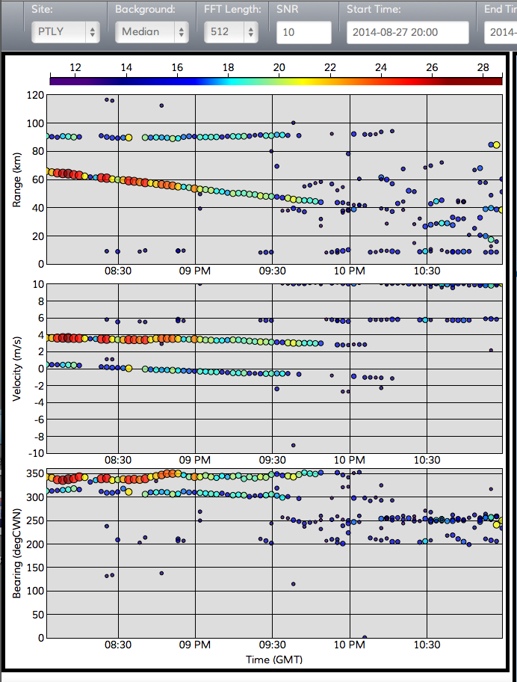
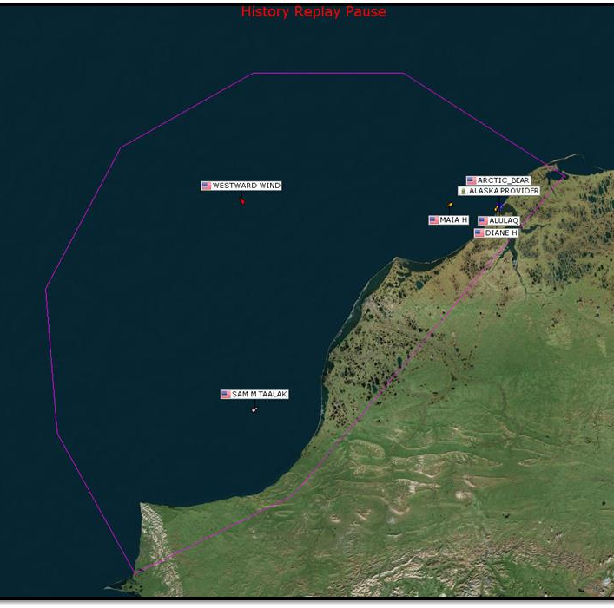
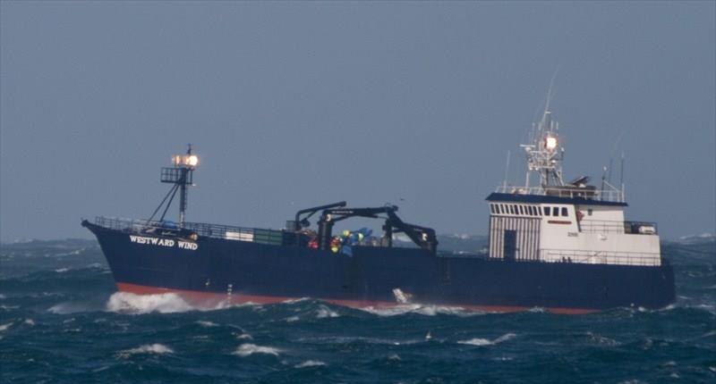
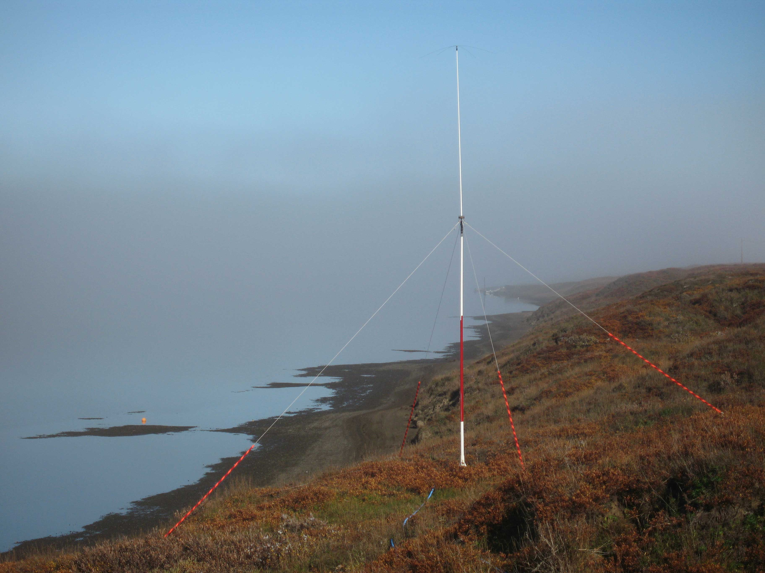
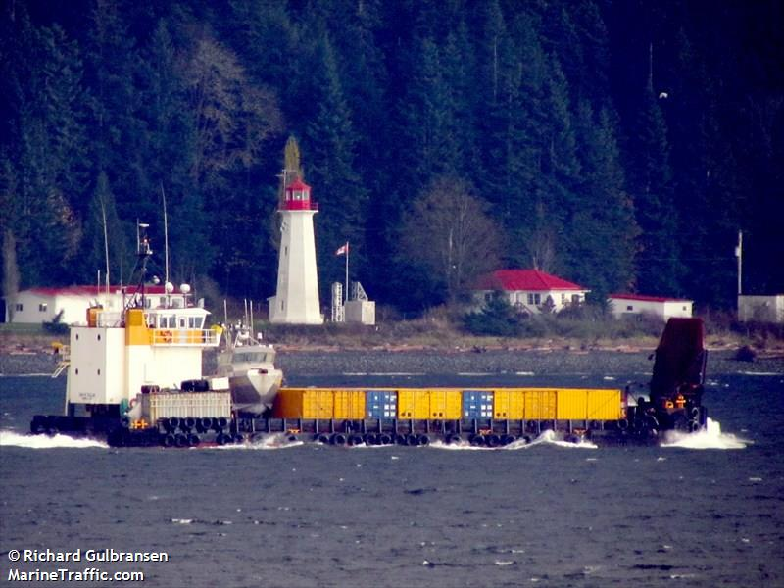
HF Radar Detects Ships Over-the-Horizon
Russian Pribaltika
Tracking a Non-Emitting Vessel
with HF Radar off Point Lay, AK
3
3
Photo taken from the Westward Wind
8/27/14 04:55 PM (GMT)
2
1
AIS Data at 06:53 PM GMT
No Vessels in Vicinity of Westward Wind
2
Westward Wind
108 km
Time of Photos
Sam M Taalak
1
Raw Radar Data: 8/27/14 05:00 - 11:00 PM GMT

Slide 14
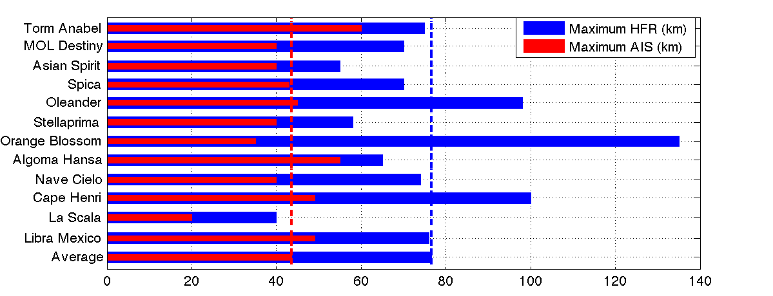
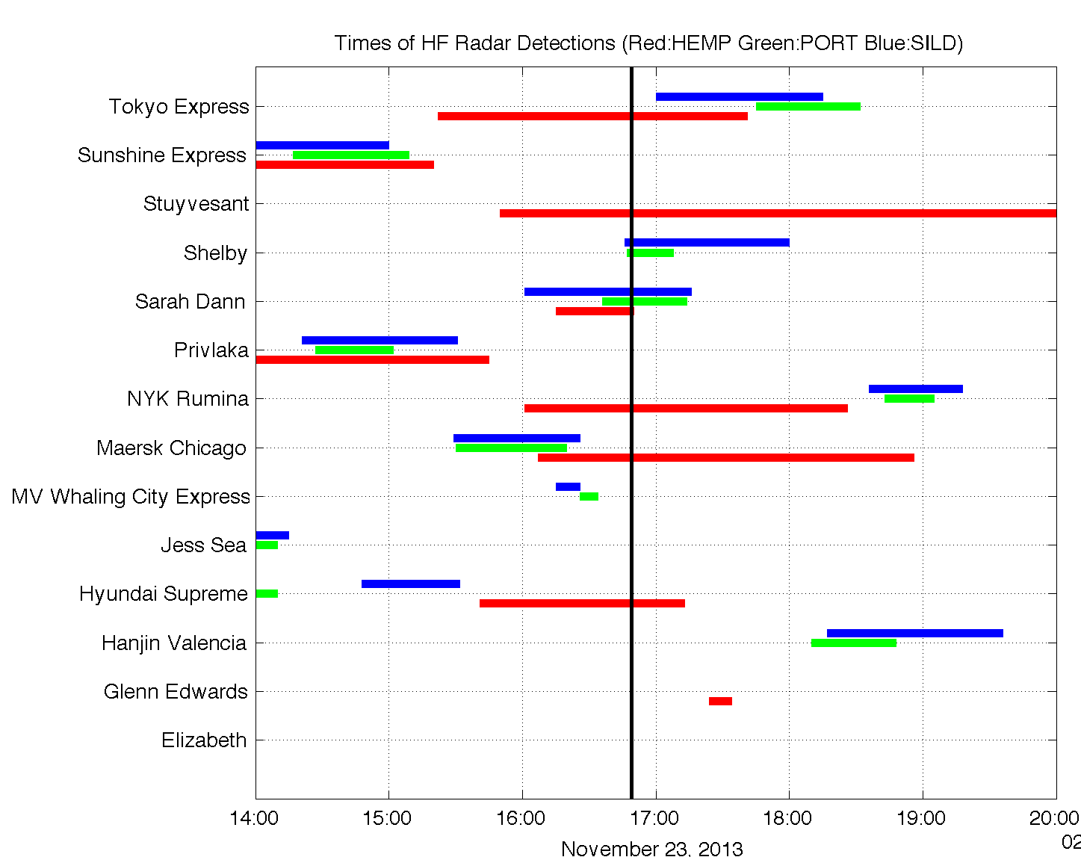
HF Radar Extends AIS & Satellite Coverage
HFR Average Max Range
77 km
AIS Average
Max Range 44 km
AIS Test
8 August 2013
Station | Detection Time (Minutes) | Samples
HEMP (5 MHz) | 139 | 9
PORT (25 MHz) | 33 | 11
SILD (25 MHz) | 58 | 11
Satellite Overpass at 16:49 GMT

Slide 15
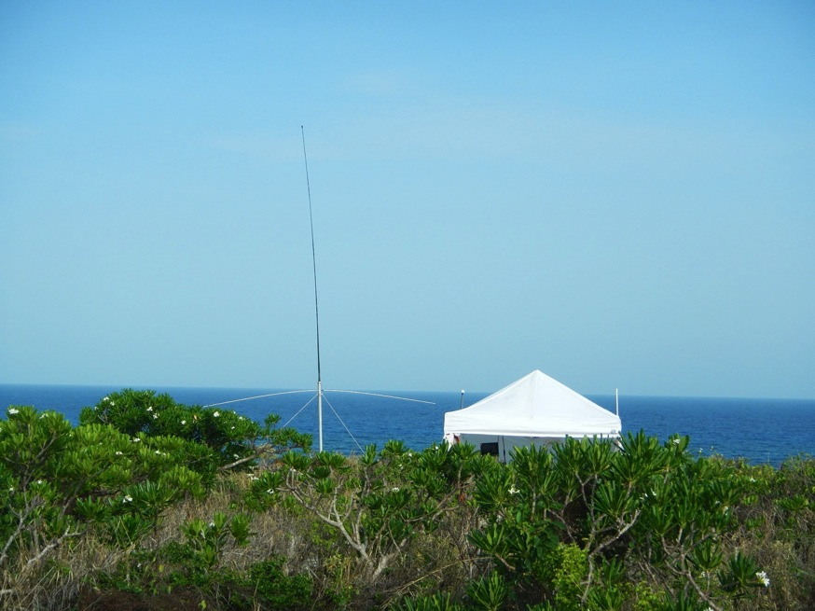
Summary
National HF Radar Network:
Uniquely Maps Coastal Surface Currents a) Hurricane Impacts, b) Search And Rescue b) Spill Response ……
Detects Ships
Monitors Nearshore Waves
Detects Tsunamis
HF Radar on Mona Island, PR

Slide 16
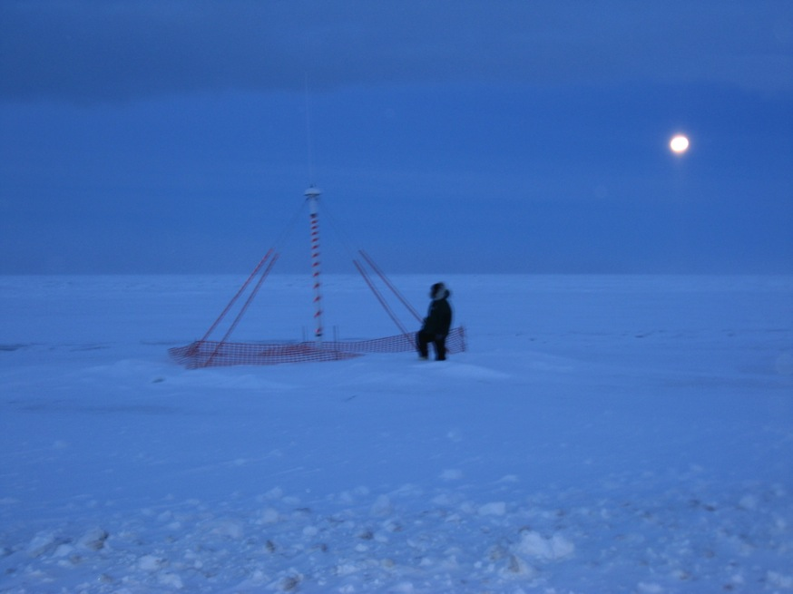
What U.S. IOOS Needs
National HF Radar Network is incomplete.
HF Radars contributed by academics are aging.
New procurements are required to fill gaps, replace aging systems, and provide spares.
Support for Operations and Maintenance is required by Regional Associations.
Additional backbone components required to transport data and support more national plans.
HF Radar at Point Barrow, AK

Slide 17
Backups

Slide 18
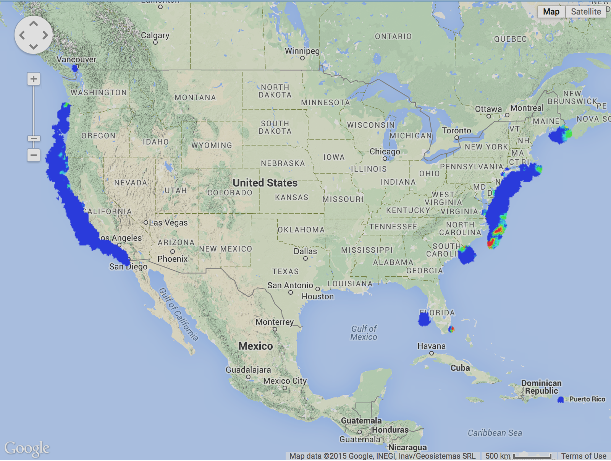
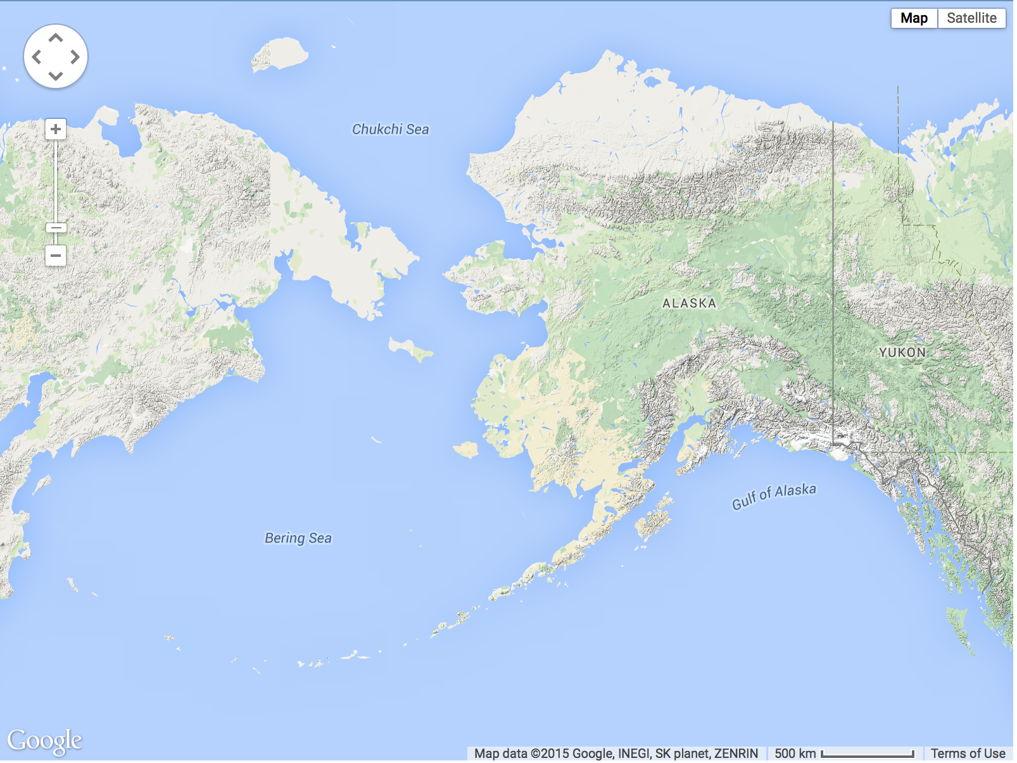
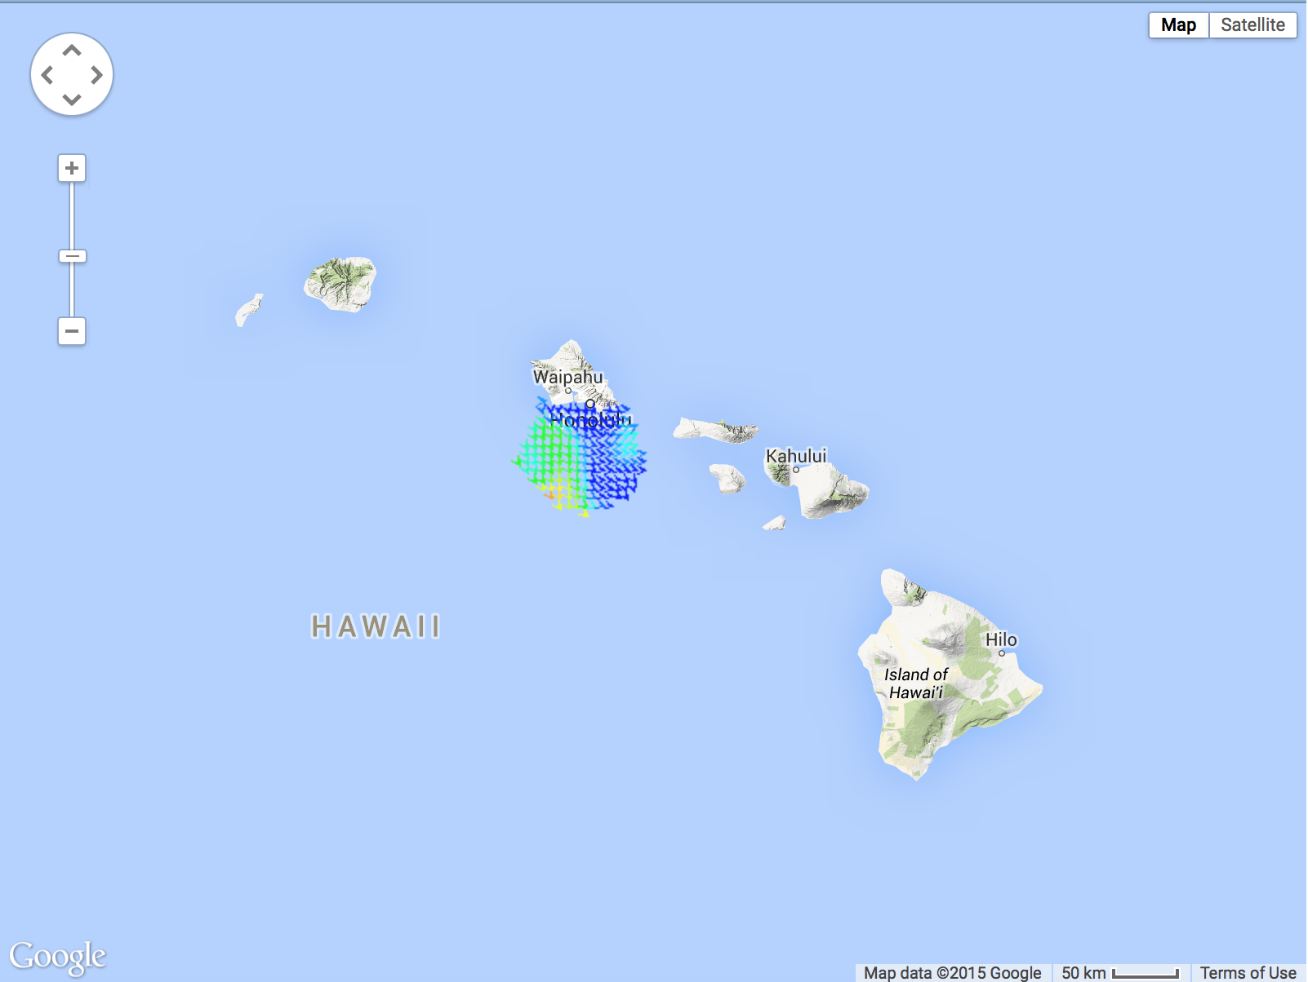
National HF Radar Network
Coverage for 20 Feb 2015
150 HF Radars Registered
121 HF Radars Reporting

Slide 19
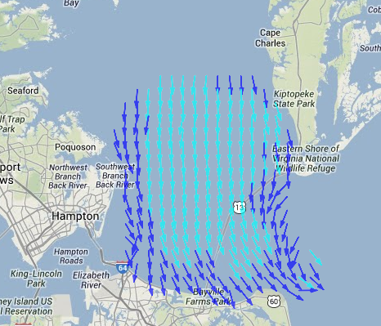
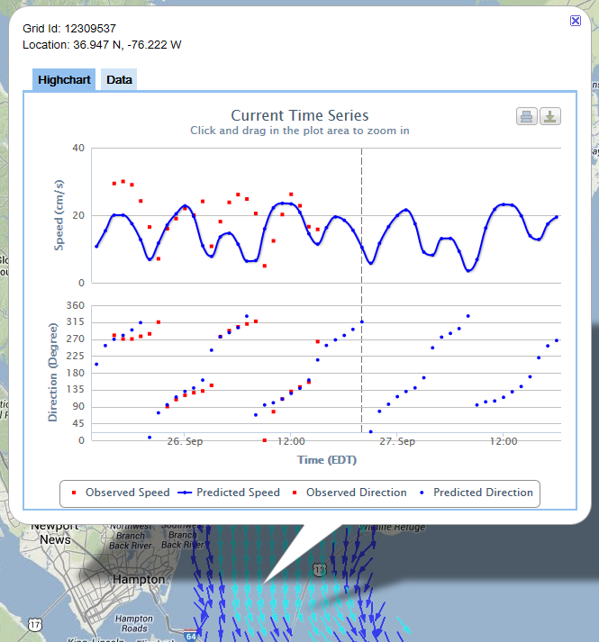
NOAA NOS CO-OPS
PORTS System
High Frequency RADAR
Surface Currents
Hourly maps of the surface current velocity can be viewed for the previous 24 hours (observed currents) and next 24 hours (predicted tidal currents)
Each point is clickable and will bring up time series plots of observed and predicted speed and direction (pictured)
Text output of time series will also be available
Searchable to find nearest grid point to entered latitude and longitude values
http://tidesandcurrents.noaa.gov/hfradar/

Slide 20
Wind Resource Analysis
RUWRF is the Rutgers University version of the Weather Research and Forecasting model, a real-time 3km atmospheric model run by the RU Coastal Ocean Observation Lab (RUCOOL) for offshore wind energy
→Now, we can begin to spatially evaluate RUWRF model performance offshore!

Slide 21
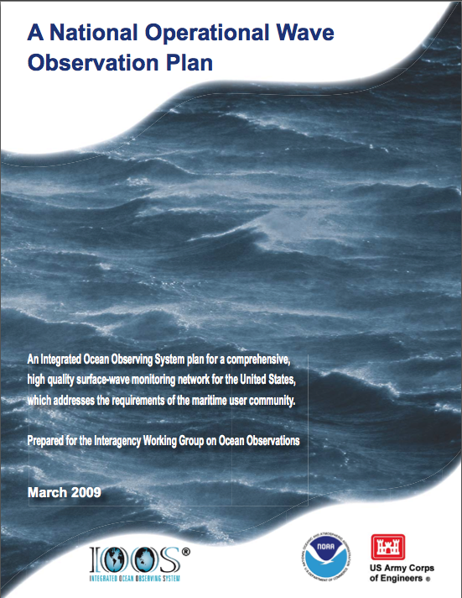
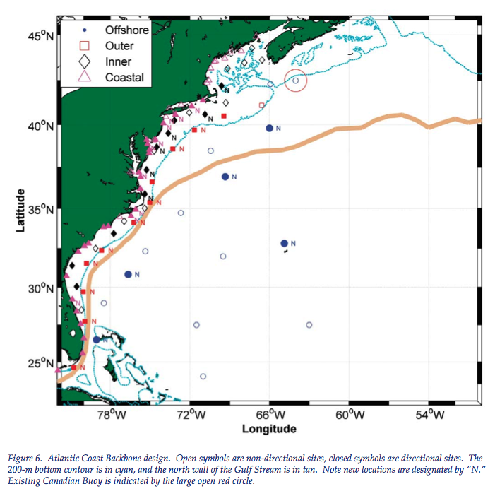
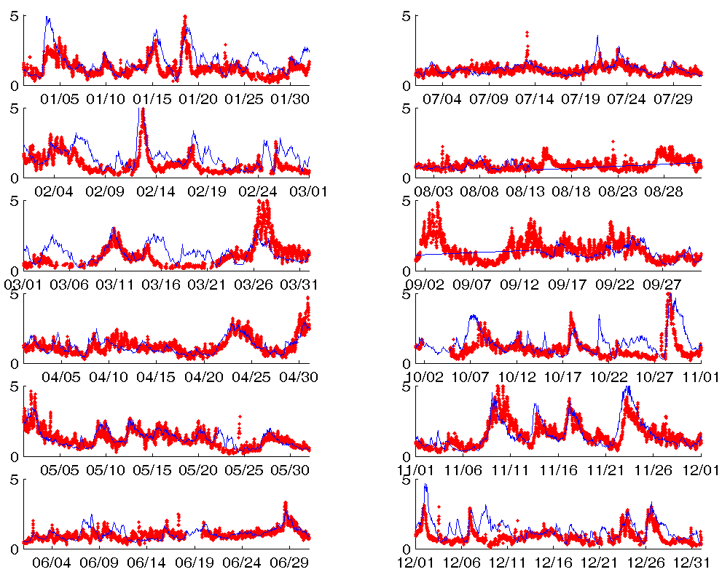
HF Radar Monitors Nearshore Waves
Codar at Breezy Pt.
NOAA Buoy 44025
Significant Wave Height (m)
13 New Buoys in
Mid Atlantic
Nearshore HF Radar product
Validation with a NOAA Buoy
National Waves Plan

Slide 22
HF Radar Detects Tsunamis
6 km offshore
10 km offshore
14 km offshore
18 km offshore
Long Beach Island, NJ
22 km offshore

