Slide 1
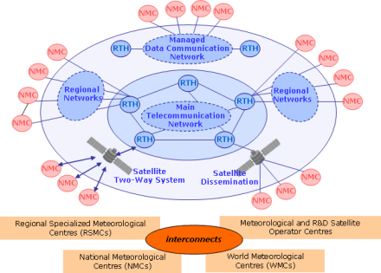
OpenGTS Pilot Project
Kevin O’Brien
University of Washington/JISAO
NOAA/PMEL

Slide 2
Global Telecommunication System (GTS)
A coordinated global system of telecommunication infrastructure for the rapid collection, exchange and distribution of observations
GTS is organized into three levels: the Main Telecommunication Network (MTN), six Regional Meteorological Telecommunication Networks (RMTN) and numerous National Meteorological Telecommunication Networks (NMTN).

Slide 3
Project Description
A pilot project to take well understood data (ie, physical ocean data) from known platform types and inject the data in near real-time onto the GTS for distribution globally. Retrieve this data and other “essential” data from the GTS and make them available through interoperable web services for public access.
The goal of the pilot project is to prototype a workflow providing ocean data producers a simpler method of distributing real time data through the GTS infrastructure and ocean data consumers a simpler method of accessing that data.

Slide 4
Project Description
A pilot project to take well understood data (ie, physical ocean data) from known platform types and inject the data in near real-time onto the GTS for distribution globally. Retrieve this data and other “essential” data from the GTS and make them available through interoperable web services for public access.
*Essential: All available in situ observations from the marine environment as well as upper air observations are regarded as “essential” by WMO resolution 40 and thus they can be exchanged without charge and with no conditions on use

Slide 5
Why?
A lot of overhead to get data onto GTS
Too much for some ocean platform managers
A lot of overhead to get data off GTS
BUFR encoded data makes this even more difficult
Change can be slow with GTS
Some European partners have not been able to move to new BUFR template for years
Provide more data to operational forecasters, etc.
Possibly a way to increase pace of adding “new” parameters to the GTS data stream

Slide 6
Project Partners
NOAA Ocean Observations and Monitoring Division
Observing System Monitoring Center
NOAA National Data Buoy Center
Puertos del Estado, Spain
National Institute of Oceanography and Experimental Geophysics (OGS), Italy
International Arctic Buoy Program

Slide 7
Project Partners
NOAA Ocean Observations and Monitoring Division
Observing System Monitoring Center
NOAA National Data Buoy Center
Puertos del Estado, Spain
National Institute of Oceanography and Experimental Geophysics (OGS), Italy
International Arctic Buoy Program
NOAA IOOS

Slide 8
OpenGTS initiative
Identify platforms (12) whose data will be inserted on the GTS
Tide Gauges
Moored Buoys
Gliders
Possibly Ice Drifters
Use ERDDAP as the data platform for RT data collected by projects
NDBC will harvest from ERDDAP and encode data for transmission onto GTS
Similar to IOOS Glider DAC

Slide 10
OpenGTS initiative
For access, OpenGTS will also leverage ERDDAP
Provide ability to access RT data for the project platforms
OSMC is already doing this for RT ocean data from the GTS
Demonstration of project slated for JCOMM V in October, 2017

Slide 11
Requirements for data ingestion
Data must be well understood physical ocean data (ie, temperature, salinity, meteo-marine data)
Platform must be a well understood type and associated with known BUFR templates with which to encode the data for distribution onto the GTS
Each platform must have a WMO ID assigned by authorized entity (i.e., JCOMMOPS)
Platform observation data must be in recognized file format and be associated with complete metadata

Slide 12
Process for ingestion of data onto GTS
Platform observations and metadata to be available in known format (netcdf, csv, xml)
Requires WMO ID to be assigned to platform
Will be working directly with JCOMMOPS
Data and metadata will then be ingested into ERDDAP server/framework
Participating GTS institution (NDBC) will use the defined ERDDAP API to access the platform observation data and metadata
Participating institution will encode the data and metadata using the appropriate BUFR template
Participating institution will inject encoded BUFR message onto GTS
This process will be automated for daily or more frequent data ingestion, as required

Slide 13
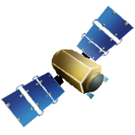
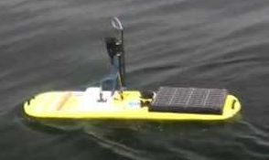
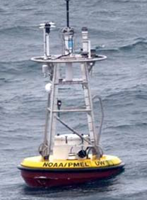
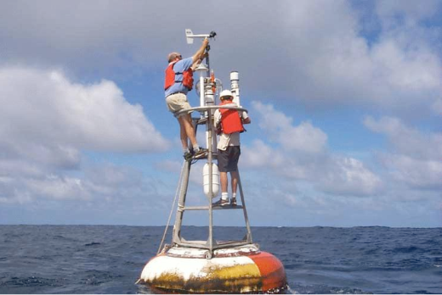
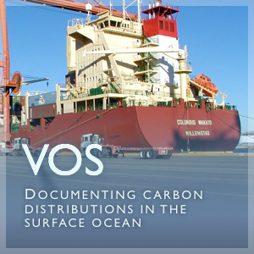
OpenGTS initiative
GTS
Insert data onto GTS
Real time
Transmit to GTS
Harvest from ERDDAP
REST services via OSMC/ERDDAP
ENCODE into BUFR

Slide 14
Process for accessing data from GTS
The OSMC project already pulls data hourly from the GTS at the National Data Buoy Center and makes this data available through an ERDDAP framework
The OSMC project will retrieve the newly inserted platform data from the GTS, decode the BUFR data with the appropriate decoder and then add the data and metadata to the OSMC database
OSMC project will develop web-accessible tools and visualizations to illustrate the platform data in context with the other real time observations available from the GTS

Slide 15
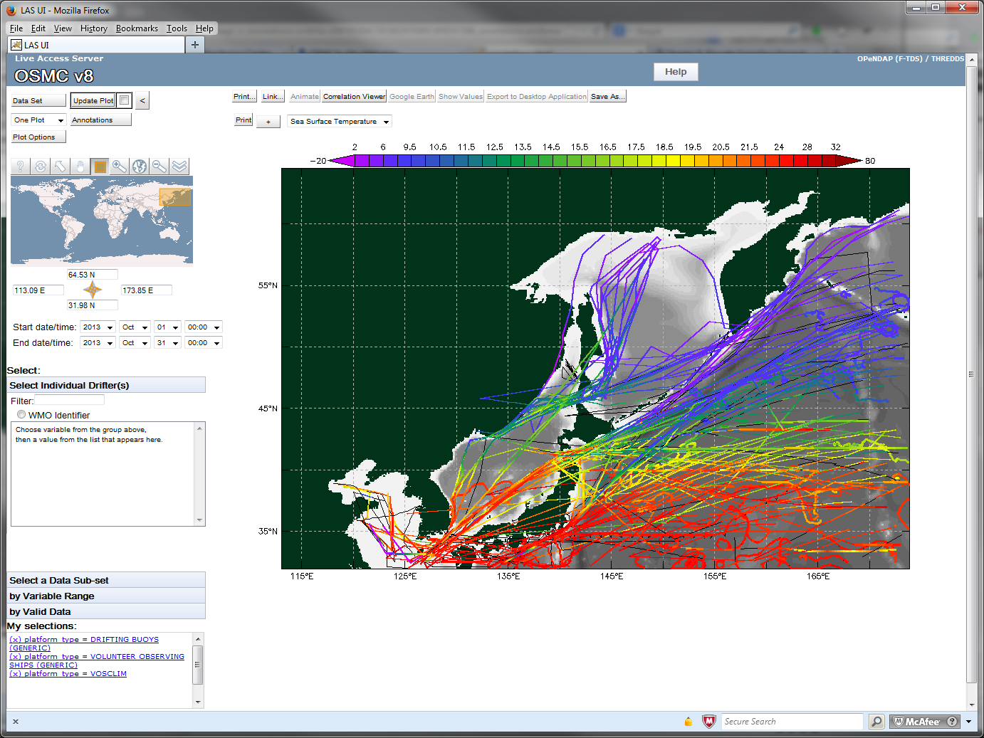
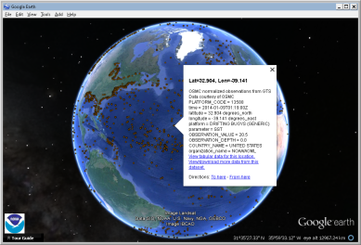
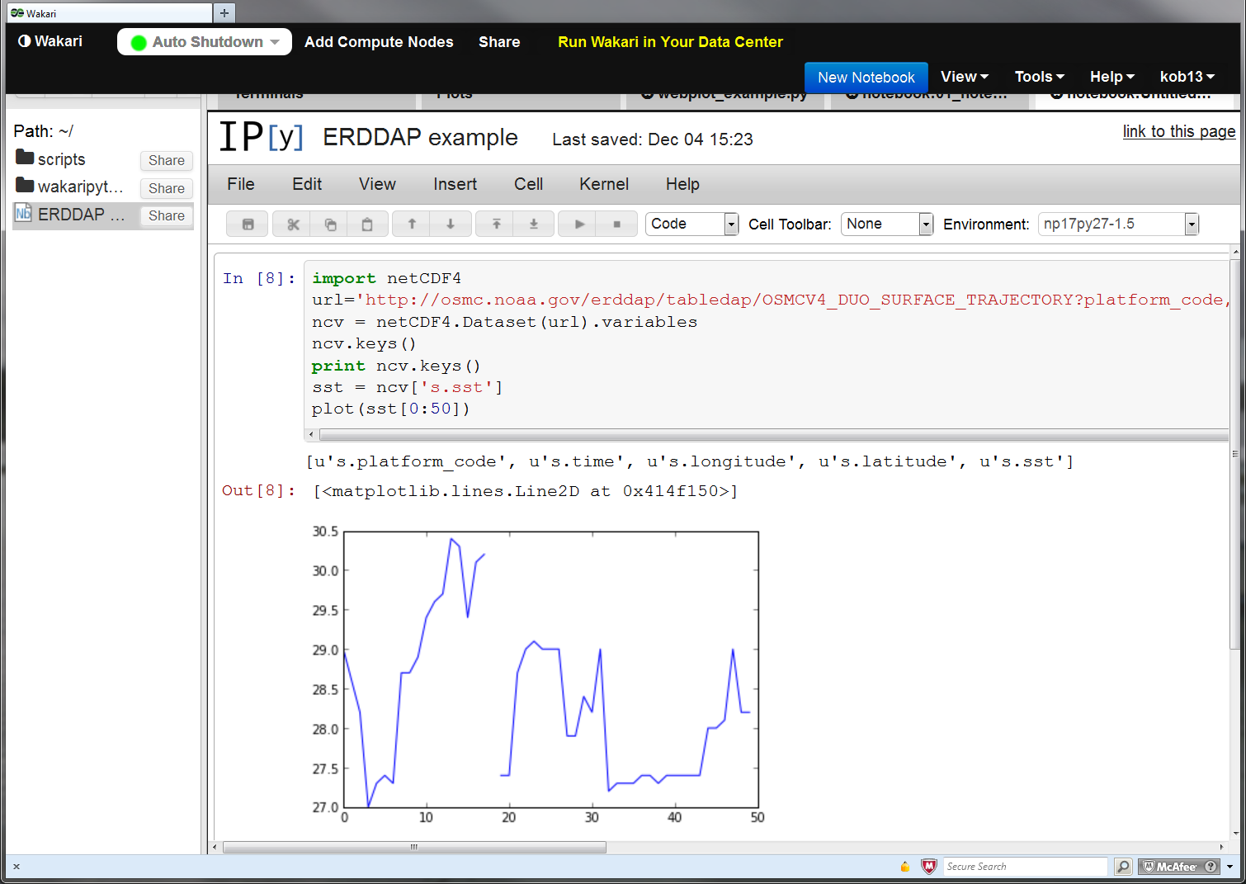
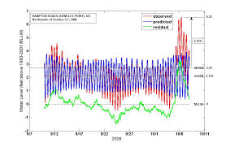
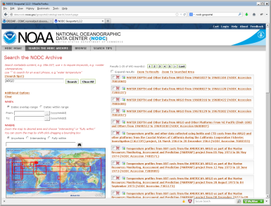
OpenGTS initiative
Live Access Server
Retrieve data from GTS
Google Earth
REST services via OSMC/ERDDAP
iPython notebook
DECODE from BUFR
IOOS coastal modeling
Matlab™
Metadata available through international standards
GTS
Data flows directly into users’ applications
ESRI Geoportal

Slide 16
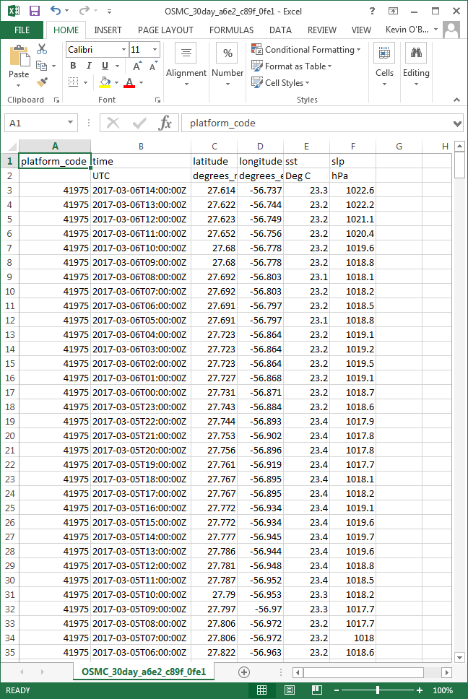
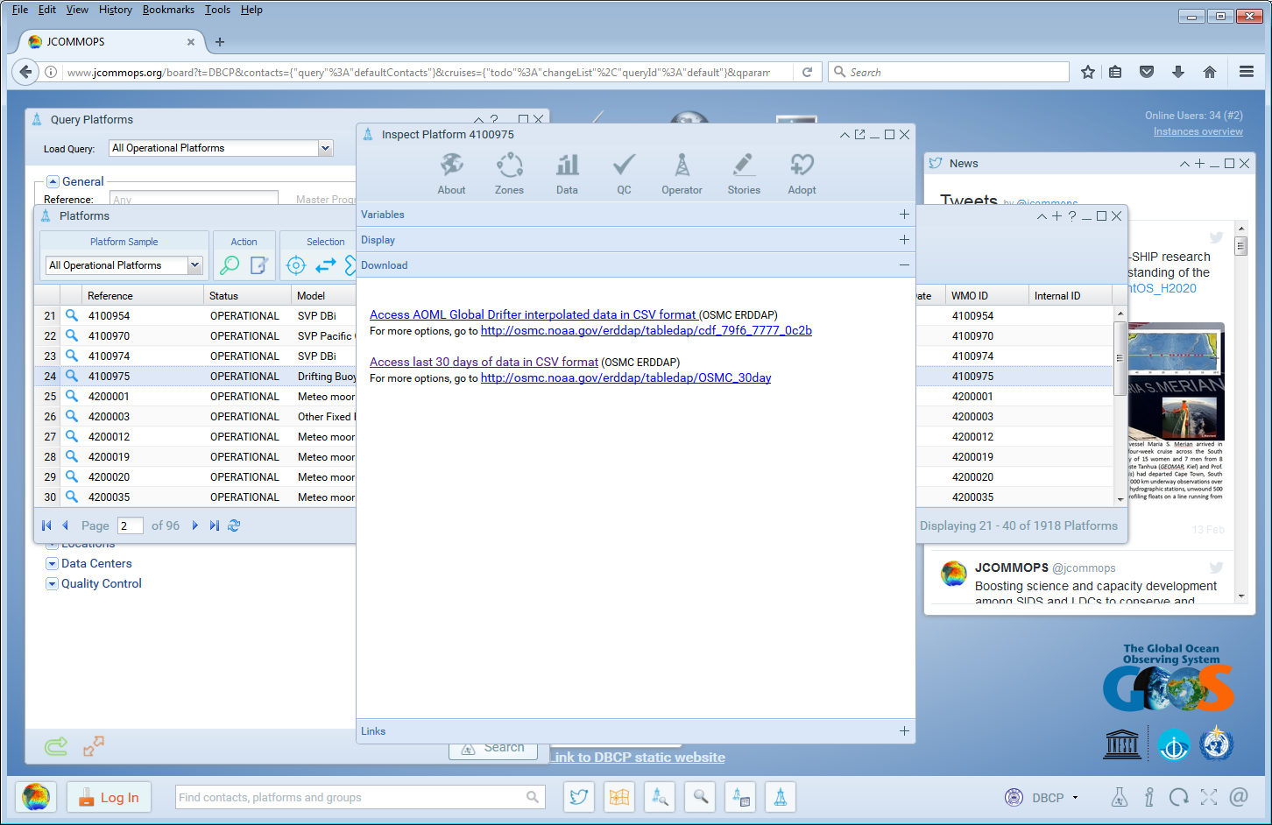
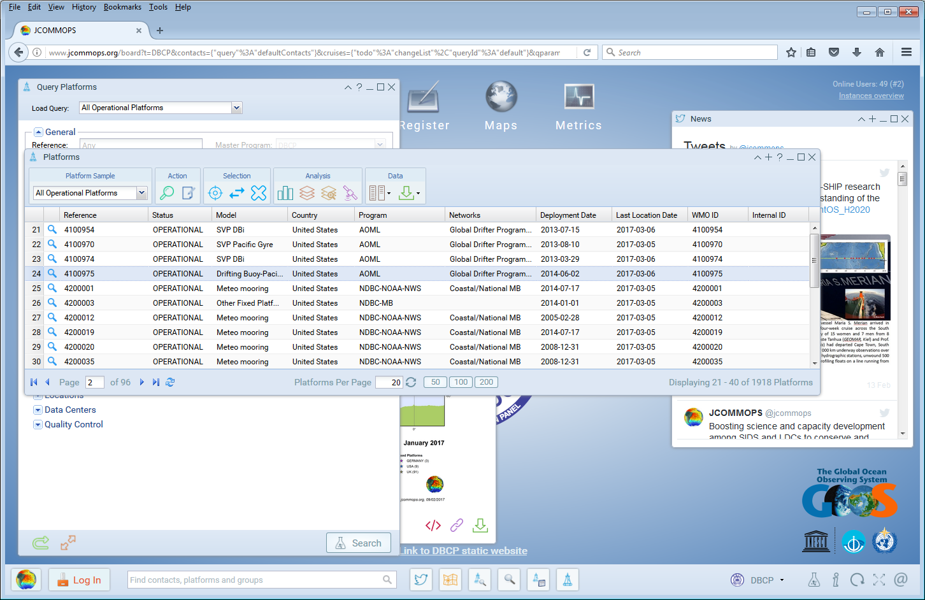
Accessing GTS real time data through JCOMMOPS website

Slide 17
Questions moving forward
Is there wider interest for this project
Yes!
Which IOOS RAs might be interested in participating?
Have had some preliminary discussions with NANOOS
What institution will be responsible for inserting data onto GTS?
NDBC is part of pilot project, but further discussion with them on making this operational is required
How would this affect the way RAs and other currently submit data to GTS?
Could potentially reduce burden of providing RT data to GTS if providing access to data and providing data to GTS were part of same process – ie, serving through an ERDDAP server.
Prototype high frequency data submissions, i.e., 15 minutes, etc
Prototype “new” parameters for GTS. BGC for example
Support other formats of data – i.e. sensor obs

