Slide 1
NERACOOS DMAC 3/16/2017
Successes & Challenges
Successes
RICE Application Submitted
New Sensors and Data Streams
Adopting and extending ERDDAP
Novel products from data
Challenges
Limited resources
Legacy systems
Standards compliance

Slide 2
RICE Application Submitted
Process review of existing QA/QC for all data providers
Began assessment of how existing QA/QC measures up to QARTOD standards
Updated documentation of data systems
Data providers setting up their own local THREDDS servers
UConn, UHN, URI, UMaine, Umass
Multiple paths to DAC ingest– ERDDAP, TDS, ncSOS, DAP, etc

Slide 3
RICE Application Submitted (cont.)
NCEI Request for Archive submitted
Testing with UMaine getting underway
UMaine leading efforts with NCEI
Can be applied to both NERACOOS and CariCOOS (buoys and data are managed by UMaine)
Output of efforts will serve as model for other data providers

Slide 4
New Sensors and Data Streams
New sensors and data streams deployed
Improved processes for integrating data into NERACOOS DAC (ERDDAP/TDS) and data products
Ocean Technology Transition (OTT)
Nutrient Observatory – P04, N03, NH4 sensors (CT-ME)
Ocean Alkalinity – UNH & aquaculture industry partner
Imaging Flow Cytobot (IFCB) – with WHOI/GCOOS
NSF EPSCoR
UMaine - Loboviz and coastal buoys
ESP HAB Buoy (WHOI)
TEMPESTS
NOAA/CINAR rapid response storm intensity study

Slide 5
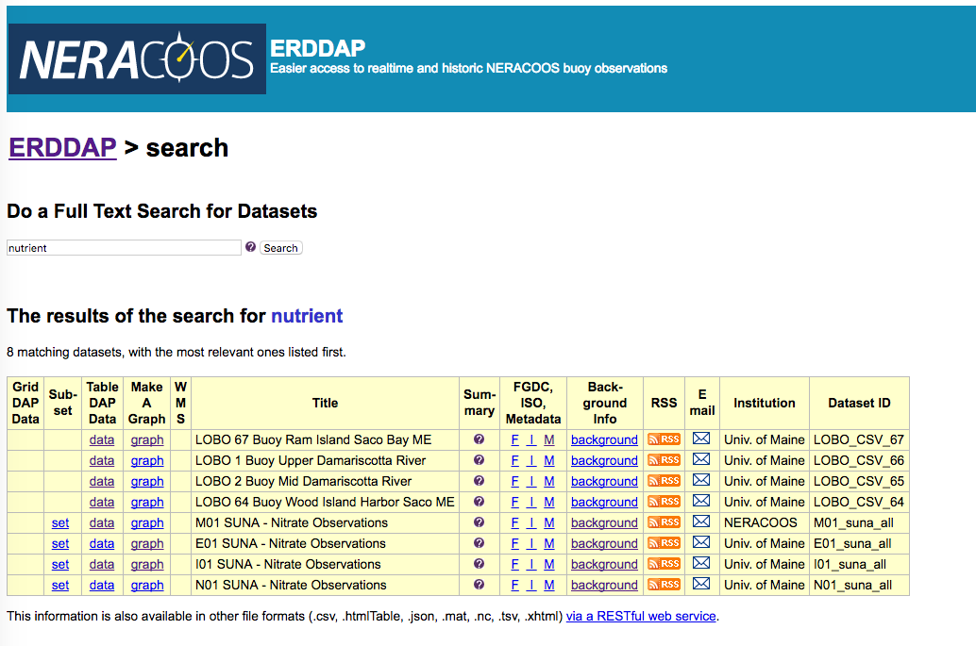
Leverage ERDDAP as back-end
146 + datasets in catalog and growing!

Slide 6
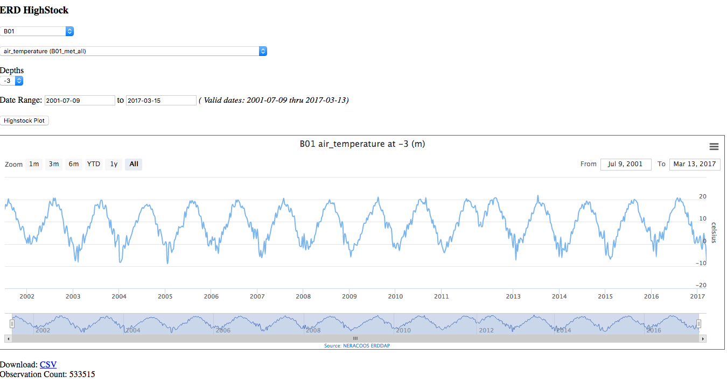
Leverage ERDDAP as back-end
533,315 observations in seconds!
http://www.neracoos.org/lgnc/ERDHighStock/hs_erddap.html

Slide 7
Novel Product: GMRI Lobster Forecast Model
GMRI scientists developed model and forecast for Maine lobster industry using NERACOOS buoy bottom temperature observations
2012 heat wave led to early molt
Processors and dealers were not ready
Caused glut in market, tanked prices, lobsters dumped!
Multiple years of temp data coupled with landings data determines “start” of Maine season
Lobsters move in shore to molt, leads to uptick in landings
Forecast now running annually
Helps industry prepare for actual “start” of season to avoid repeat of 2012

Slide 8
NERACOOS DMAC Challenges
Resources
Most of NERACOOS’ funding is devoted to supporting buoy assets and preserving long time series
Limited funds for DMAC as compared to other RAs
Increased push for standards compliance leaves less for product improvement and new development
Data providers also have limited resources to implement data standards
Legacy
Long time series - including deep water oce obs - began before latest standards (~1999).
Much legacy code to be updated, re-formatted; including retrofitting QA/QC to new standards

