Slide 1
Developing Scalable Data Management Solutions for Large Scale AIS Data and Beyond
Rob Bochenek
January 2017

Slide 2
Summary
Background
What is cluster computing and how is it useful?
What is Apache Spark and why are we using it?
Review an Example Spark Data Analysis Pipeline - AIS Vessel Heatmap
Notes:
Not going to go into a ton of detail about how Spark works, or look at very much code.
I wanted to open this up to everyone because
a) this stuff is cool and I like sharing cool things with people,
b) the more Axiom people who understand what this tool is and how it can be used, the more chance we have of seeing a relevant RFP and winning that work,
c) this kind of tooling is above and beyond what most PI's are using, but could be hugely useful for their work.

Slide 3
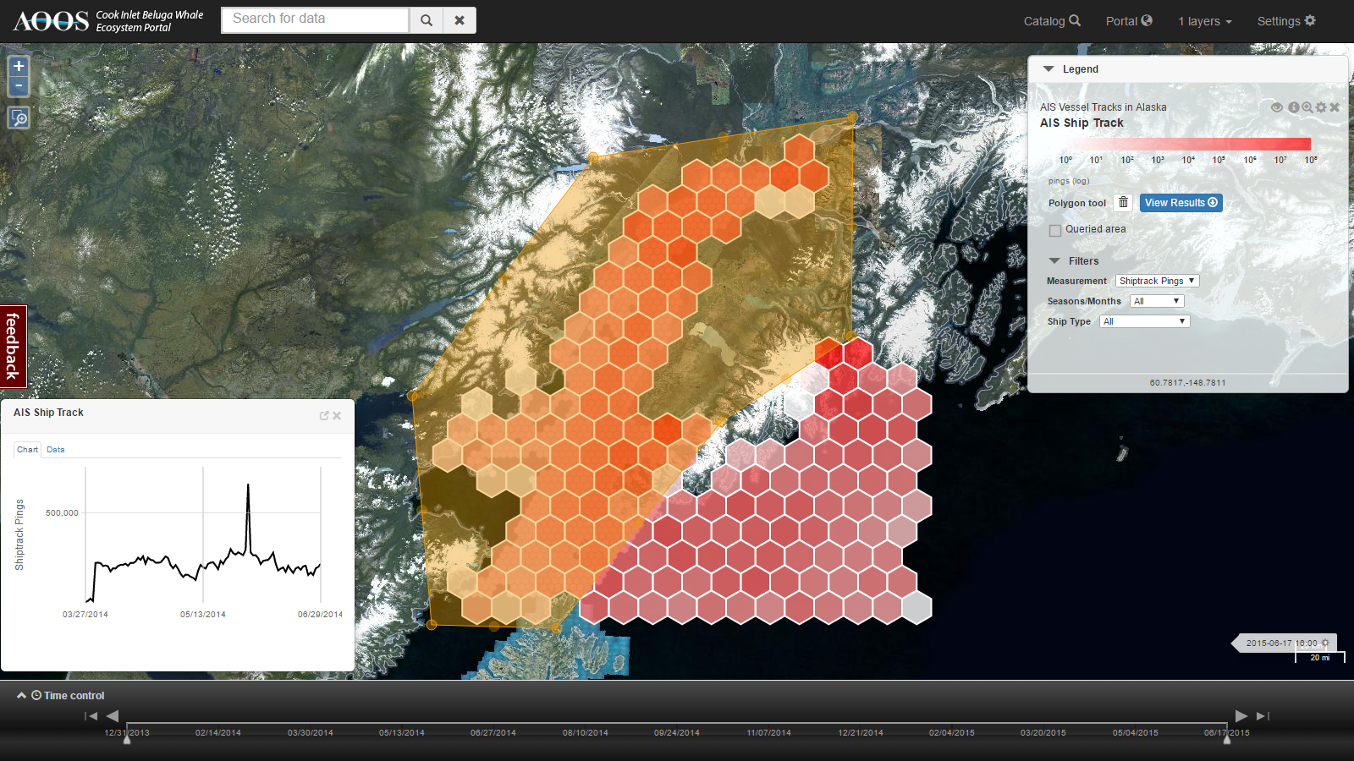
Background?
In 2015, Axiom worked with a small’ish AIS test Data Set (250M Records) from 2014 to build some prototype tools
Using tools we were familiar with
PostgreSQL Spatial-Storage
Java (JTS) Spatial Analysis
Took several weeks
Need new approach…..
2016 NOAA EDM (Lucy Hick, OCS)

Slide 4
What is cluster computing?
When doing analysis or transformations on large datasets, it's helpful to perform these calculations in parallel
It’s possible to parallelize your application across multiple cores (CPUs) on a single computer
Another approach: join several computers over a network to form a "cluster"
The advantage here is that you can scale beyond the max number of cores
But you also add a huge amount of complexity
Over time, many frameworks have emerged to help manage this complexity

Slide 5
What is cluster computing?
Application
When using one of these frameworks, you typically write an application and "submit" it to the cluster
The framework will divide up the work across the cluster as the application runs
Final results are joined together and stored on the master (or a shared filesystem)
https://dzone.com/refcardz/apache-spark

Slide 6
What is Apache Spark?
Spark is one such cluster computing framework
It's similar to Hadoop, but can be hundreds of times faster because it does a lot more in-memory processing
Advantages:
Fairly mature (v2.1)
Under active development, healthy community
Includes a UI for viewing job status and metrics
Has APIs for several major languages
Scala, Java, Python, R
Can handle "streaming" data
Note: we haven't tried this yet
Has built-in functionality for SQL-like querying and ML processing
Lots of third-party libraries (including GIS)

Slide 7
What is Apache Spark?
Things to watch out for:
Many different ways to accomplish the same task -- can lead to confusion for beginners
Rapid development means state-of-the-art changes quickly and is hard to follow (books and talks from 2014 feel very outdated in 2016)
The language APIs have varying levels of support
In order of maturity: Scala, Java, Python, R
Can be huge differences in performance between Scala and Python apps
Third-party libraries might have API for only a subset of languages
For example, GeoTrellis only has a Scala API (python is on the roadmap)

Slide 8
How Spark Works
Runs in the JVM
Keeps data in memory, but can spill to disk if a worker runs out of memory
Can run in a single thread on your local machine (useful for unit testing)
Since you're just writing a Java/Scala/Python application, you can interface with pretty much anything
Filesystem, network, external database, etc
In some cases, people have written functions to quickly do I/O with these systems
e.g., read/write partitions of a file in parallel on HDFS, or load in data in parallel from a database
https://dzone.com/refcardz/apache-spark

Slide 9
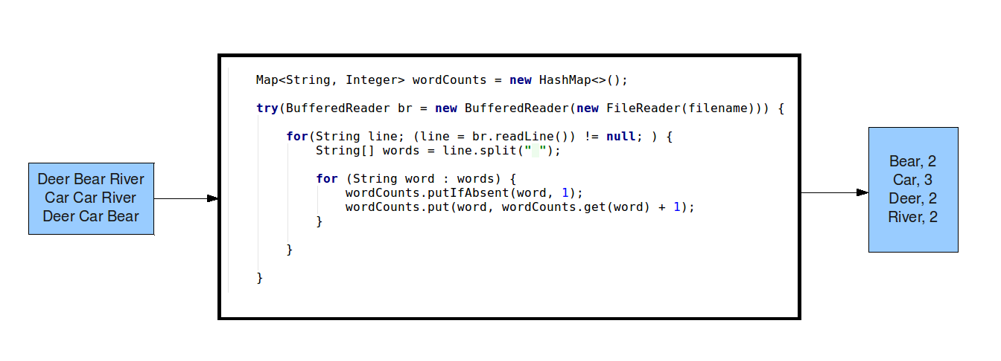
How is writing a Spark application different?
Program needs to be written so that calculations can be distributed across many workers
Instead of for loops, use built-in functions: map, filter, groupBy, etc
Notes:
Analogous to learning MATLAB or SQL:
In MATLAB, you use vector/matrix operations instead of for loops,
In SQL, you use joins

Slide 10
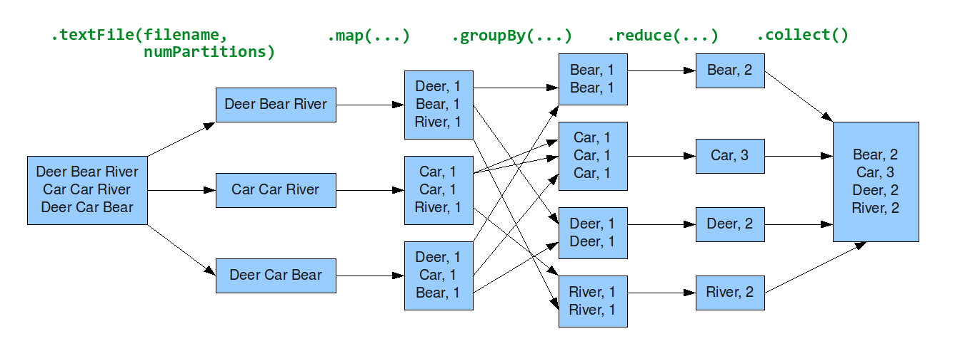
How is writing a Spark application different?
Program needs to be written so that calculations can be distributed across many workers
Instead of for loops, use built-in functions: map, filter, groupBy, etc
Notes:
Analogous to learning MATLAB or SQL:
In MATLAB, you use vector/matrix operations instead of for loops,
In SQL, you use joins

Slide 11
Third-party libraries in Spark
Most spark libraries take advantage of existing code, but have classes that allow code execution to be done in parallel
Example: GeoTrellis
For doing typical stuff like projections, geometry, etc, it leverages existing libraries
proj4, jts.geom, etc
To perform these calculations in a fast, distributed way, it introduces the concept of a Tile and TileLayout (a grid of Tiles), which allow for spatial indexing of data

Slide 12
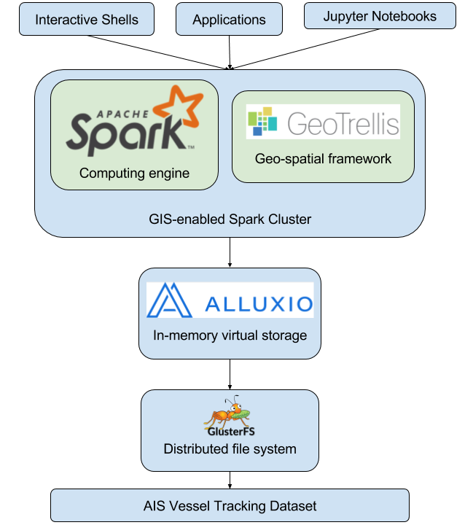
Axiom Spark Computing Cluster
One master node (spark01.axiom)
8 worker/slave nodes (spark[01:08])
Connected over infiniband
Each slave has 16 cores, and 96GB => 128 total cores
Master and slave nodes run in docker containers (on host network) and are managed by ansible, so you can easily add new nodes
A network filesystem is required; we're using the shared gluster instance
In our new datacenter, spark cluster will have its own filesystem
Using GeoTrellis for raster and vector analysis

Slide 13
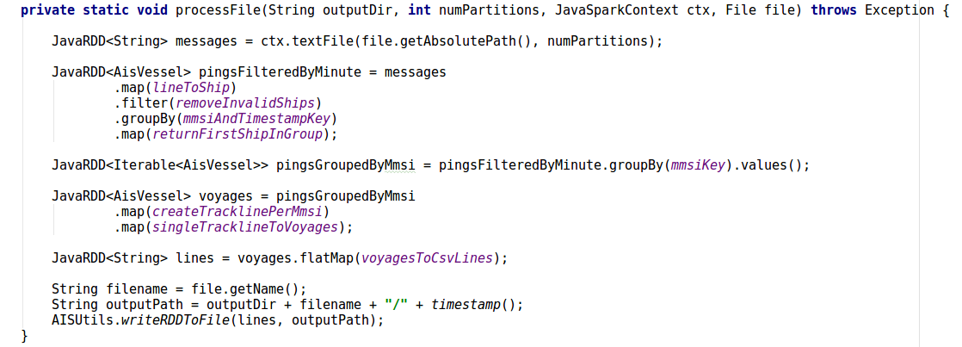
Spark UI Example
This task took lat/lng coordinates for ships, and built tracklines.
http://192.168.15.73:9000/history/app-20161230233051-0275
http://192.168.15.73:9000/history/app-20161230233051-0275/jobs/job/?id=364

Slide 14
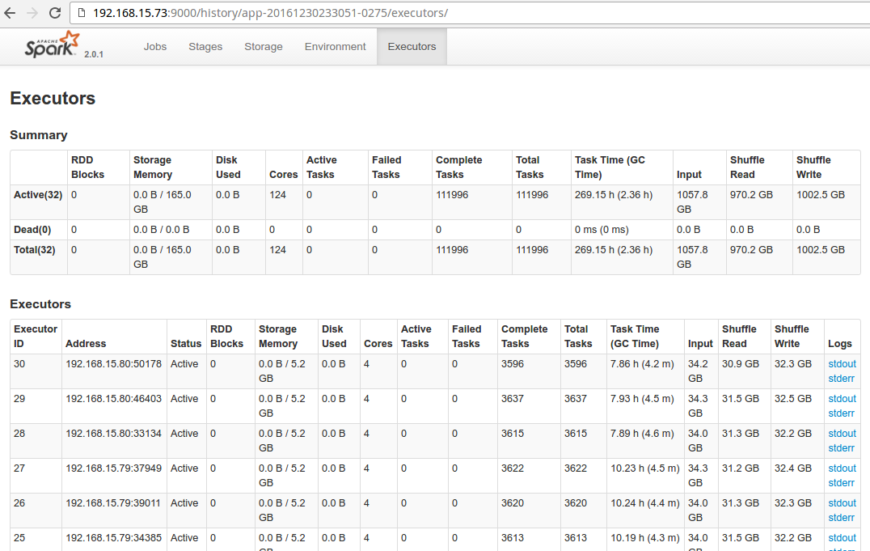
Spark UI Example
The job took 5.2 hrs overall, but took 269.15 hrs of task time spread across 30 executors
http://192.168.15.73:9000/history/app-20161230233051-0275/executors/

Slide 15
Example: Analyzing AIS Vessel Traffic Data
Background/Motivation:
NOAA manages a Hydrographic Health Model, which establishes priorities for surveying across all US waters
Includes metrics like: When was this area last surveyed? What is the seafloor complexity? What is the typical vessel traffic in this area? Have there been any major storms or geological events since the last survey? etc
To determine vessel traffic across an entire year, need to analyze billions of vessel AIS (Automatic Identification System) messages
Each message includes a unique vessel ID (MMSI), lat/lng, speed over ground, etc
Previous work with 100s of millions of pings took several weeks using PostgreSQL
Currently state-of-the-art (an ArcMap plugin) requires user to load one month and one UTM zone at a time: https://marinecadastre.gov/ais/

Slide 16
Example: Analyzing AIS Vessel Traffic Data
2015 Dataset: 7.5TB of raw NMEA messages (74,212,891,806 total pings)
Desired output: Set of heatmaps describing vessel traffic in the US
We only care about ships that are moving and that are in US waters
Need to be split out by ship type and metric
Tanker, Cargo, Passenger, and Other
Total Vessel Count and Unique Vessel Count
Dataset is very noisy
Duplicate messages
Inaccurate data (e.g., ship has NavStatus “Underway” but is not actually moving)
Messages are sparse away from coastlines (where the receivers are)
We decided to break up this work into stages, so that we could re-use intermediate results
Messages -> Cleaned up messages -> Tracklines -> Rasters
Notes:
test coverage (unit tests and integration tests) for every stage in the pipeline

Slide 17
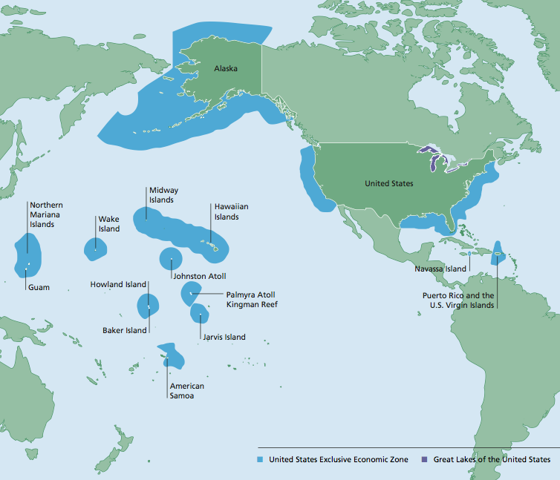
AIS Vessel Traffic Data Analysis Pipeline
Phase 1: Raw AIS Messages -> Parsed and filtered messages
Parse raw AIS messages (NMEA format)
Filter out non-Position Report messages
Filter out messages not in US EEZ
Input messages: 74,000,000,000
Output messages: 32,000,000,000
Cluster: 15 executors across 4 nodes
Duration: 33.1 hours
Output format: CSV file
http://gc.noaa.gov
Notes:
We only care about stuff in the US EEZ
We only care about ships that are moving

Slide 18
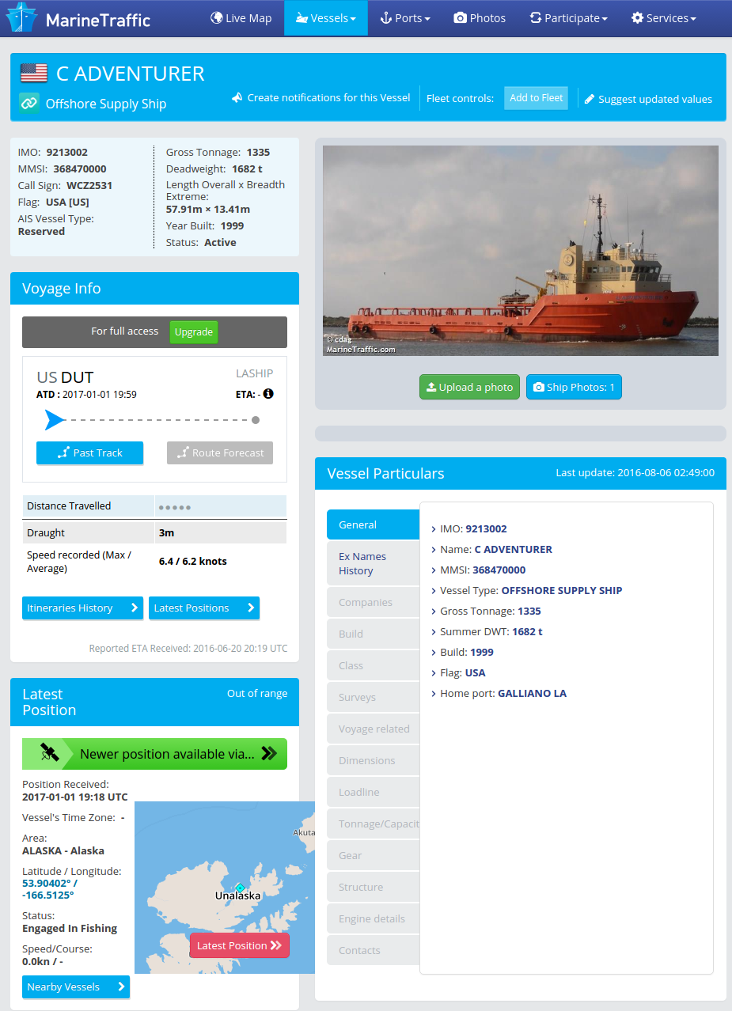
AIS Vessel Traffic Data Analysis Pipeline
Phase 2: Add in AVIS ship catalog data
Join AIS messages to AVIS ship catalog, to get ship type, etc
Input messages: 32,000,000,000
Output messages: 32,000,000,000
Cluster: 15 executors across 4 nodes
Duration: 15.6 hours
Output format: CSV file

Slide 19
AIS Vessel Traffic Data Analysis Pipeline
Phase 3: Cleanup
Remove messages where ship moving less than 0.4 knots
Remove duplicate messages
Input messages: 32,000,000,000
Output messages: 6,454,000,000
Cluster: 30 executors across 8 nodes
Duration: 15.5 hours
Output format: CSV file

Slide 20
AIS Vessel Traffic Data Analysis Pipeline
Phase 4: Generate Tracklines
Group pings by ship and order by time
Create a trackline per ship for each day
Split tracklines into “voyages” when:
Ship has stopped in one place for >5 min
Or trackline points are >50km apart
Input messages: 6,454,000,000
Output voyages: 20,000,000
Cluster: 30 executors across 8 nodes
Duration: 5.4 hours
Output format: CSV file
Green: pings
Pink: Tracklines
Notes:
Because we have pings for some ships every 30 seconds, and others every 30 min, we can’t use the pings directly to create heatmaps. There’s also the issue of sparse data

Slide 21
AIS Vessel Traffic Data Analysis Pipeline
Phase 5: Heatmap Rasters
Generate rasters for “total vessel volume” metric (using GeoTrellis)
Generate rasters for “unique vessel count” metric (using GeoTrellis)
Input voyages: 20,000,000
Output files: 24
Cluster: 60 executors across 8 nodes
Duration: 3.0 hrs
Output format: GeoTIFF file
Raster Parameters:
Projection: North America Albers Equal Area Conic (ESRI:102008)
500m resolution
One raster for each combination of the following "options" (24 rasters total):
Metric:
Total traffic volume
Unique vessel count
Region:
Continental US + Puerto Rico
Alaska
Hawaii and Pacific Islands
Vessel type:
Passenger
Tanker
Cargo
Other

Slide 22
AIS Vessel Traffic Data Analysis Pipeline
TOTALS:
Input: 7.5TB / 74 billion messages
Output: 24 GeoTIFF files
Cluster: Ranging from 4 to 8 nodes
Duration: 72.6 hours
Notes:
We were building the Spark Cluster and learning as we went, so if we ran this again we could easily get it under 48 hrs
Because we stored intermediate results, we can very quickly generate heatmaps for different metrics
e.g., generate a vessel traffic heatmap for an extent around Florida, including all vessels with draft greater than 10 meters, in the month of February 2015
Also, since most of our results were in CSV format, we could load them up pretty much anywhere, to do more analysis
e.g., as Pandas dataframes in an iPython Notebook hooked up to the cluster or Arc

Slide 23
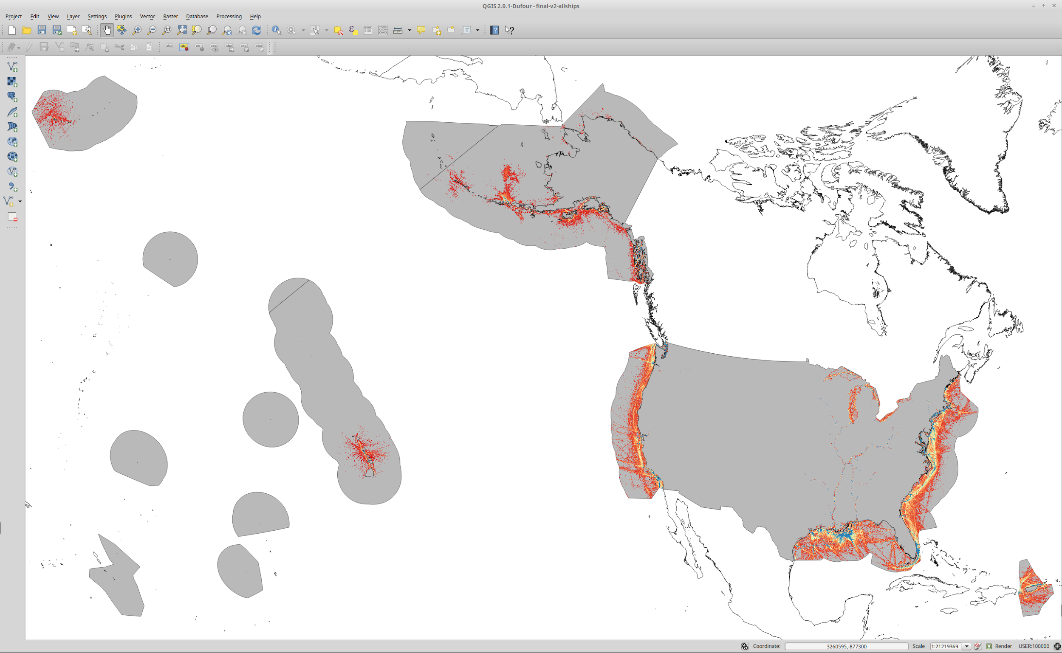

Slide 24
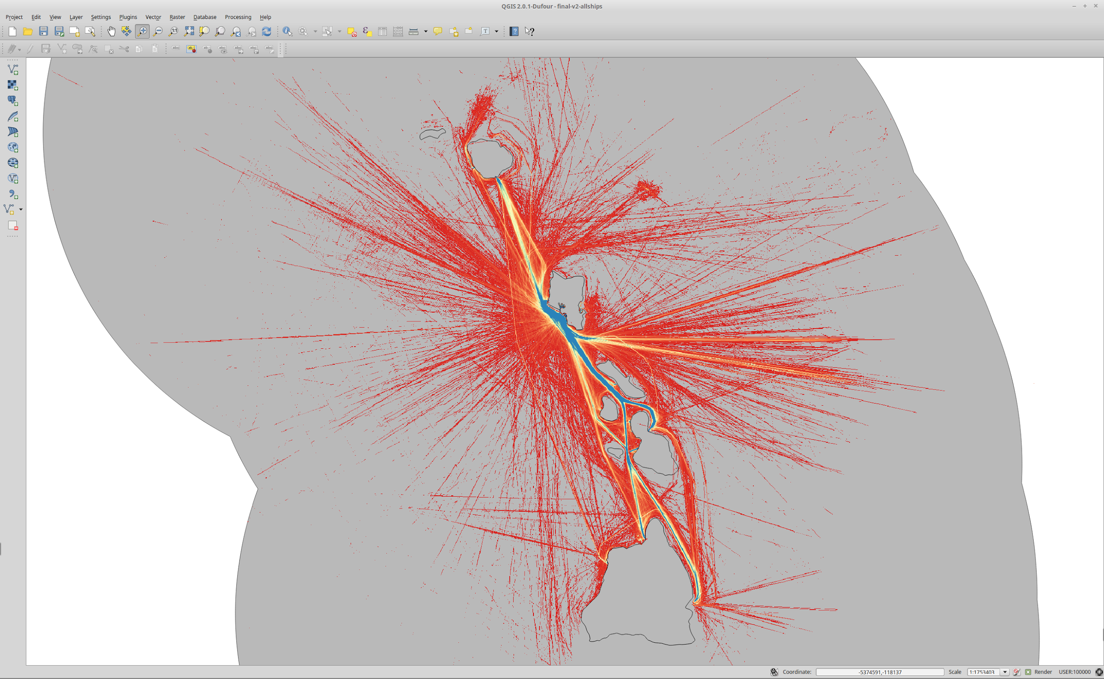
All Ship Types,
Hawaiian Islands

Slide 25
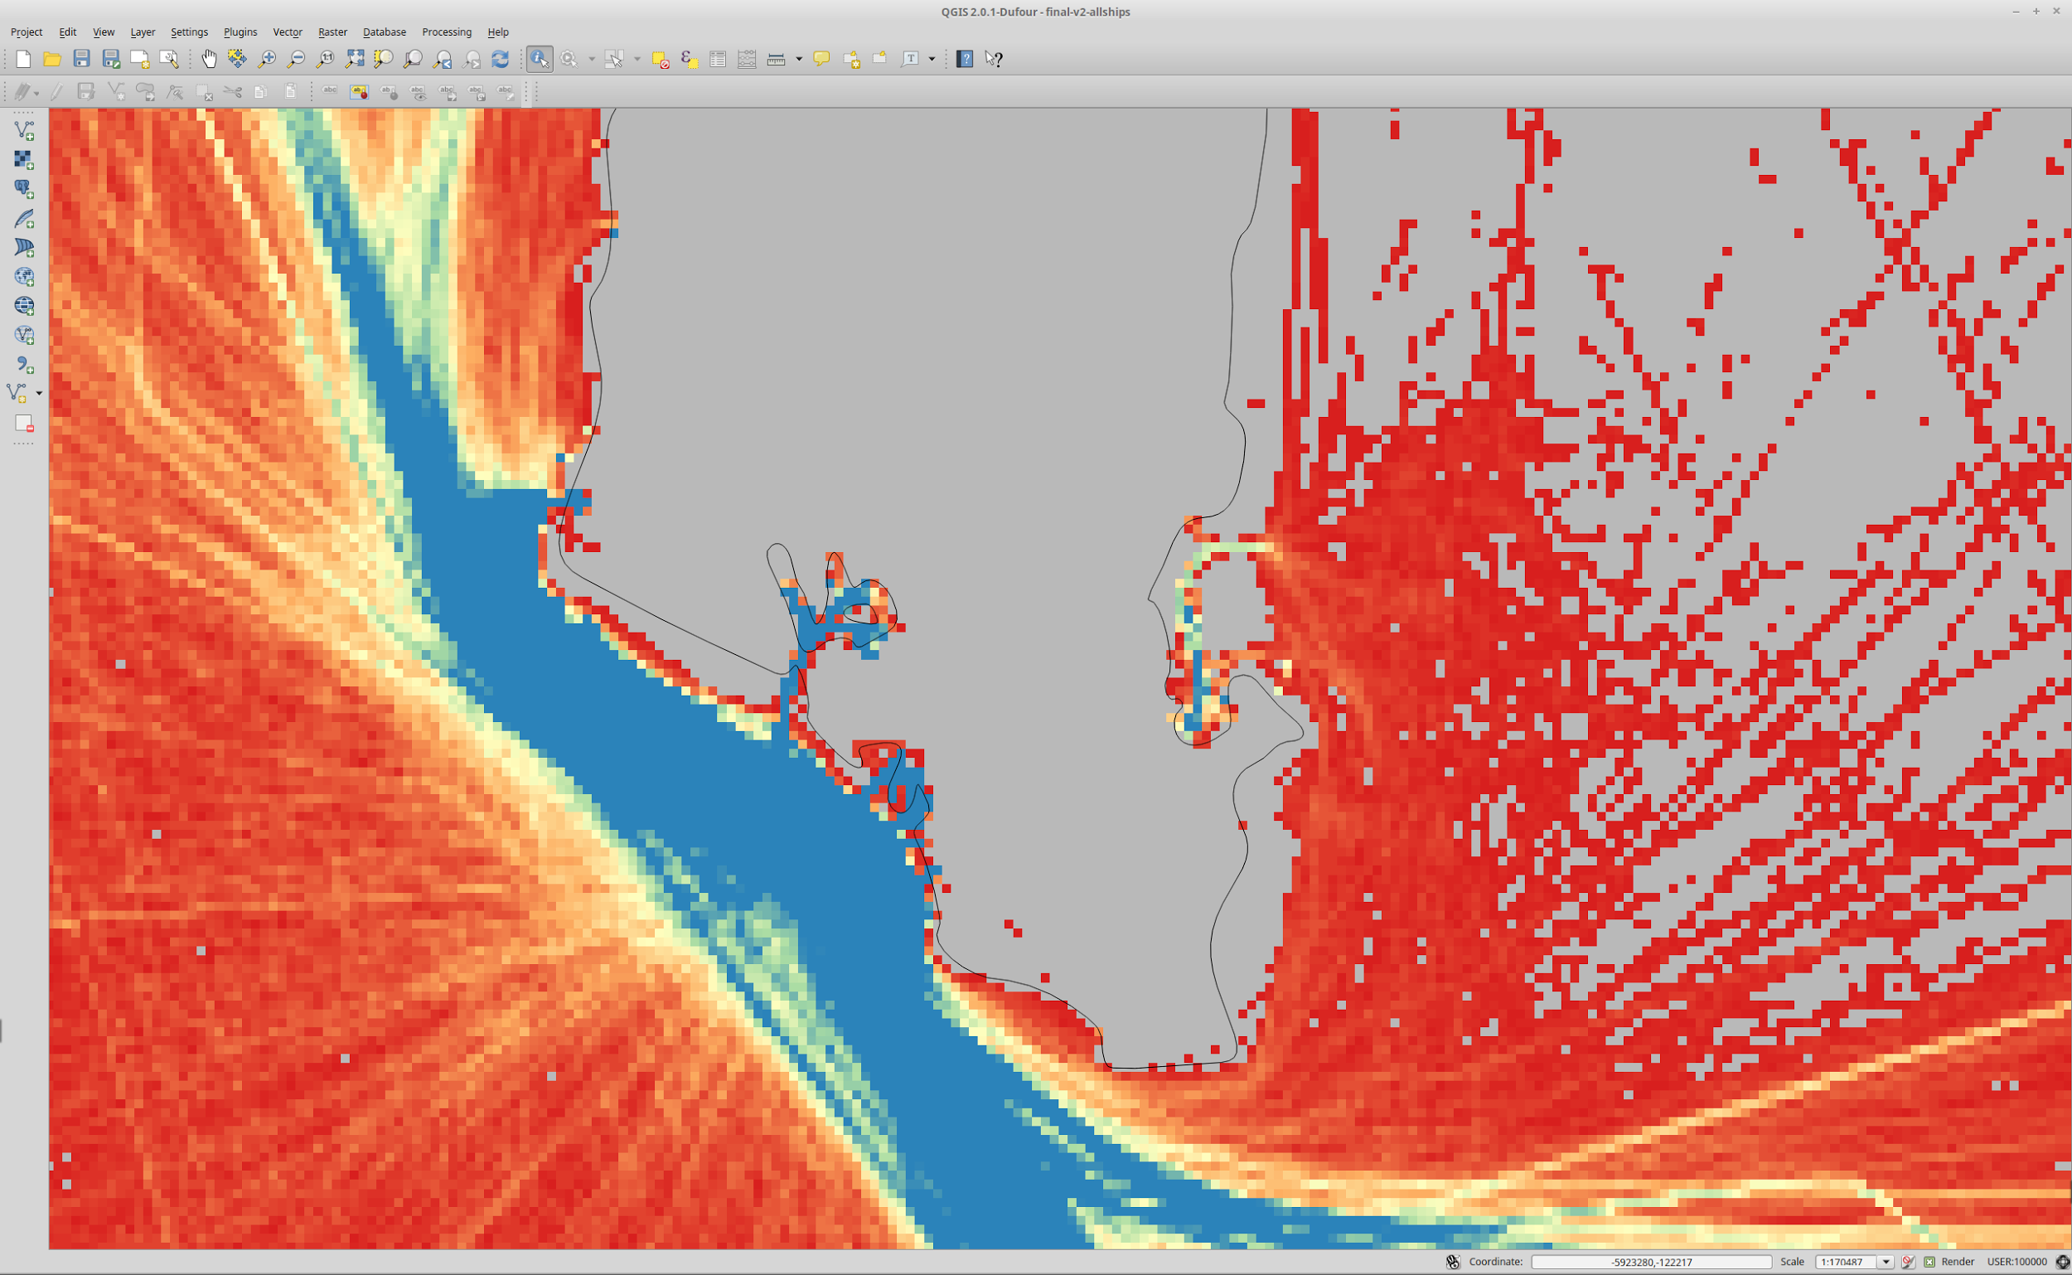
Honolulu

Slide 26
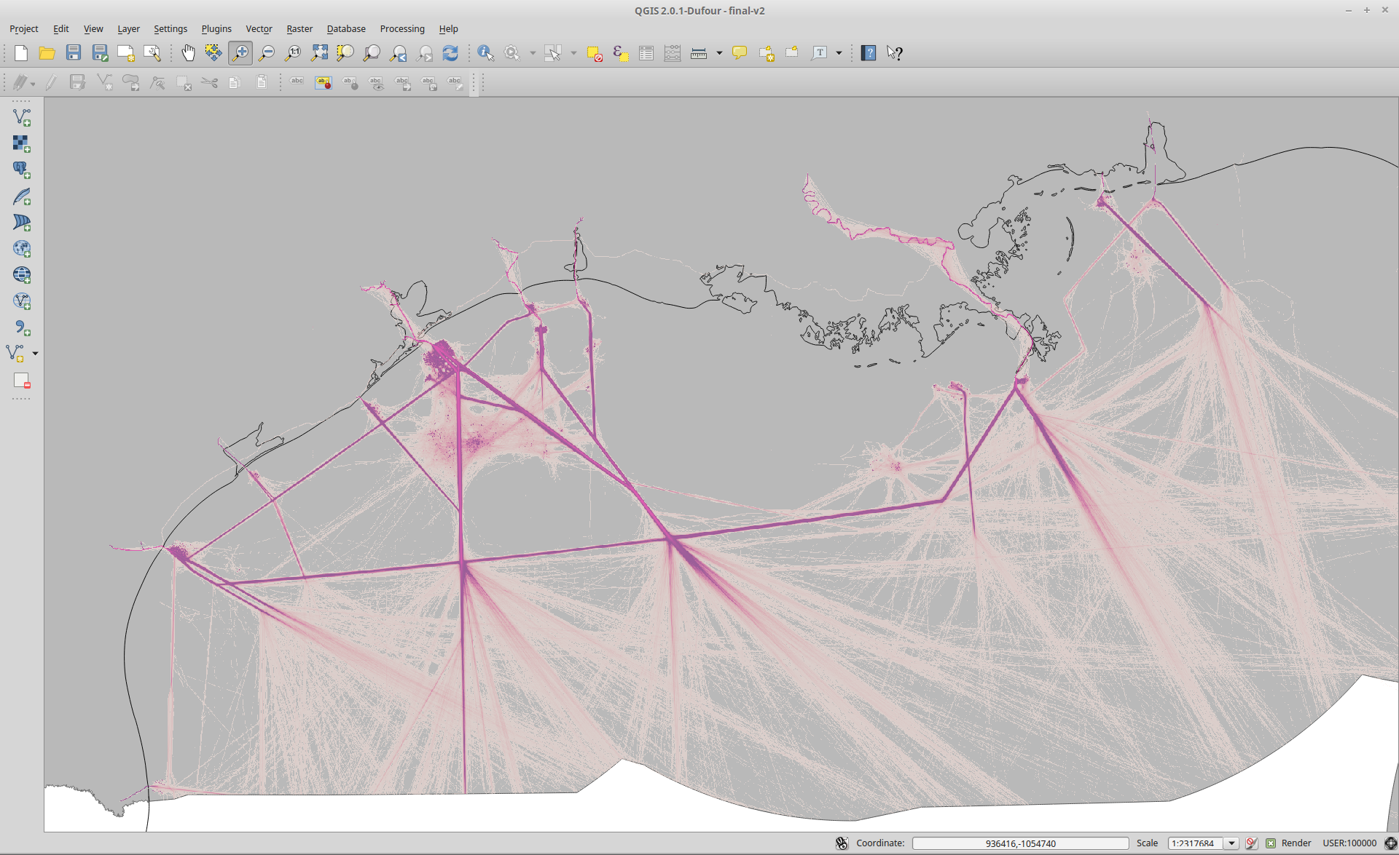
Tanker Ships, Gulf Coast

Slide 27
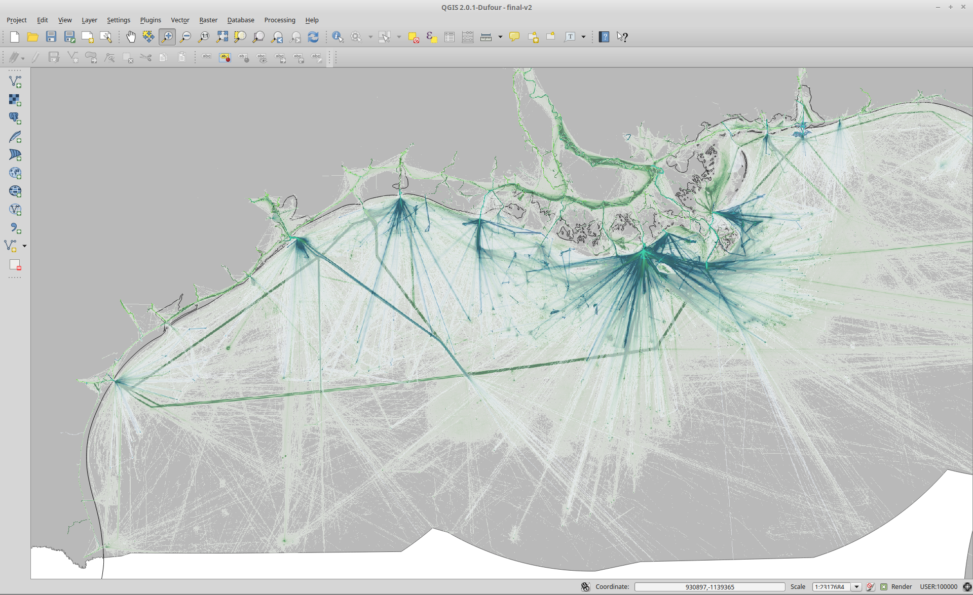
Passenger (Blue) and Other (Green) Ships
Gulf Coast

Slide 28
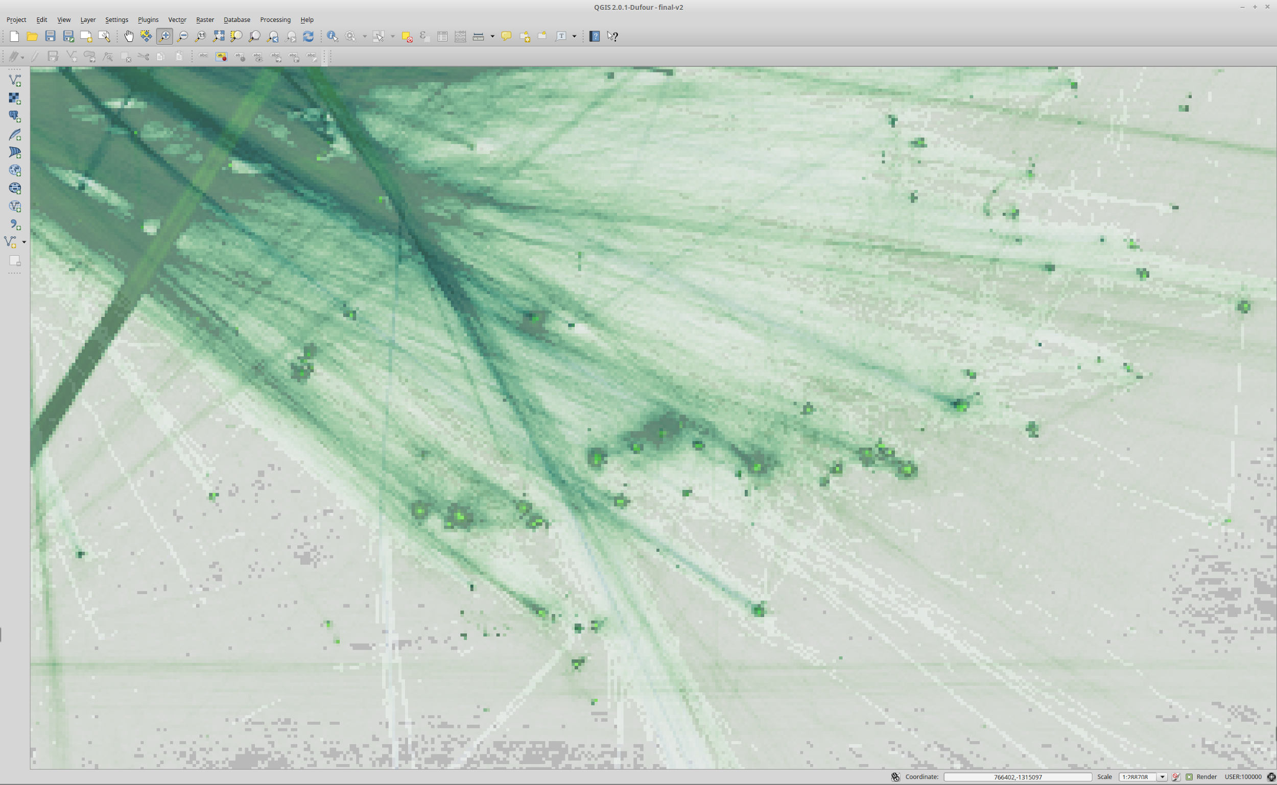
Passenger (Blue) and Other (Green) Ships
Gulf Coast

Slide 29
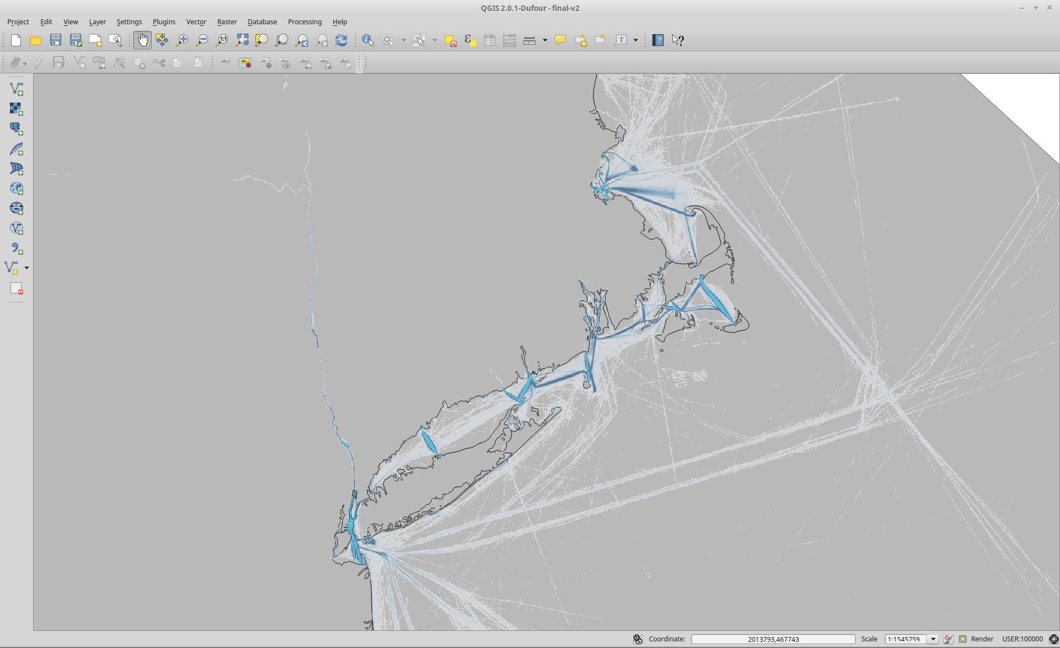
Passenger Ships, NE USA

Slide 30
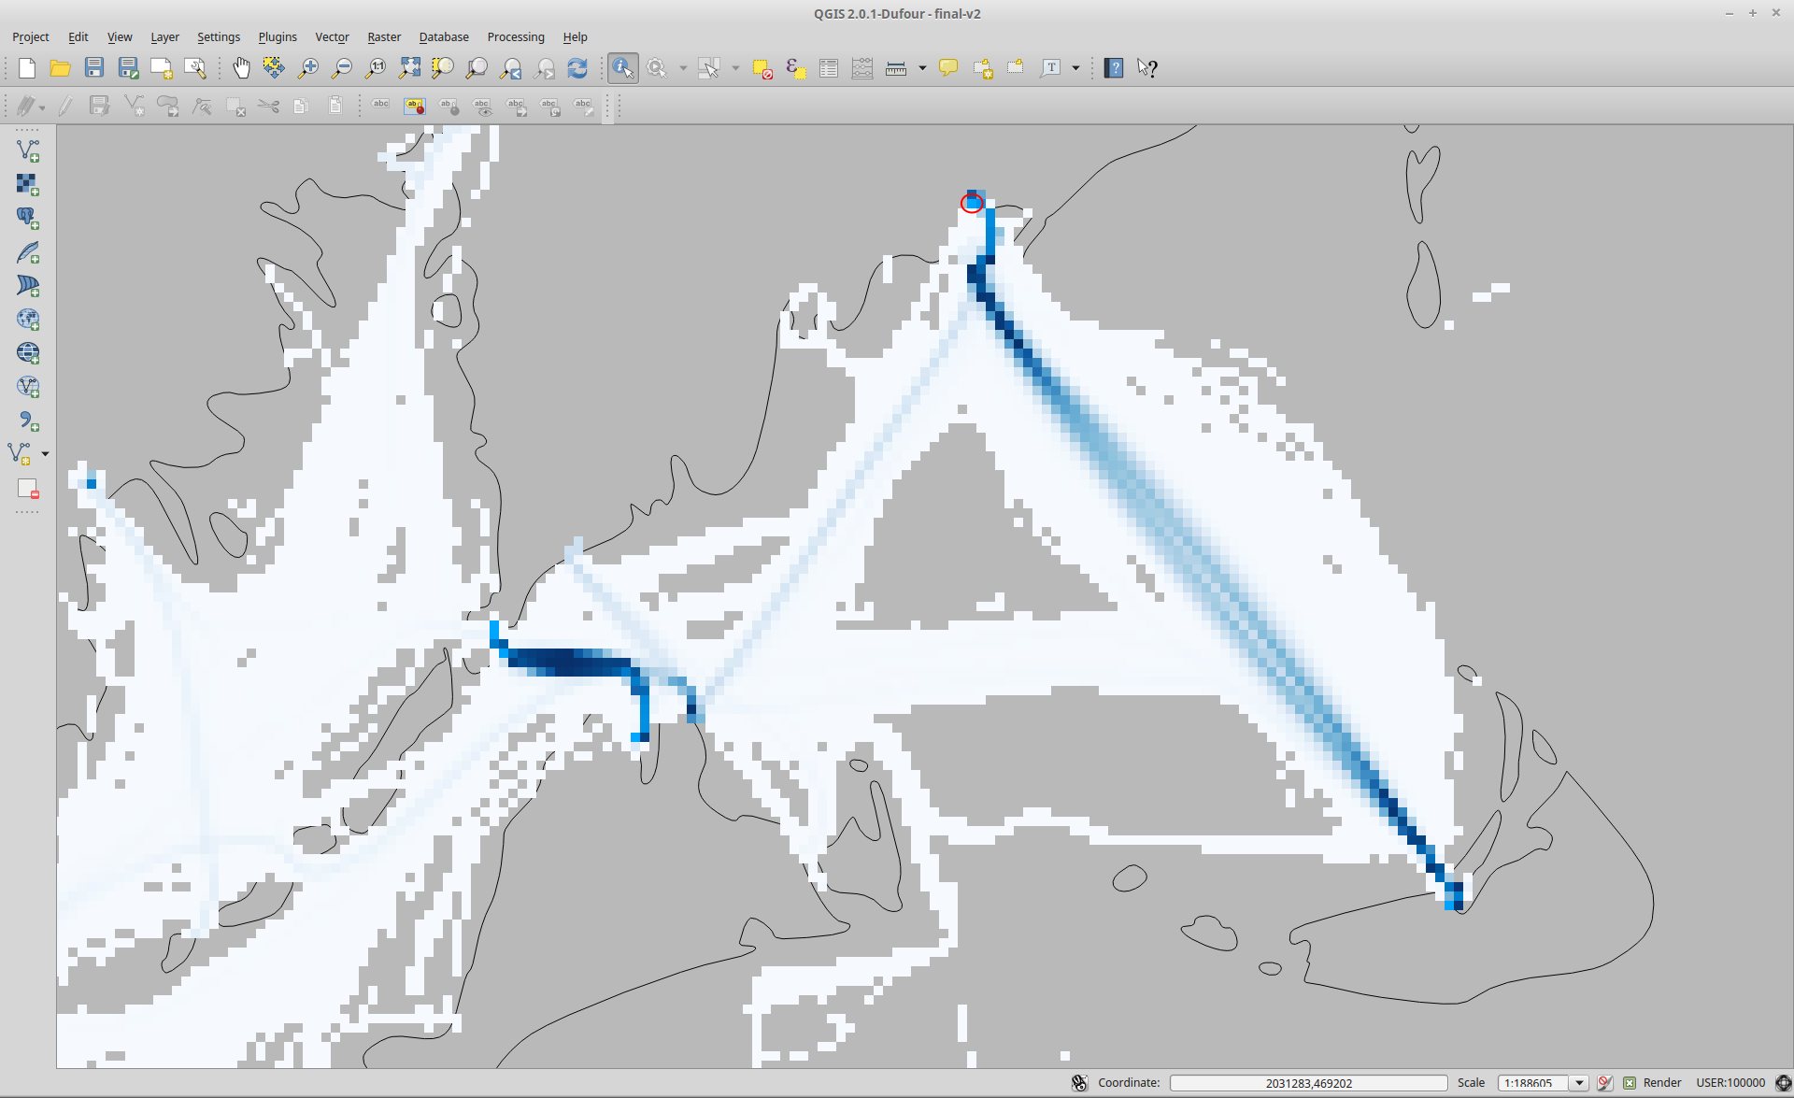
Total vessel traffic: 17,664
Martha’s Vineyard
Nantucket

Slide 31
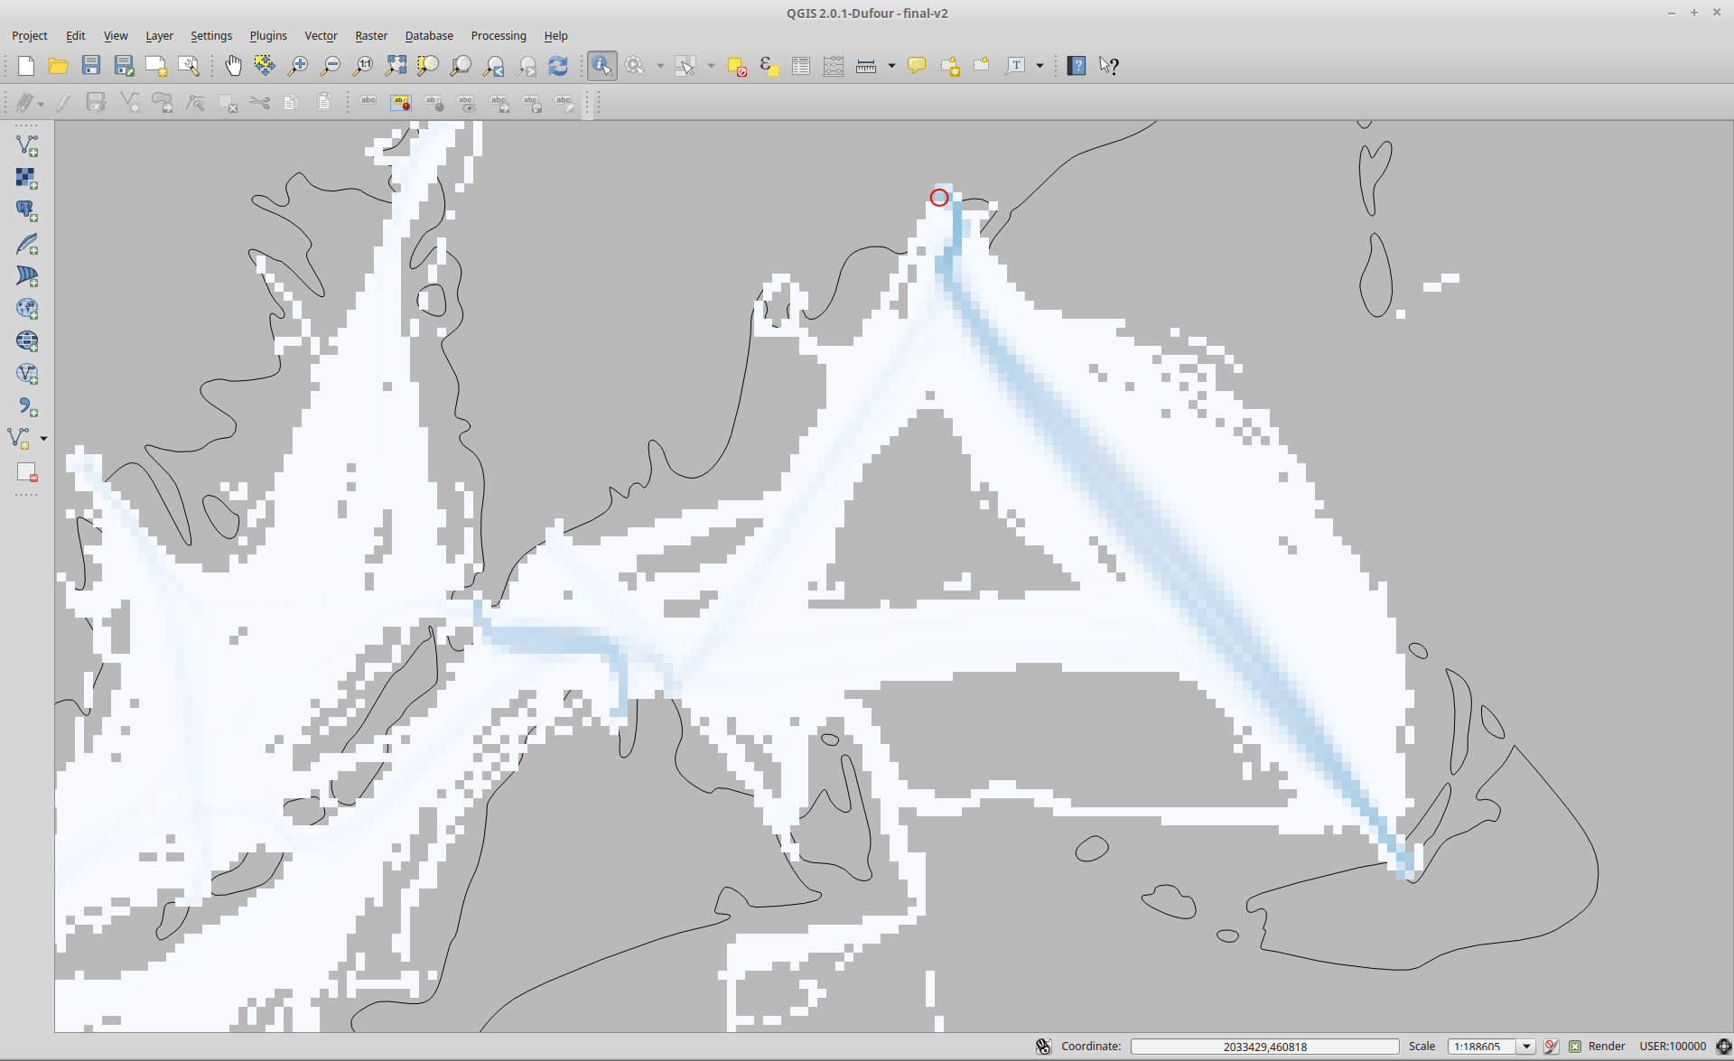
Unique vessel traffic: 1,763
Martha’s Vineyard
Nantucket

Slide 32
Next Steps
Axiom got a new data center for Christmas (Thanks Santa!)
Sparc cluster will have 768 cores (32 nodes) - 5x the compute capacity
Alluxio Optimization - Persist RDD’s instead of CSVs
Dedicated HPC Storage array
Expect 10-100 times speed up
Notes:
Not going to go into a ton of detail about how Spark works, or look at very much code.
I wanted to open this up to everyone because
a) this stuff is cool and I like sharing cool things with people,
b) the more Axiom people who understand what this tool is and how it can be used, the more chance we have of seeing a relevant RFP and winning that work,
c) this kind of tooling is above and beyond what most PI's are using, but could be hugely useful for their work.

