Slide 1
US IOOS®
Zdenka Willis
Director, US IOOS

Slide 2

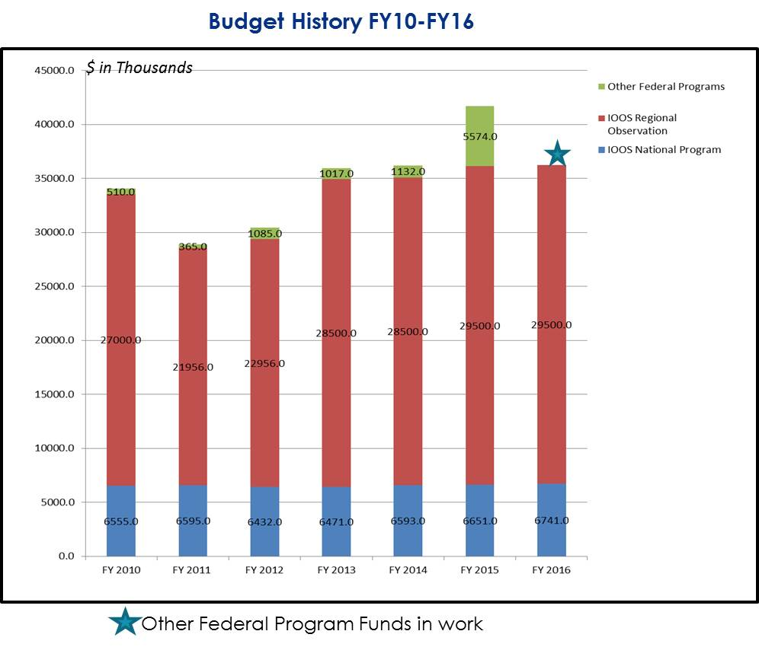

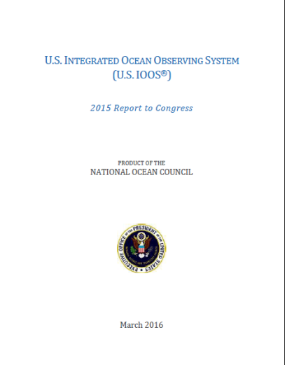
Programmatic - 2016
5 year Awards
Administration Transition

Slide 3
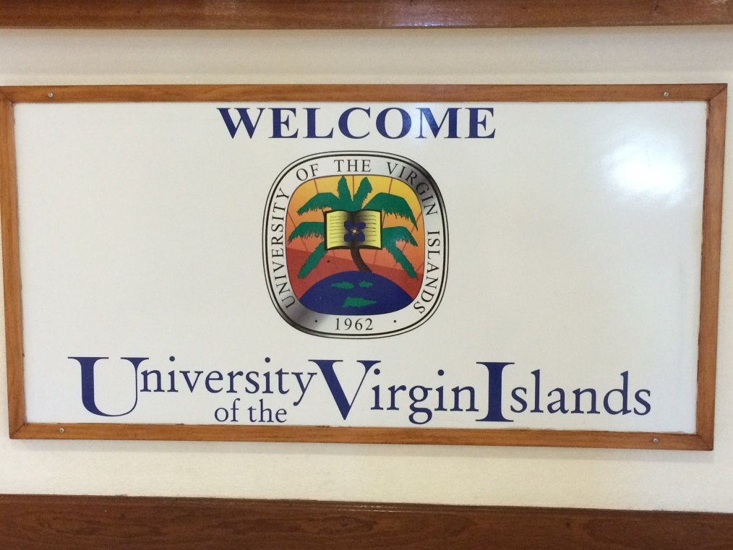
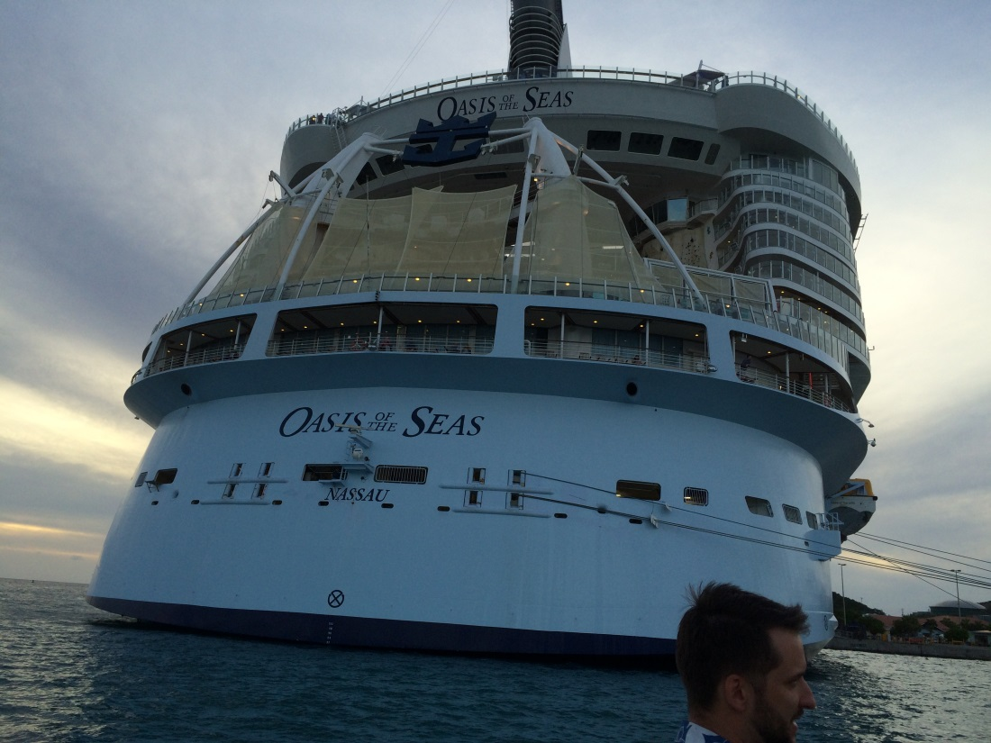
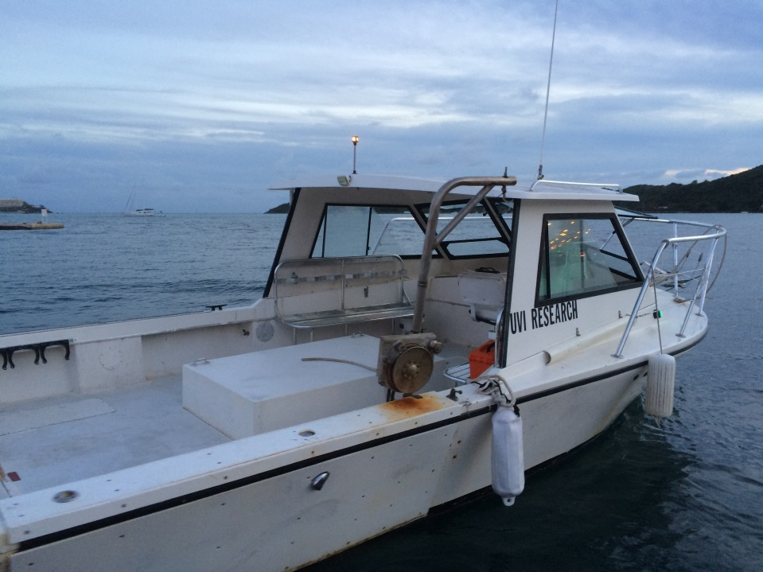
IOOS Advisory Committee

Slide 4


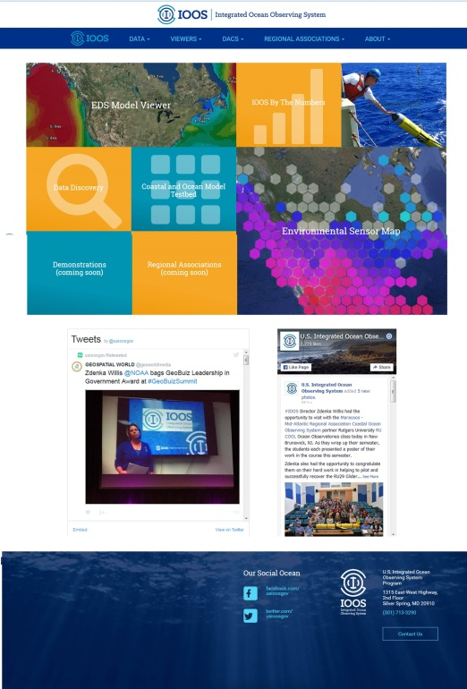
DMAC – Keep on Advancing
ioos.us Project
Outcomes:
Single landing page/entry point for DMAC access.
Full Capacity in June
New Glider DAC
New/Updated Manuals 2015
Dissolved Nutrients Observations
Ocean Optics Data
In-situ Temp. and Salinity Data
In-Situ Current Observations
In-Situ Surface Wave Data
Dissolved Oxygen Observations
New/Updated Manuals - 2016
Glider
HFR Currents
Water Level
Notes:
We continue to push the envelop on data management
Check out ioos.us
Complementary to ioos.noaa.gov bc we can’t do everything we need to do on ioos.noaa.gov
Quality control and assurance is key and we continue with this program; just been asked by the JCCOM (IOC and WMO) for potential co-brand of this effort to make these the international standards

Slide 5
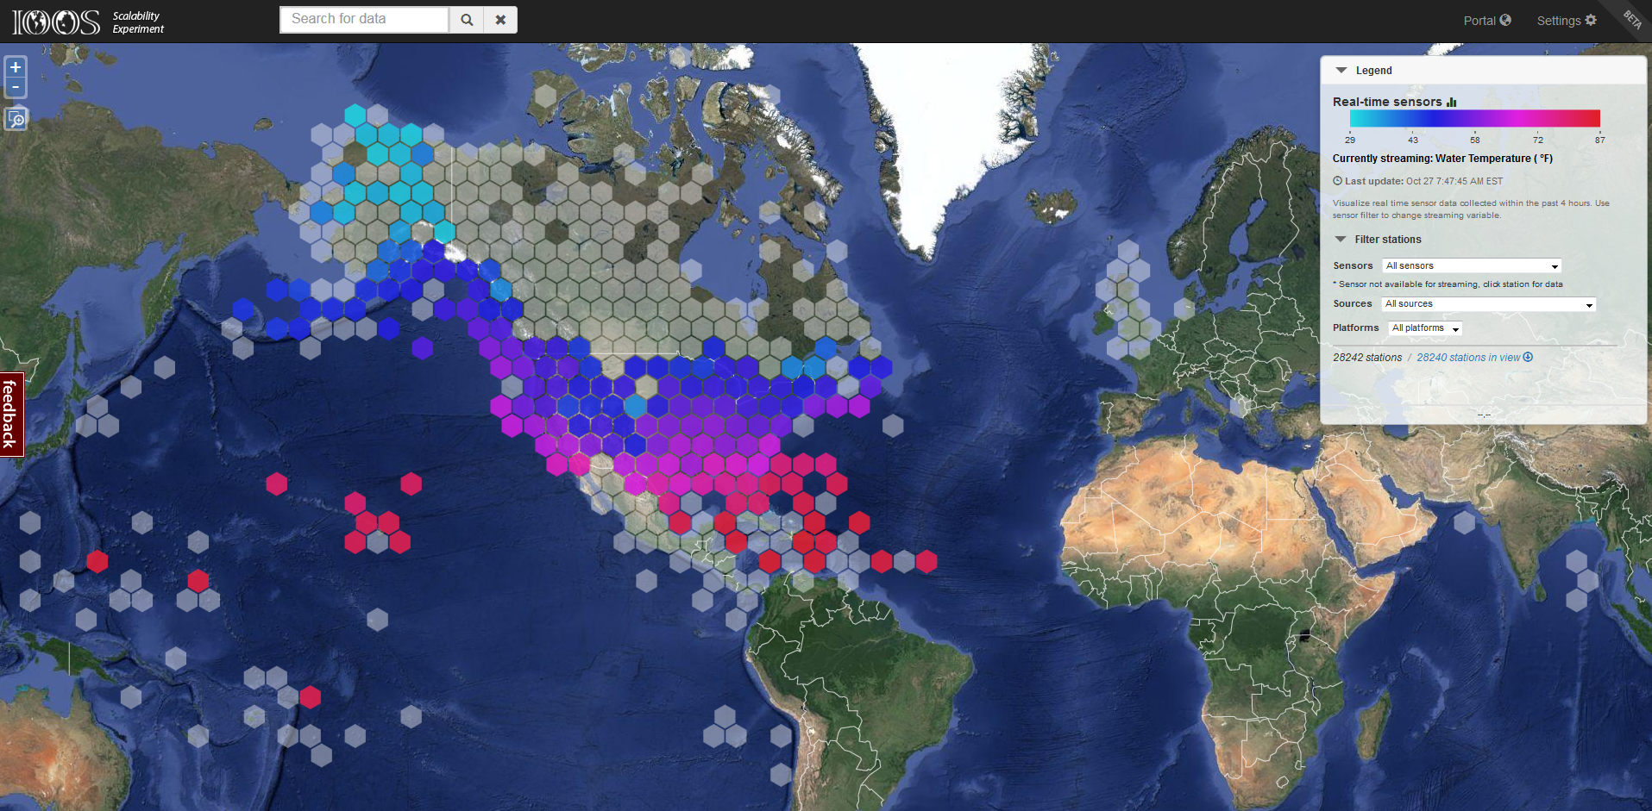
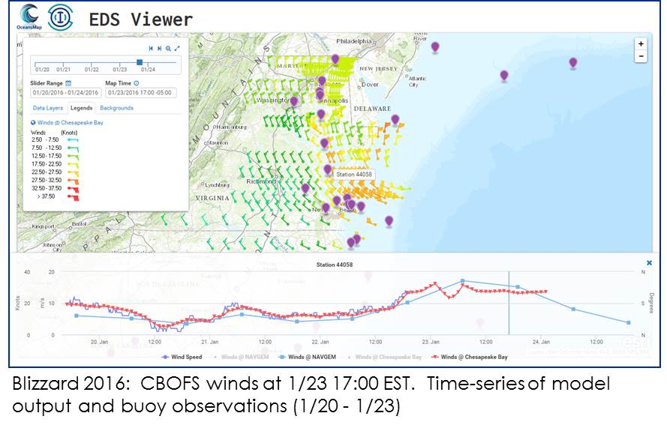
DMAC – Environmental Sensors & Model Access
2 week cache of ALL known, available real-time observations
AOOS & Axiom
Release June 2016
THREDDS, WMS access to all model output
ASA
Pre Release now
Notes:
2 efforts to better show the power of integration on the national level.
Working with AOOS and Axiom taking their model and going national. We can harvest 38M obs per week and display the results. Working on showing the obs by region but ensuring ownership is credited. Full release in June 2016. But you can view at ioos.gov
This based on the work that ASA does for the United States Coast Guard and US IOOS COMT , to visualize model output from global, national, regional models

Slide 6

HF Radar FY16 Outlook
Refinement of O&M costs
At your local WFO
Significant Wave Height
Tsunami detection – partner with NWS
Global HF Radar – GEO/GOOS
Archiving continues every month
Notes:
We are continuing to expand the us of HF Radar and some new activities for this year

Slide 7

IOOS New Logo
Collaborative effort: IOOS Office, Interagency Ocean Observation Committee (IOOC), Regional Associations,
Streamlined, integrated design reflects IOOS’s renewed focus on the user experience.
Light and dark blue stand for the coasts and deep water.
Integration represents a signal moving out in stages—local-national-global.
There’s more to discover every time you see it—just like there is with IOOS.

Slide 8
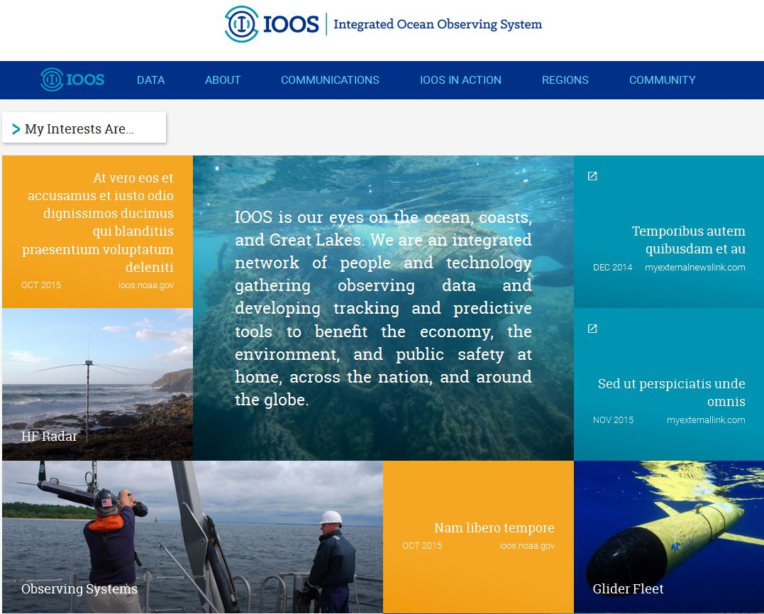
Communicating
New Web Site
Dynamic, Interactive; Streamlined
April 2016
Getting our Story Out
New outlets:
NOAA.GOV: New! Web stories 200-400 words in length, always with photos.
New NOS Site: Photos, photos, photos; reinforced by close NOS Comms cooperation.
Social Media: Regular posts create visibility with peers, partners, general public.
IOOS Blog: Coming soon! Highlight projects, RA successes, events, topics, and more.

Slide 9
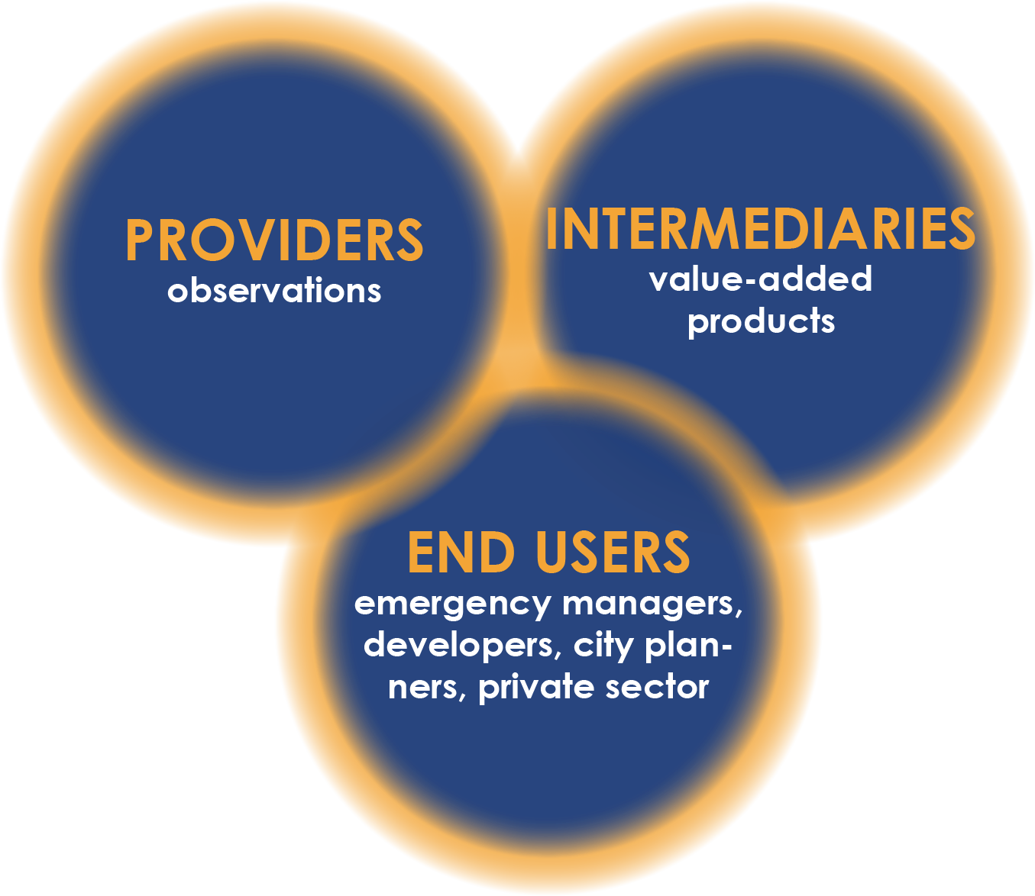
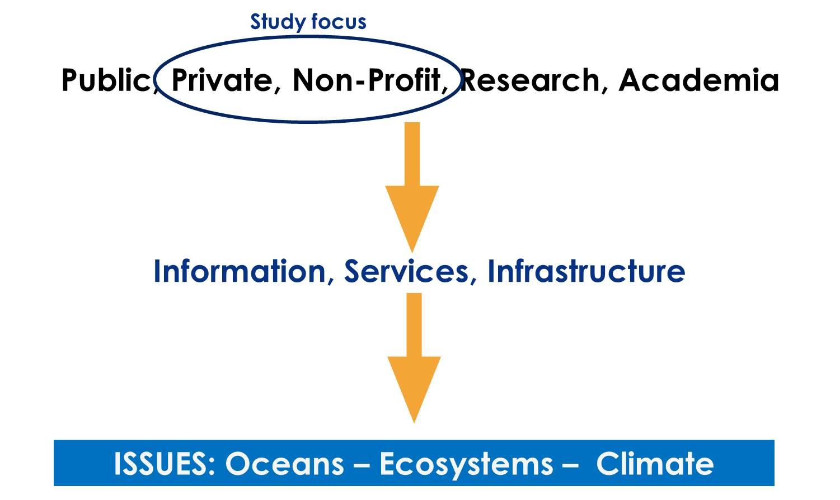
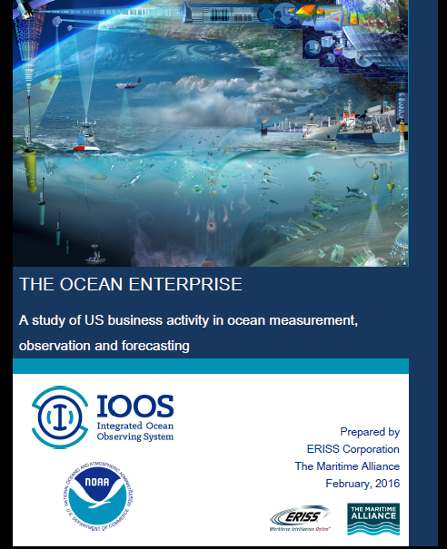
Background

Slide 10
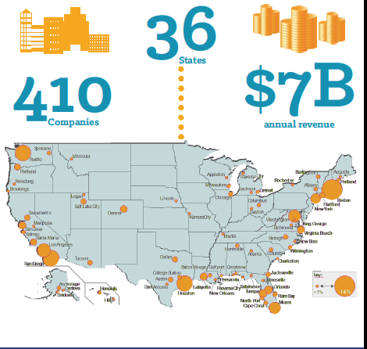
US IOOS/NOAA Ocean Enterprise Study
Ocean Enterprise Exports $1.4b
Overall Revenue $58b
Maritime Revenue $14b
Ocean Enterprise Revenue $7b

Slide 11
Ocean Enterprise Study 2015: Functions
81 % of the companies we surveyed were providers
36% were Intermediaries

Slide 12
Market Sectors
Represents ‘overall’ activities of firms
Shows provider, intermediary split

Slide 13
IOOS is a Team Sport
Programmatic
Operational Capacity
Partnerships
Champion Regional
US IOOS Office
Official Advice
Recommendations
IOOS Assoc
IOOS Advisory Comm
Congress
OMB
Sponsor Events
RA Coordination
IOOC
Interagency
Oversight IOOS
Task Teams

Slide 14


Questions
Enables decision making
Fosters Advances in Science and Technology
www.noaa.ioos.gov
https://www.facebook.com/usioosgov
@usioosgov

